Slide 1
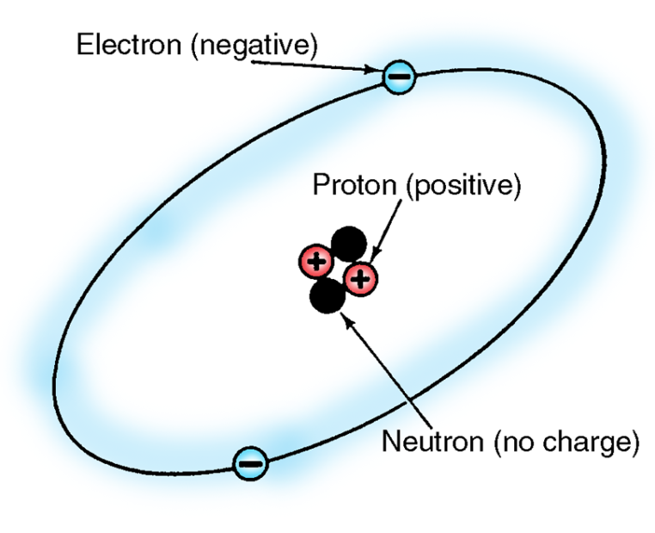
Basic Electrical Theory

Slide 2
Key Terms to Know
Circuit — A conductor through which electrons can flow away from and return to an electrical source.
Electromotive force (EMF) — Force that pushes free electrons out of orbit to create current flow in a circuit.
Molecules — Atoms that have collected to form a larger particle.
Resistance — The amount of opposition to the electrical flow in a circuit.

Slide 3
Atomic structure
An atom is the smallest particle of any element and is made up of electrons, neutrons, and protons. An atom is a carefully balanced energy machine. The center of the atom is the nucleus. Orbiting the nucleus are electrons that follow fixed paths called shells or rings.
Electrons are negatively charged parts of an atom that orbit the nucleus.
Neutrons are the uncharged parts of an atom located in the nucleus.
NOTE: There are no neutrons in hydrogen, which is the simplest atom.
Protons are positively charged parts of an atom located in the nucleus.

Slide 4
Atomic structure
Atoms are the building blocks of matter and cannot be seen by the naked eye. They are so small that billions and billions of them are needed to make up a single drop of water.
A balanced atom has an equal number of protons and electrons. Positive protons hold the electrons in orbit. Centrifugal force prevents electrons from moving inward. Neurons cancel the repelling force between protons so that the core of the atom holds together.
Balanced atom

Slide 5
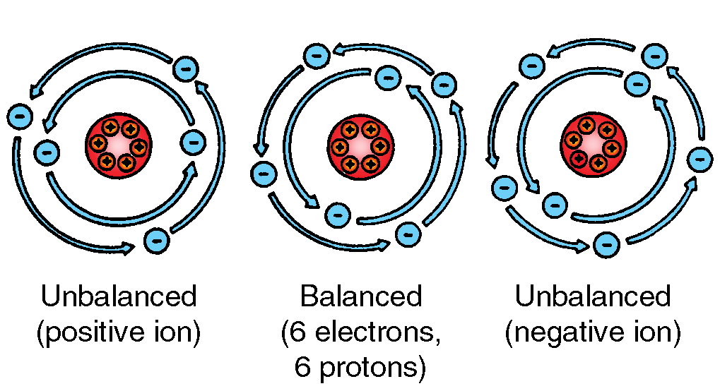
Atomic structure
Ions have an equal number of electrons and protons. If an atom gains electrons, it is a negative ion. If an atom loses electrons, it is a positive ion. When positive ions attract electrons from neighboring atoms to become balanced, electron flow occurs.

Slide 6
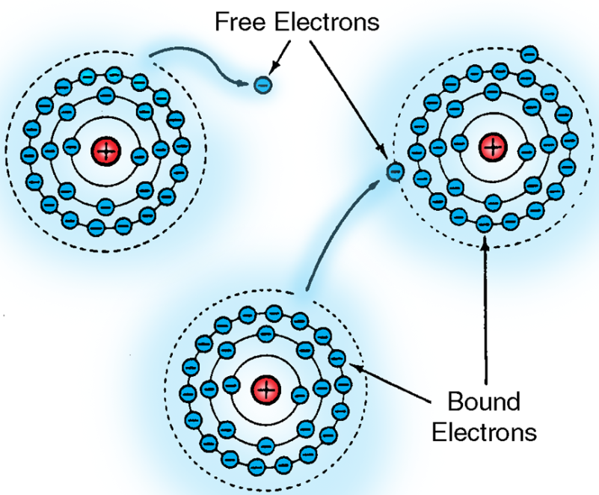
Atomic structure
The number of electrons in the outer orbit determines the ability of the atom to conduct electricity.
Bound electrons are those in the inner rings that are strongly attracted to protons.
Free electrons are those in the outer rings that are less strongly attracted to protons. Free electrons have a weak attraction to the nucleus and may easily pass from atom to atom.

Slide 7
Atomic structure
Forces that free electrons include friction, heat, light, pressure, chemical action, or magnetic action. Free electrons move away from the electromotive force (EMF) from one atom to the next. This stream of atoms forms an electrical current.

Slide 8
Electrical energy
Electrical energy occurs due to the atomic structure of matter. Certain types of force can cause electrons in some materials to move from one atom to the next. This movement is electricity.
When electricity passes through a material that inhibits its flow, heat is produced. Electrical devices use this heat to do work.
When a light bulb receives electrical current, billions of electrons per second flow into and out of the filament. The electrons do not flow across the filament as easily as they flow across the wire leading to the light bulb.
Atoms that are already on the filament have to give up heat energy in order to make room for the newly arrived electrons. Heat energy causes the filament to glow.

Slide 9
Electrical energy
An electrical circuit does not use up electrons. Electrons flow through a circuit in the same way as coolant flows through the radiator and engine.
When a person receives an electrical shock, billions of electrons are forced into the body. At the same time, atoms that make up the body pass electrons on, making the person part of an electrical circuit.
Human beings can easily become part of an electrical circuit.
An electrical shock interferes with muscle function and can, in some cases, cause the heart to stop.
CAUTION: It takes less than half of an ampere to stop the heart.

Slide 10
Electrical energy
A person can receive a dangerous shock or burn from a vehicle’s electrical system. High voltage from spark plug wires can be dangerous.
It is important to understand how electricity functions at the atomic level. Today’s vehicles use more electrical devices than ever before. Many of which can be destroyed by improper use of electronic testing equipment. Understanding fundamentals of electricity allows the technician to work with electrical circuits confidently and safely.

Slide 11
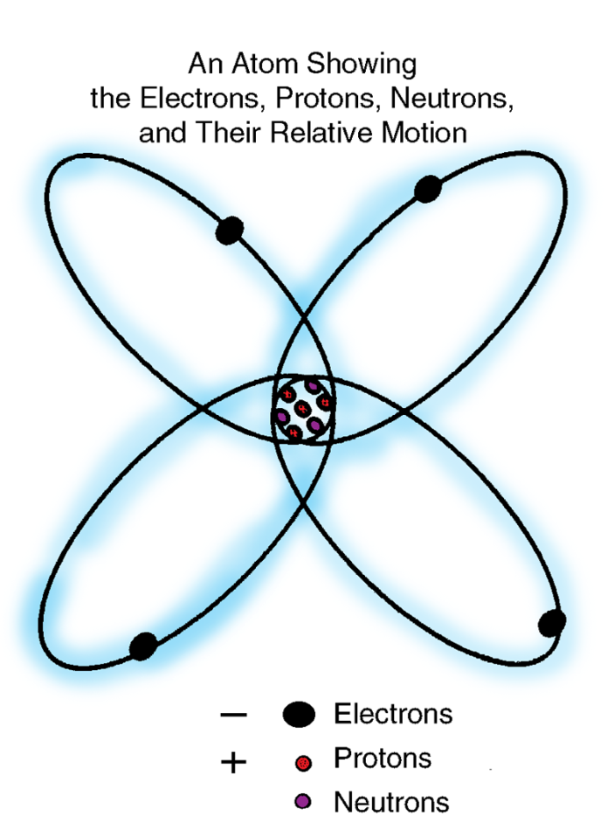
Atomic forces
Atom in motion
Electrons, neutrons, and protons are tiny, but they still have weight and occupy space. An electron cannot be moved unless some force acts upon it. The forces that work within the atom are called atomic forces.

Slide 12
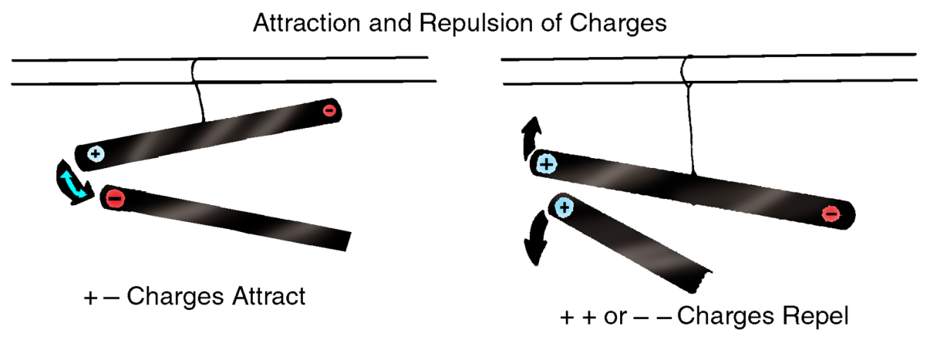
Atomic forces
Attraction is the force that pulls differently charged particles towards each other. Repulsion is the force that pushes similarly charges particles away from each other.
Electrons, which are negatively charged (-), are attracted to protons, which are positively charged (+).
If one atomic particle is positively charged and another is negatively charged, then the two atomic particles attract each other.

Slide 13
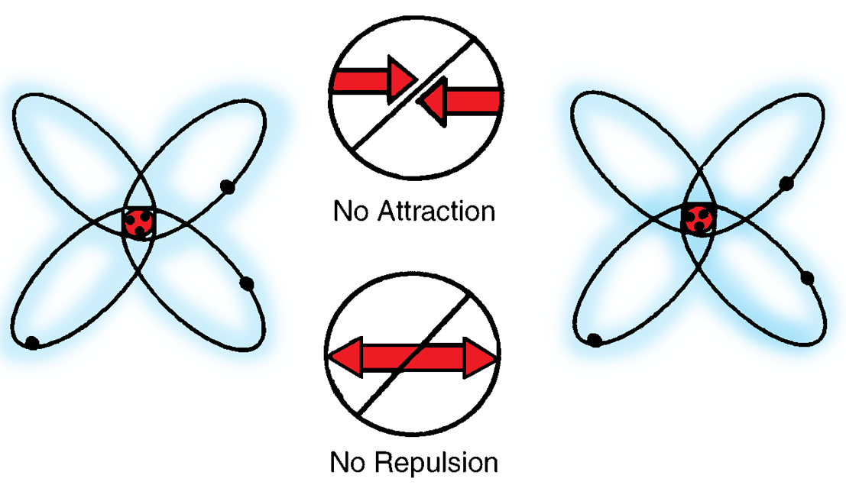
Atomic forces
Any two atomic particles that are both positively or negatively charged repel each other.
When an atom contains an equal number of protons and electrons, the forces of attraction and repulsion within the atom are balanced. A neutrally charged atom will neither attract nor repel any other atom.

Slide 14
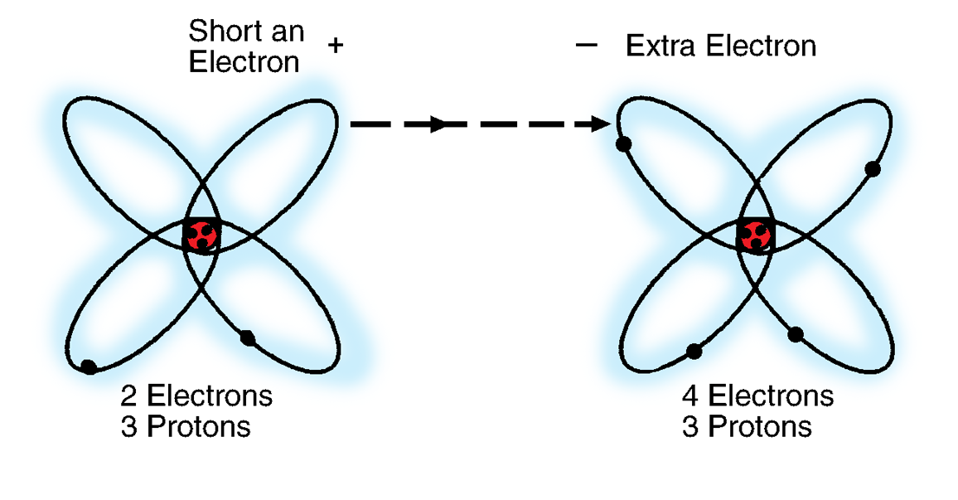
Atomic forces
Atoms can be both positively and negatively charged.
If an external force causes an electron (-) to depart from its orbit around a neutrally charged atom, the electron leaves behind a positively charged hole (+) that changes the balance and makes the atom positively charged.
In a neutrally charged atom, the balance between positive and negative charges can be upset if the atom is forced to accept an extra electron (-). The extra electron makes the atom negatively charged.

Slide 15
Atomic forces
Any material has the same state-of-charge as the atoms that make it up.
If the majority of the atoms in a material are short an electron, the material is positively charged.
If the majority of the atoms in a material have an extra electron, the material is negatively charged.

Slide 16
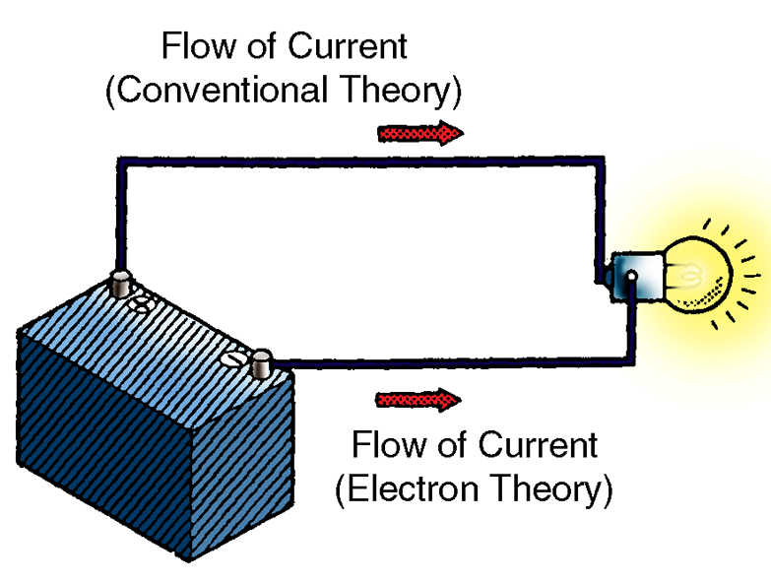
Circuits and basic circuit components
Current is the flow of electrons in the same direction. There are two theories relating to electron movement in current flow.
The conventional theory states that current flows from an area of high potential (+) to an area of low potential (-). The conventional theory is used for vehicle systems.
The electron theory states that current flows from an area of negative potential (-) to an area lacking electrons that is positive potential (+). This balances the charges. The electron theory is used for electronics.

Slide 17
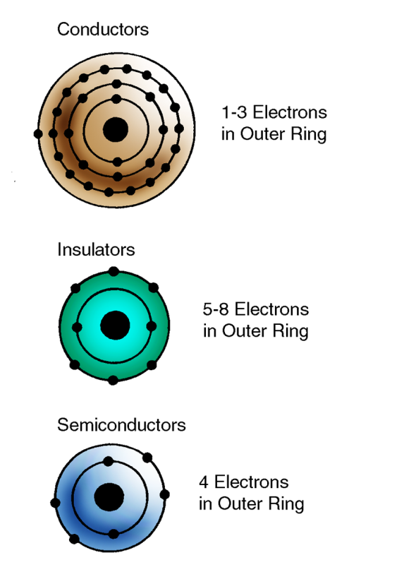
Circuits and basic circuit components
NOTE: The direction of current flow makes a difference in the operation of devices such as diodes. The direction of current flow does not affect the measurable units of electricity: voltage, current, and resistance.
Conductors, insulators, and semiconductors each have different electron properties.

Slide 18
Circuits and basic circuit components
A conductor is a material that allows current to flow easily. A conductor has one to three electrons in the outer ring that are loosely held with room for more. A low EMF causes a flow of free electrons. Conductors include silver, copper, and carbon.
Insulators usually have five to eight electrons in the outer ring that are tightly held with a fairly full ring. A high EMF is required to cause any electron flow. Insulators are poor conductors and include glass, rubber, and certain plastics.
Semiconductors have four electrons in the outer ring. They are neither good conductors nor good insulators. Semiconductors include carbon, germanium, and silicon.
Electron movement is based on the principle of equilibrium. An atom that is short of electrons attracts new electrons. An atom that contains extra electrons repels extra electrons.

Slide 19
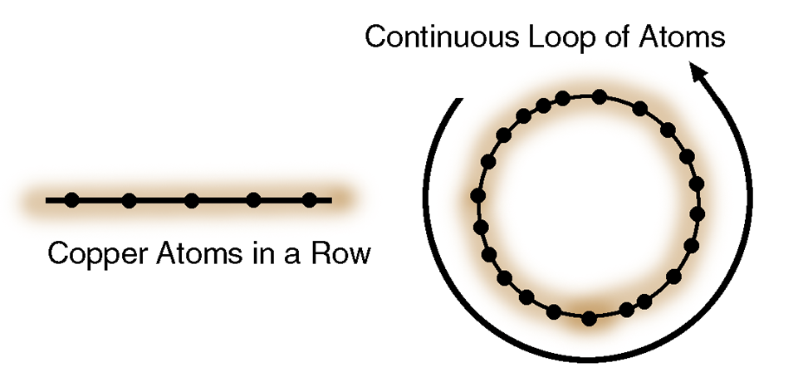
Circuits and basic circuit components
The copper atom has only one electron on its outer layer. Because this electron (-) has a weak attraction to the proton (+) in the nucleus, the electron is easily dislodged from its orbit. When the outer electron is free, the copper atom is a good conductor of electrons.
If some outside force causes one electron in the row of copper atoms to leave its orbit, that electron begins to orbit the neighboring atom.
The atom from which the electron was dislodged becomes more positively charged, due to the absence of an electron.

Slide 20
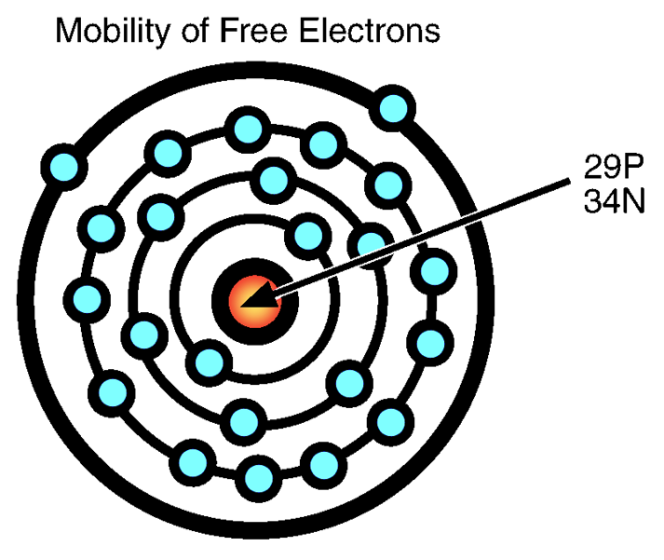
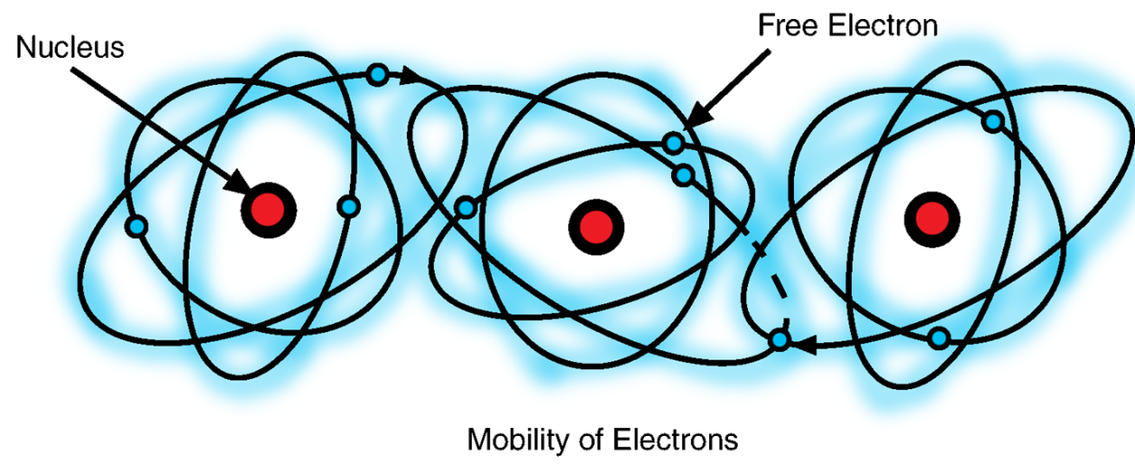
Circuits and basic circuit components
The atom around which the electron begins to orbit becomes more negatively charged, due to its extra electron.

Slide 21
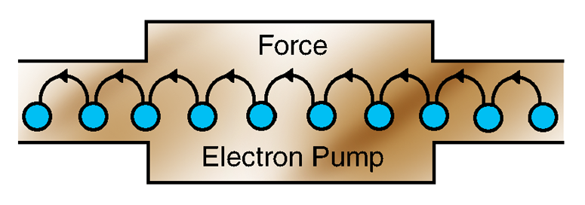
Circuits and basic circuit components
Movement of a single electron begins a chain reaction to create a circuit.
The atom that becomes positively charged due to the movement of the electron attracts the free electron in the neighboring atom.
The negatively charged atom repels its new electron and pushes it to the next atom in the loop.
Electrons then are passed from atom to atom around the loop, which is a circuit.
The chain reaction continues as long as the outside force causes the electrons to move. When the force is removed, the atoms again become balanced and electron movement stops.
Electron pump

Slide 22
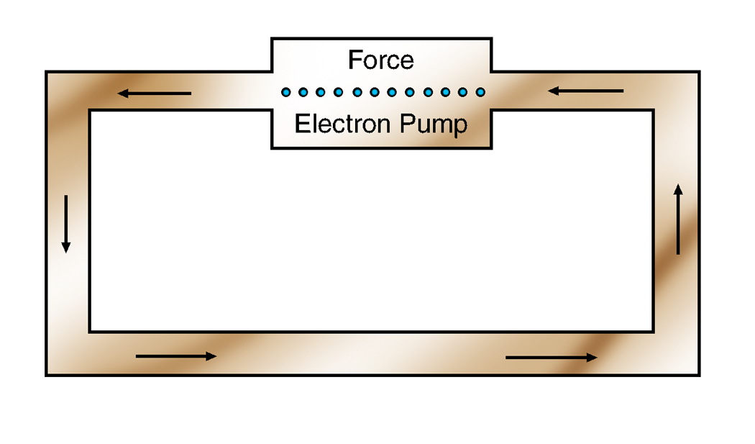
Circuits and basic circuit components
The movement of electrons is current. Current can be converted into mechanical, thermal, or magnetic energy.
Before current can flow through a circuit, electrons must be forced to move. The electron pump is a device that produces this force by pulling electrons from one atom and forcing them to the next. The electron pump comes in a variety of forms, such as a flashlight battery or a nuclear power plant.

Slide 23
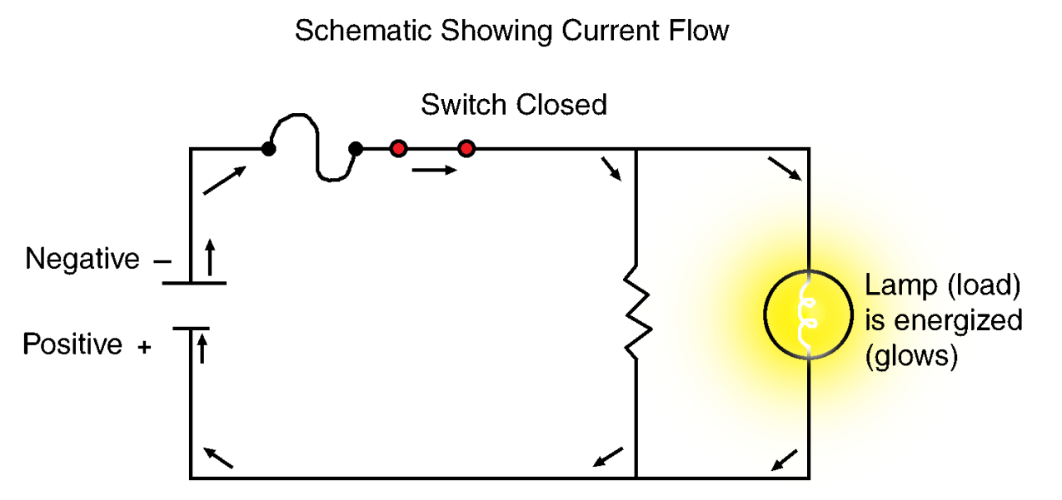
Circuits and basic circuit components
Electrical devices contain components that resist electrical current flow, causing current to produce mechanical, thermal, or magnetic energy. The component that provides resistance in an electrical circuit is called a load.
The filament in a light bulb is a load. Electrical current, or electron flow, is forced across the filament to provide resistance. The heat produced causes the filament to glow.
If more than one load device is connected in parallel across any part of a circuit, current flow in the circuit is divided in proportion to the resistance of each of the parallel load devices.

Slide 24
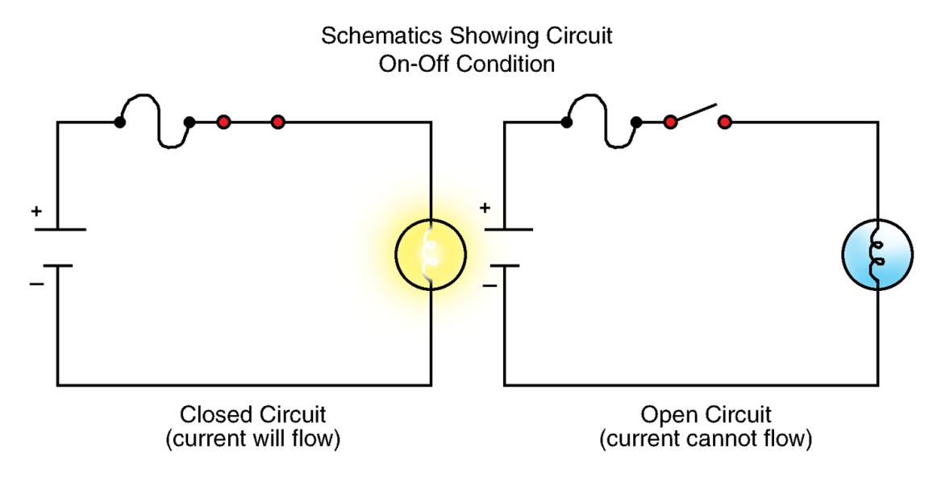
Circuits and basic circuit components
Electrical controls are devices that allow or prohibit current flow in a circuit. A simple switch can be used to control a circuit such as a light bulb. When the switch is open, current flow stops, and the light bulb goes out. When the switch is closed, current flow resumes and the light bulb comes on.
Circuit on-off
condition
Safety devices, such as fuses, fusible links, or circuit breakers, within an electrical circuit are designed to open when the circuit is overloaded. Safety devices protect the circuit and its components.

Slide 25
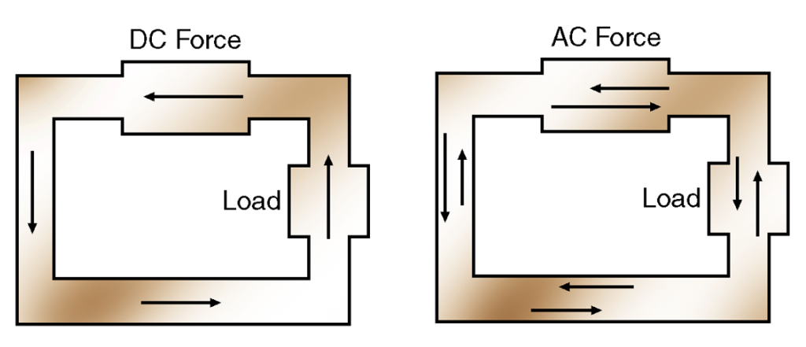
Circuits and basic circuit components
The direction of electron flow within a circuit is important.
In some circuits, the electron pump causes electrons to flow in only one direction. These are direct current (DC) circuits.
DC current
flow
AC current
flow
In other circuits, the electron pump moves electrons in alternate directions. These are alternating current (AC) circuits.
There are advantages and disadvantages to both AC and DC circuits. DC circuits are usually used in vehicles.

Slide 26
How electron pumps produce current
The principle of potential difference operates when one side of a circuit has more electrons than the other side. The excess electrons flow through the circuit to the side with fewer electrons.
If free electrons are dislodged from a conductive material, then that material no longer maintains a neutral charge. The more electrons removed from the material, the stronger the material’s attraction for new electrons becomes.

Slide 27
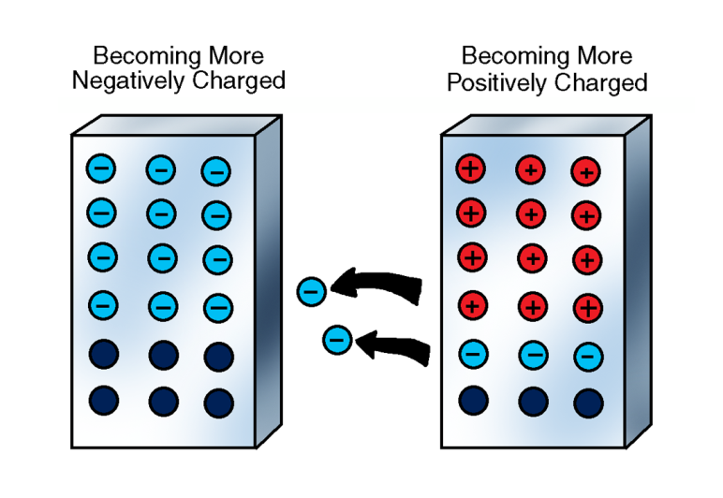
How electron pumps produce current
If free electrons from the first conductive material are collected and forced into orbit around the atoms of a second conductive material, the second material becomes negatively (-) charged and tends to repel extra electrons.
In the first conductive material, the number of electrons increases to develop a strong negative charge.
In the second conductive material, the number decreases to develop a strong positive charge.

Slide 28
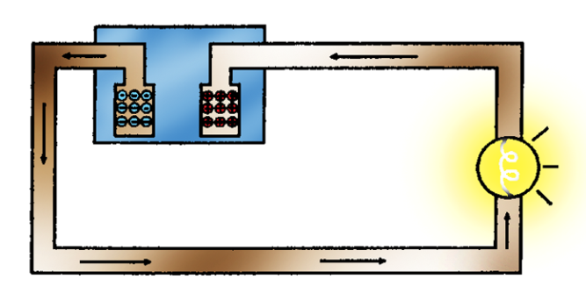
How electron pumps produce current
A potential-difference device contains both positively and negatively charged materials.
If a potential-difference device is placed in a circuit, extra electrons from the positively charged material flow through the circuit to the negatively charged material.
While electrons are flowing, the electrical circuit is live and can perform work.
While all electrons have returned to the positively charged material, electron flow stops.

Slide 29
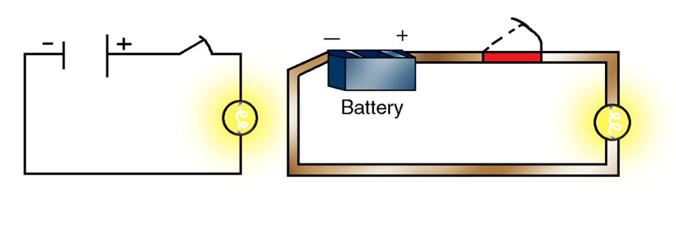
How electron pumps produce current
NOTE: Current flow strength depends on the strength of the negative and positive charges in the two materials. As the two materials lose their charges, current flow decreases.
The automotive battery is a potential-difference device. The battery has two distinct poles; one positive and one negative. In a completed circuit, electrons move from the electron-dense negative pole to the positive pole.

Slide 30
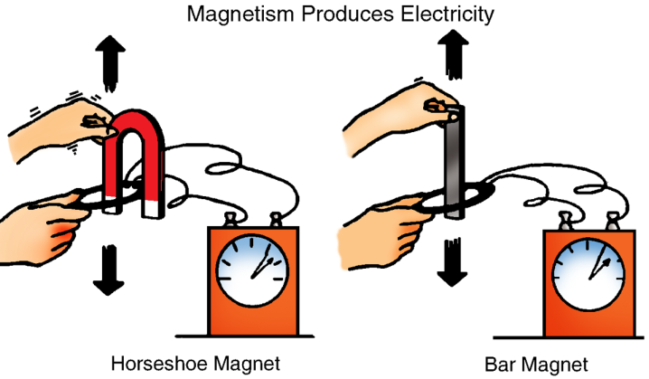
How electron pumps produce current
Electron flow, or current flow, and magnetism are closely related. A principle of magnetic force states that if a magnetic field passes across a conductor, electrons in that conductor are forced to move.
Magnetism produces electricity

Slide 31
How electron pumps produce current
NOTE: The strength of the magnetic field determines the amount of force applied to the electrons.
As a magnetic field passes across an electrical circuit, it dislodges electrons from their orbit.
Free electrons are either attracted or repelled by the magnetic field and current flow is created.
The stronger the magnetic field, the greater the current flow.

Slide 32
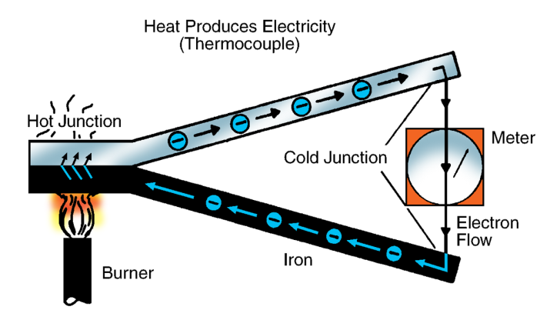
How electron pumps produce current
If two conductors, each with a slightly different electron density, are placed in a circuit and heated, electrons are forced to flow from one conductor through the circuit to the other conductor. Electrical devices that use thermal energy to operate are called thermocouples. In vehicles, thermocouples have limited use.
Heat produces electricity

Slide 33
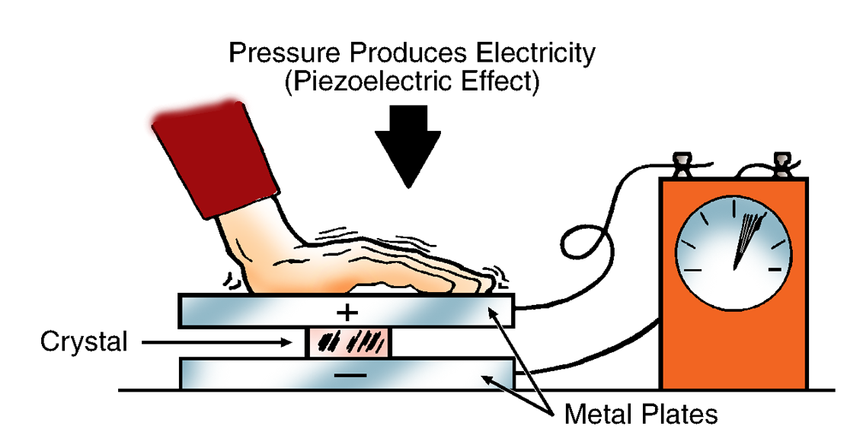
How electron pumps produce current
If a crystal is bent or vibrated, it produces a small amount of electrical current. Currently, crystals have limited use in automotive electrical systems.
NOTE: Only certain types of crystals are used in electrical circuits. These crystals are called piezoelectric devices.

Slide 34
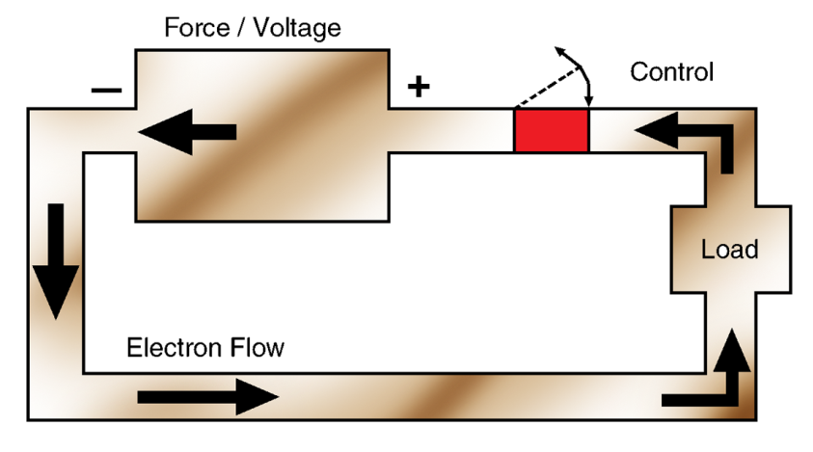
How electron pumps produce current
The following illustration demonstrates how electron force, a load, and a electrical control work together in a circuit.

