Slide 1
Module 2:
Electrical/
Electronic
Systems

Slide 2
Safety precautions
It is important to take careful safety precautions when servicing electrical/electronic systems.
Vehicle batteries produce more than 700 amps of current. Harmful by-products of this current flow are heat, hydrogen, and acid outgassing. Consider the following when working on or around a battery.
High-current discharge within an electrical/electronic system can overheat conductors and create a fire hazard.
The battery contains sulfuric acid, which can burn flesh. Also, clothing and vehicle paint can be damaged by sulfuric acid. Wear personal protective equipment (PPE) to protect eyes, skin, and clothing. Take precautions to protect the vehicle.
High battery activity causes the escape of hydrogen gas, which is highly explosive. An exploding battery throws debris and sulfuric acid in all directions.

Slide 3
Safety precautions
Electrical arcing can occur anywhere where high-potential voltage contacts a source of low-potential voltage. Electrical arcing can cause fuel or hydrogen vapor to burn or explode.
CAUTION: When opening an electrical circuit, disconnect the negative battery cable or ground cable first. To prevent electrical arcing, connect the negative battery cable last.
Many of the hazards technicians face when servicing electrical/electronic systems can severely damage a vehicle.
The following precautions should be taken before service or repair.
Inspect under the hood for exposed wiring, heat damage, or the presence of fuel and acid.

Slide 4
Safety precautions
Consider whether the service or repair involves heavy current flow or electrical arcing and develop a prevention plan for each hazard.
Plan a test sequence.
The following precautions should be taken during service or repair.
Use a grounding wrist strap to maintain equivalent ground potential when working with sensitive electronic components.
Avoid unintentional grounding or shorting of circuit components.
Avoid testing unprotected circuits.
Avid loading sensitive circuits with test lights or other load-test equipment.

Slide 5
Safety precautions
The following precautions should be taken after service or repair.
Inspect repaired systems for defective wiring insulation.
Inspect for proper routing of wires.
Activate the repaired circuit and all circuits related to it to ensure all are fully operational.

Slide 6
Importance of service information
Vehicles have become so technologically advanced that service information is used on every job. Service information is the most comprehensive and best source of information for a specific vehicle.
Service information includes vehicle specifications, diagnostic and service/repair procedures, wiring diagrams, parts diagrams, and special tools required.
Because so many technical changes occur after service information is published, manufacturers provide technical service bulletins (TSBs) to update service information. The information in the TSBs also appears in the next edition of the service information.

Slide 7
Importance of service information
Service information contains specific information needed to diagnose and service electrical/electronic systems, including wiring diagrams, diagrams of system ground points, brief descriptions of how a circuit works, and troubleshooting hints. Also, most service information includes a list of electrical symbols used in the wiring diagrams and an explanation of color-code abbreviations.
The two types of wiring diagrams are the pictorial and the schematic.

Slide 8
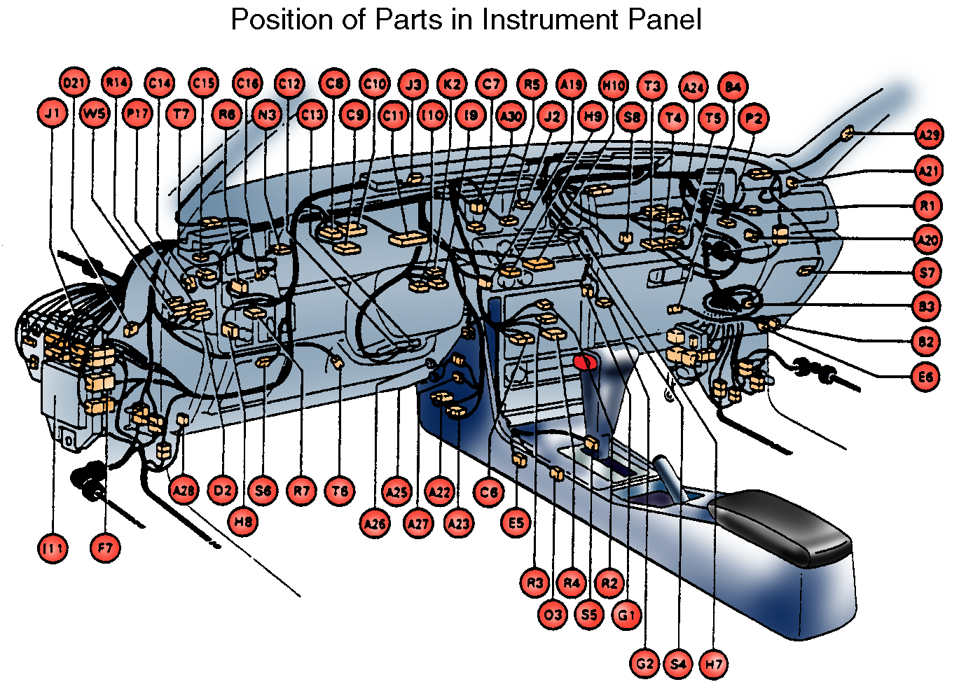
Importance of service information
The pictorial wiring diagram is a drawing of the physical appearance of a wring circuit used to identify and locate components. Detailed diagnostics are difficult to perform when using only pictorial wiring diagrams.

Slide 9
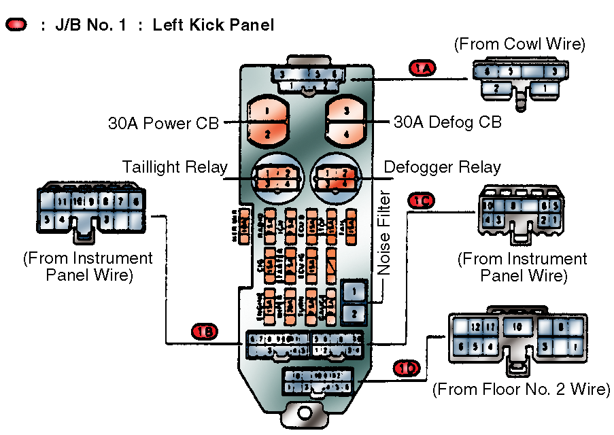
Importance of service information
A wiring schematic is a drawing of an electrical circuit that shows each individual wire, component, etc. The wiring schematic is used when performing diagnostic procedures.

Slide 10
Importance of service information
A wiring schematic does not represent an actual length of wires or the distance between components. Some components may be separated by 2 inches of wire while others are separated by 10 feet.
Symbols are used to identify components.
Common electrical symbols used in wiring diagrams
Service information includes an individual wiring diagram for almost every electrical/electronic system in the vehicle.
For each system, only the circuits and components of that specific system are included, making it easier to identify potential trouble spots. The following is a wring diagram of an interval wiper/washer system.

Slide 11
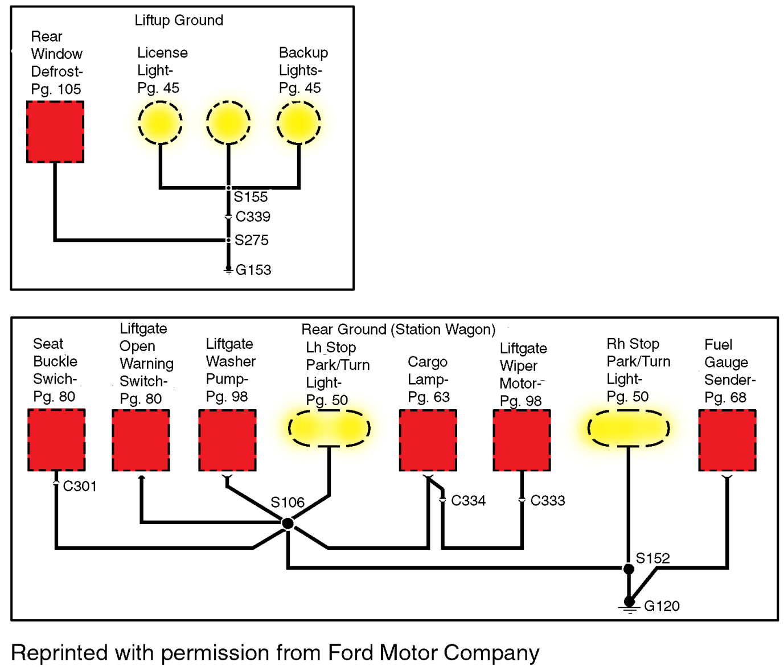
Importance of service information

Slide 12
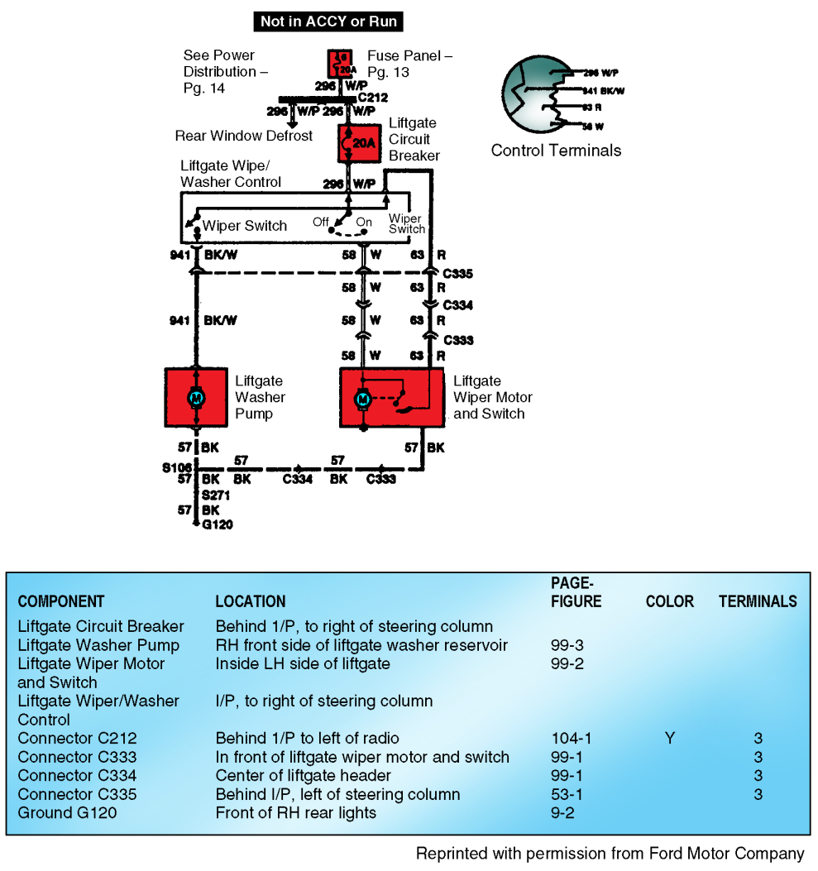
Importance of service information
Wiring diagrams show the locations of the components included in a particular electrical/electronic system circuit. The following is a wiring schematic of a liftgate wiper/ washer system.

Slide 13
Importance of service information
Service information includes a list of electrical symbols to help interpret the wiring diagram. This list uses abbreviations for the component or connection being symbolized. For example, the splice/crimp connection symbol is designated as S100. The letter S stands for splice/crimp, and the number 100 indicates that it is the 100th splice/crimp in the entire electrical/electronic system.
In most electrical/electronic systems, wires and connectors are color coded to make identifications easier. When troubleshooting a circuit, the technician will test for voltage at various points in a particular conductor or wire.

Slide 14
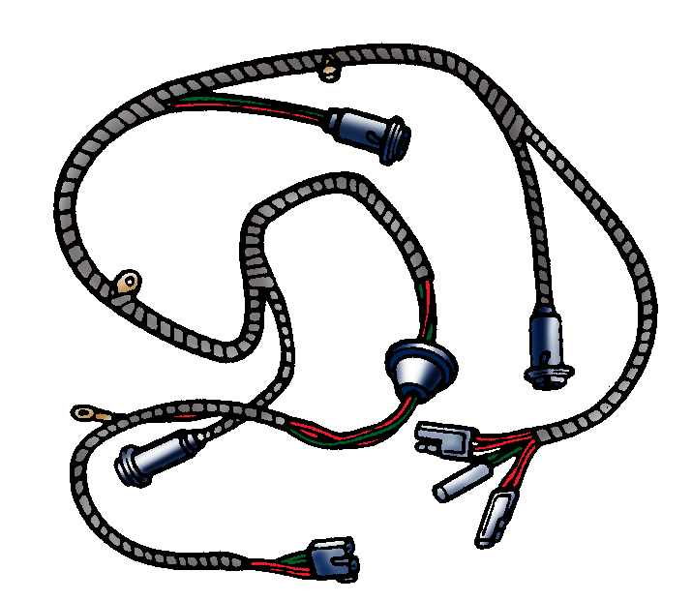
Importance of service information
A wiring harness is a bundle of wires placed together in plastic wrapped with tape or molded into a flat strip. The colored insulation of different wires allows circuit tracing.
NOTE: Wires from several different electrical/electronic systems can be routed together in the same wiring harness.

Slide 15
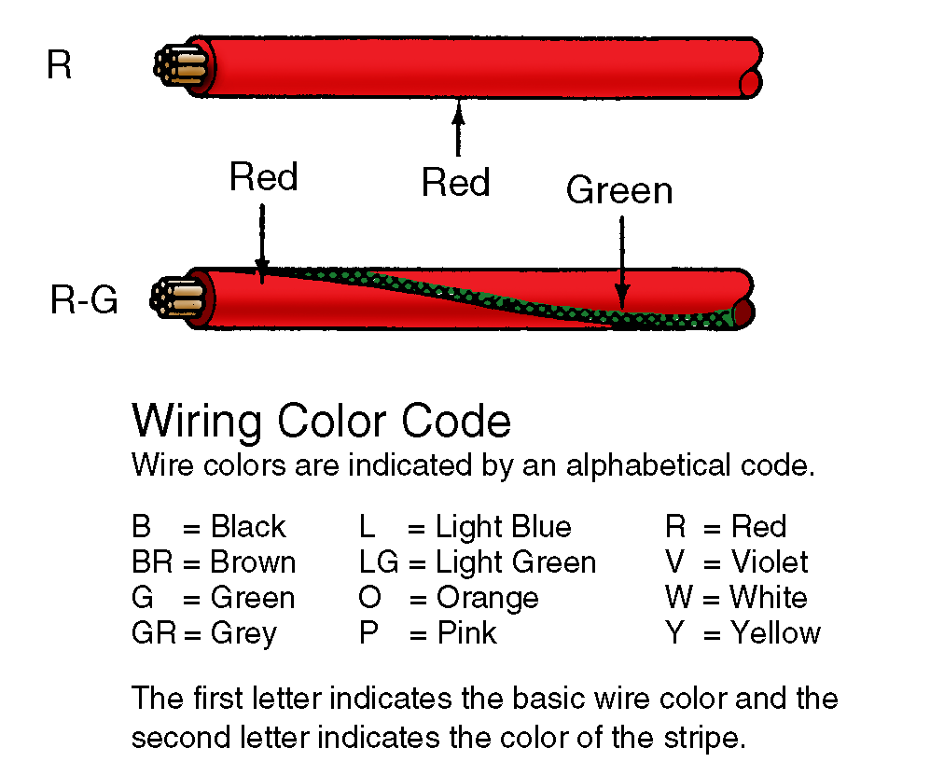
Importance of service information
Because color-coding systems are manufacturer specific, the color of wires and connectors is indicated by abbreviations on the wiring diagram. An explanation of these abbreviations is included with service information.

Slide 16
Importance of service information
Some wiring diagrams include an end view of component connectors showing the color of the wire connected to each matching terminal in a connector. This helps locate the proper terminals to probe when performing tests.
NOTE: This type of wiring diagram is valuable when bench testing a component.
Wiring diagrams begin at the fuse or circuit breaker. A current flow path is shown from the fuse through switches controlling current flow to the load unit and on to ground. The current flow path is usually located at the bottom of the wiring diagram.
When system ground is suspected, locating the ground point using a wiring diagram can be a time saver. Ground points usually are found on a separate wiring diagram.
NOTE: Two or more circuits often share one ground point.

Slide 17
Test equipment
NOTE: A technician uses different equipment to test electrical circuits. This equipment determines how well a circuit or component performs.
CAUTION: Always follow the test equipment manufacturer’s instructions for using the equipment and observe all safety precautions.
Digital multimeter (DMM)
The DMM is one of the most commonly used pieces of test equipment because of its versatility in making various electrical measurements. The DMM is a voltmeter, ohmmeter, and ammeter all in one unit and is used in place of these separate meters.
The DMM’s voltmeter function is used to measure the electromotive force (EMF), also known as pressure or voltage difference, between two points in a circuit. The difference is measured in volts.

Slide 18
Test equipment
The ohmmeter function measures the electrical resistance of a component or portion of the circuit. Its unit of measurement is ohms.
The ammeter function measures the amount of electrical current through a circuit. Its unit of measurement is amperes or amps.
Meter independence
A DMM has high meter impedance, usually a minimum of 10 megaohms (10 million ohms). Meter impedance is the combined resistance to current created by the resistance, capacitance, and inductance of the meter.
High meter impedance keeps the amount of current coming through the meter low and thus minimizes any adverse effect on electrical circuits.

Slide 19
Test equipment
Standard analog meters have lower meter impedance values, usually 20,000 to 30,000 ohms per volt. This lower impedance decreases the total resistance of the hookup and allows more current through the circuit.
CAUTION: Using low-impedance meters on some electronic systems and components like oxygen sensors can cause damage or inaccurate results.

Slide 20
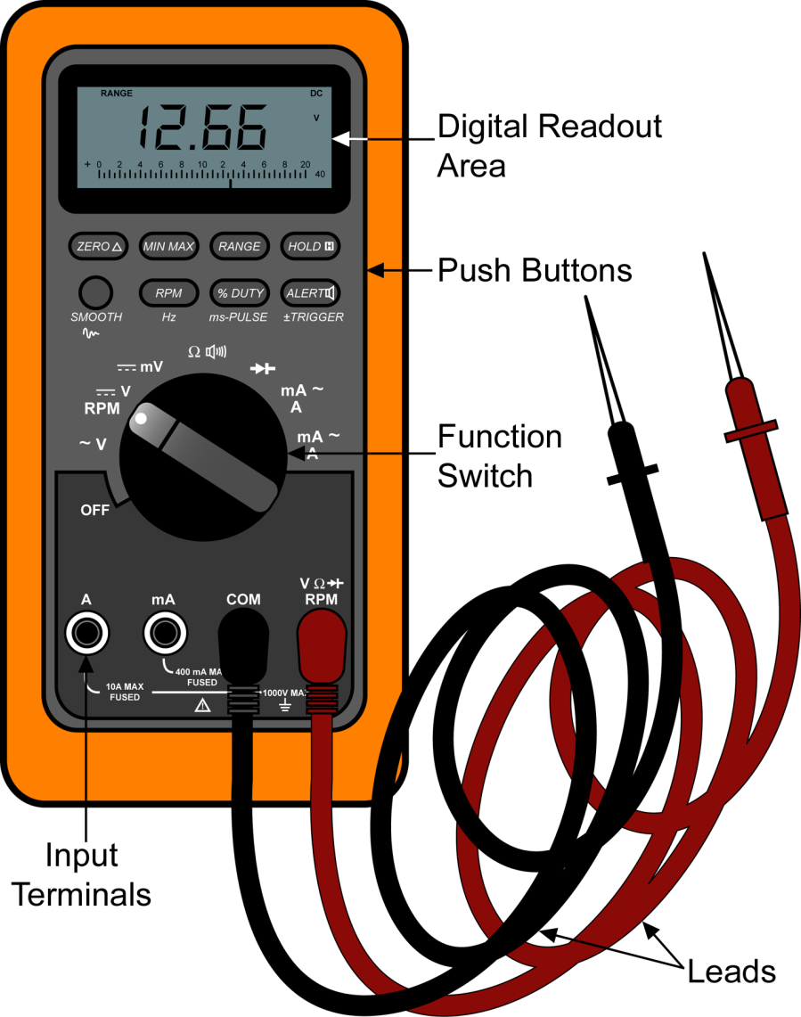
Test equipment
Major DMM components

Slide 21
Test equipment
NOTE: DMMs vary somewhat depending on the manufacturer, but many DMMs will have the following features.
The top part of the DMM has the digital readout area where the readings are displayed. Some DMMs have needles similar to older analog meters.
The digital reading is displayed in numerical values with decimal points along with prefixes and symbols. The decimal point, prefixes, and symbols must all be properly interpreted to get an accurate reading.
Symbols displayed on the meter include the following:
M – means mega or million
k – means kilo or thousand
m – means milli or one-thousandth

Slide 22
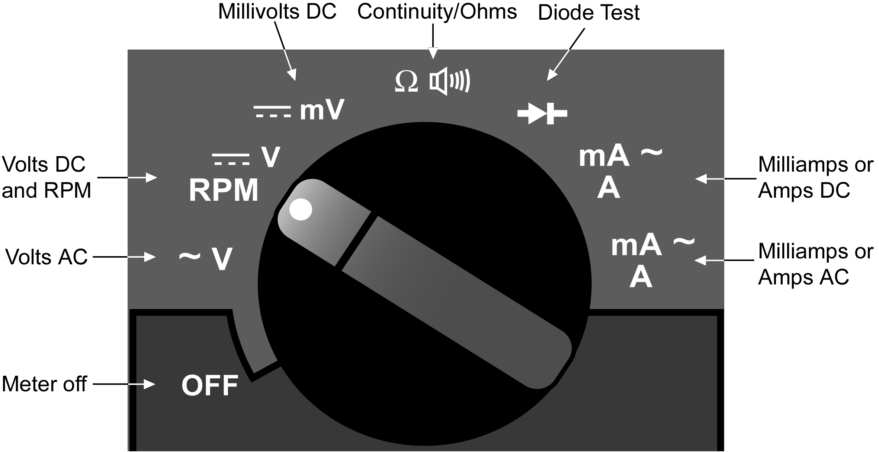
Test equipment
The push buttons below the display include the range button, which is used to control whether the user selects the range (manual range) or the meter automatically selects the best range (autorange).
The large round knob near the middle is the function switch. The user turns this switch to select the different functions and levels of voltage, current, and resistance.

Slide 23
Test equipment
At the bottom are the input terminals where the leads are plugged in. The COM or common terminal is the location where the black lead is connected for all measurements. The other terminals, used for specific types of measurements, are locations where the red lead is connected.
A DMM has two leads, one black and one red. One end of the lead is plugged into the DMM’s input terminal. The other end is a probe that is used to connect to the electrical component.
Tips for reading DMM measurements
When using manual range, be sure to select the range that is above and closest to the voltage being tested. If the range is too low, the reading will show OL (overload). When the range is too high, the meter will not provide the most accurate measurement.

Slide 24
Test equipment
Example: Testing battery voltage
Ranges available: 4000V, 400.0V, 40.00V, and 4.00V
The best range selection is 40.00V because it is the one that is above and closest to 12.66, which is the reading for a fully charged battery. Using this range would yield the result of 12.66 if the battery is fully charged. If the higher range of 400.0V were used, the reading would show fewer places after the decimal (12.6) and therefore would be less accurate.
When using automatic range, be sure to note the decimal place of the reading and the measurement symbols displayed with the reading. Ignoring the decimal and misinterpreting the symbols will result in an inaccurate test result.

Slide 25
Test equipment
When using automatic range, be sure to note the decimal place of the reading and the measurement symbols displayed with the reading. Ignoring the decimal and misinterpreting the symbols will result in an inaccurate test result.
Meter Reading on Ohms Function | To Convert to Basic Unit | Equals
18.7 with “M” displayed | Multiply by 1,000,000 | 18,700,000 ohms
18.7 with “k” displayed | Multiply by 1,000 | 18,700 ohms
Meter Reading on Amps Function
225.6 with “mA” displayed | Divide by 1,000 | 0.2256 amps
Meter Reading on Volts Function
12660 with “mV” displayed | Divide by 1,000 | 12.66 volts

Slide 26
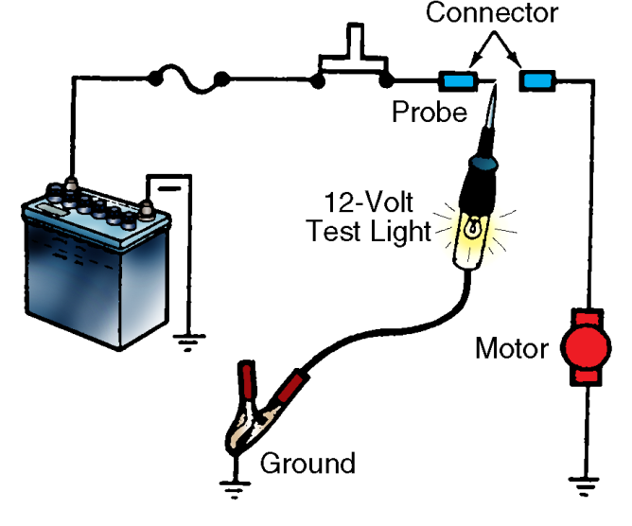
Test equipment
Test light
A test light confirms the presence of voltage in a circuit. It uses an incandescent bulb with approximately 20 to 30 ohms of resistance.
If the test light bulb comes on when hooked in parallel to a circuit, enough voltage is present. The brighter the light, the greater the voltage of the circuit.

Slide 27
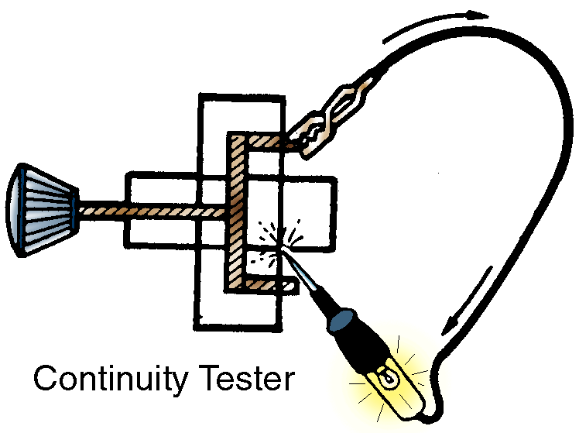
Test equipment
A continuity tester, or self-powered test light, confirms that a circuit can conduct electricity. It has a battery and an incandescent bulb with approximately 1 ohm of resistance. If the test light bulb comes on when hooked in series to a circuit, the circuit is continuous.
CAUTION: The power must be off when using a continuity tester. If a lamp is connected to a powered circuit, the high current can burn out the lamp.

Slide 28
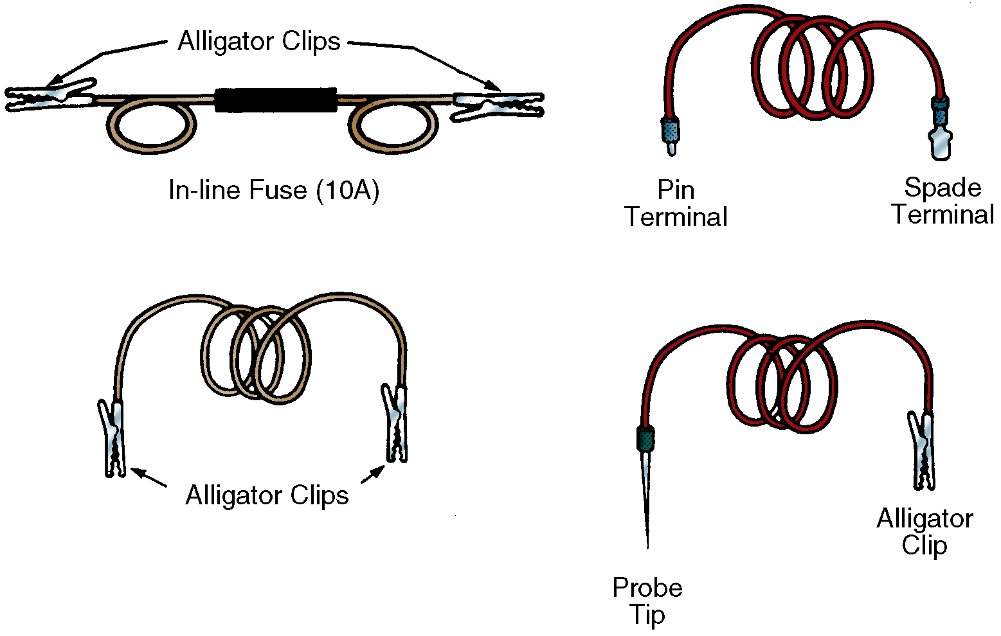
Test equipment
Jumper wire
A jumper wire is a simple but effective testing tool that is composed of a piece of insulated wire with a terminal on each end. Various types of jumper wires are available and equipped with different types of terminals.

Slide 29
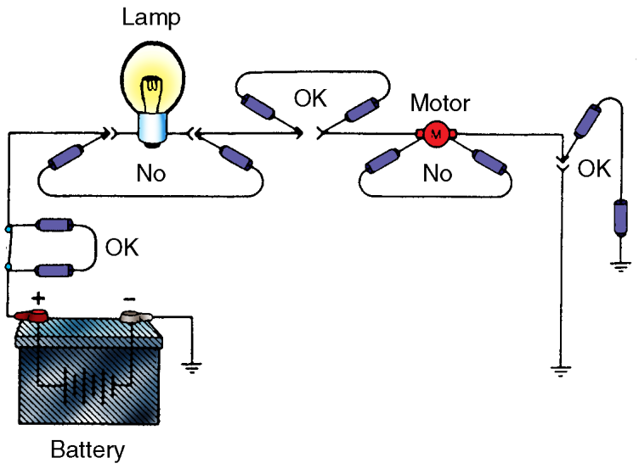
Test equipment
Jumper wires exchange a recognized good circuit for a suspected faulty portion of the circuit. If the circuit works correctly with the jumper wire but not without, there is an open in the area being jumped.
A jumper wire should only be used to bypass switches, connectors, sections of wiring, and other nonresistive parts of the circuit. Bypassing a lamp, motor, coil, or any load with a jumper wire can result in circuit resistance and high current flow, damaging wiring and components.

Slide 30
Test equipment
Digital storage oscilloscope (DSO)
An oscilloscope, or scope, is a voltmeter that displays voltage in relation to time, showing voltage vertically and time horizontally. The voltage displays as a line across a cathode ray tube or liquid crystal screen. Oscilloscopes have been used for automotive testing for many years, including the following uses.
Checking ignition system performance
Testing diodes in the alternator’s rectifier
Testing signals from sensors in powertrain control module systems

Slide 31
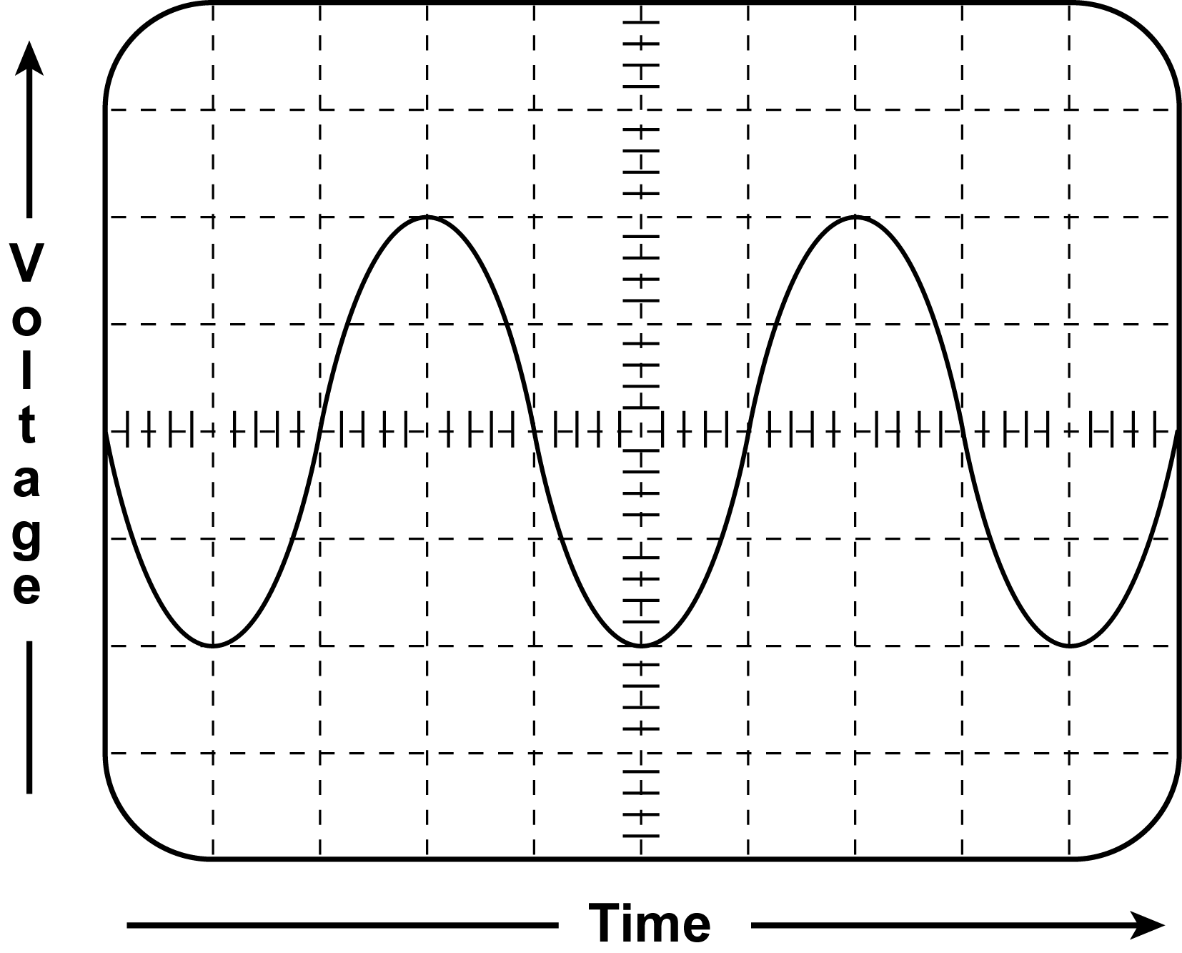
Test equipment

Slide 32
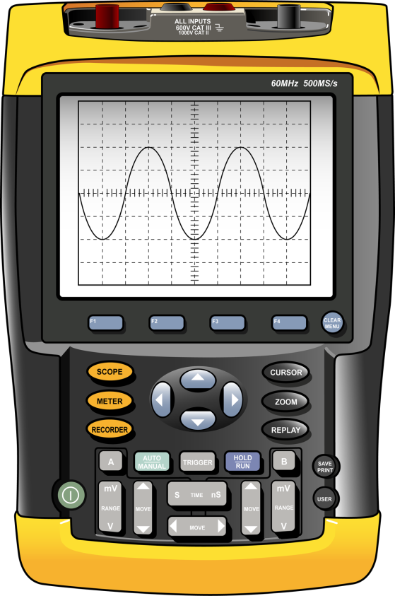
Test equipment
The digital storage oscilloscope (DSO) is one of the latest advances in scope technology. A DSO is handheld and therefore much more portable than older scopes. It measures voltage and time over a wider range, which is useful in diagnosing the complex electrical systems found on modern vehicles.

Slide 33
Test equipment
Controls include the settings for voltage (vertical), time (horizontal), and trigger. The trigger setting controls when the pattern begins to display on the screen and allows the patterns to begin and end at the same points on the screen. The correct trigger setting is important when observing the timing of events.
Other DSO features
Converts the signal to a digital display and has the ability to freeze or hold the signal for analysis, store the data, and recall the data for later use.
Typically has the ability to display more than one voltage pattern at a time allowing the user to observe differences between signals; a two-channel DSO can display two signals at once, a four-channel DSO can display four signals, etc.

Slide 34
Test equipment
May provide sample good patterns for common automotive tests, such as the correct pattern for an alternator under full load, that can be used to compare to the signal being tested.
May have a feature that identifies and stores abnormal readings, called glitches.

