Slide 1
Fasteners
Used to join together the various parts of the automobile.
Spot Welding
Soldering
Nuts & Bolts
Washers
Screws
Clips
Clamps
Studs
Rivets
Studs
Splines/Keys/RollPins
Glue/Silicone/Adhesives
Crimped (Body seams, electrical connections)

Slide 2
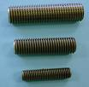
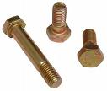
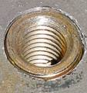
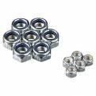
Fasteners
External Threads (Male Threads)
Bolts, Studs, Screws
Internal Threads (Female Threads)
Nuts, Threaded holes

Slide 3
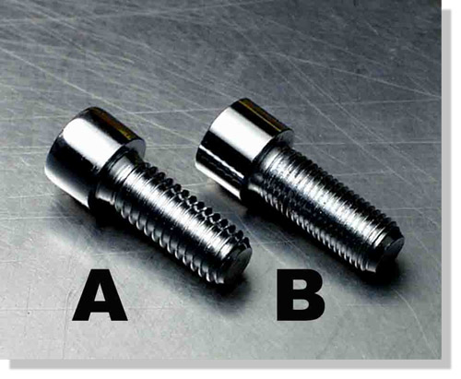
Fasteners
Imperial Threaded Fasteners
UNC – Unified National Coarse.
UNF – Unified National Fine.

Slide 4
Fasteners
Fine Threaded Fasteners
Stronger Thread
Less likely to come loose
Slow to assemble
Easier to ruin the thread (cross thread)
Imperial threaded fasteners come in inch increments.
½”, 5/16”, 3/8”, 7/16” …

Slide 5
Fasteners
5/16” UNC X 1 ½” Bolt
Diameter
1 ½” Long
Coarse

Slide 6
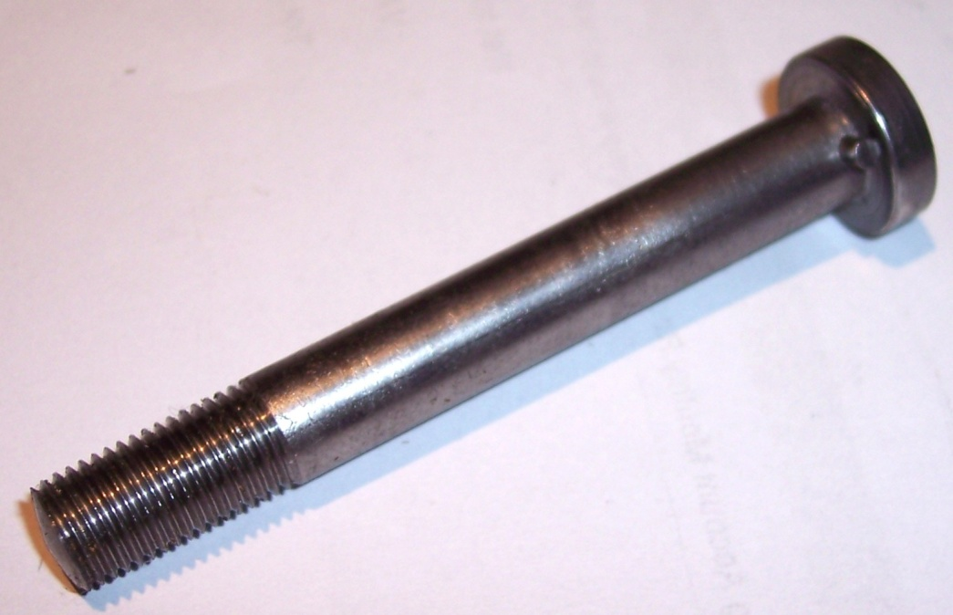
Fasteners
5/16” - 13 X 1 ½” Bolt
13 Threads/inch
Total Length
Major Diameter

Slide 7
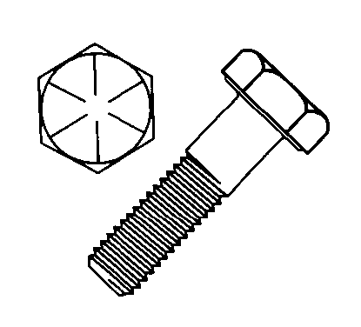
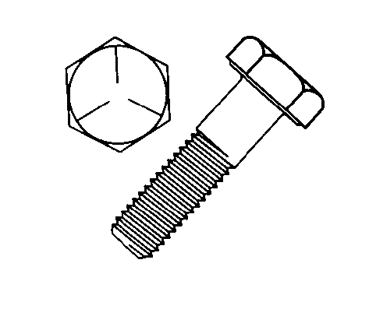
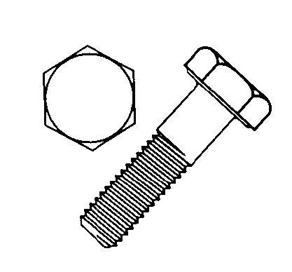
Fasteners
Bolt Grading (Strength)
Grade 8
Grade 5
Grade 2
Add 2 to the number of lines

Slide 8
Fasteners
Metric Threaded Fasteners
ISO Metric – International Organization for Standardization
Most new vehicles have metric fasteners
M6, M7, M8, M10, M12, M14 …
M8 X 25 X 1
Metric
8mm
25mm long
Pitch (threads are 1mm apart)

Slide 9
Fasteners
Imperial
Metric
Black/Silver in colour
Gold, red, green, yellow, etc.
Lines on the head
Numbers on the head
UNC, UNF
ISO metric
Standard tools (inch)
Metric tools (mm)
In inches
In millimeters

Slide 10
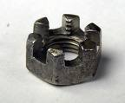
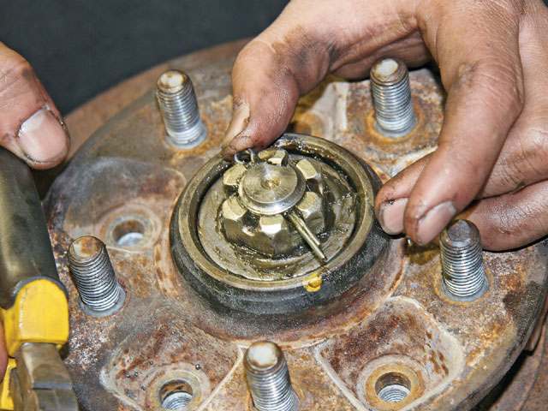
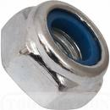
Nuts
Hex Nut – Most common on automobiles.
Castle Nut – locks with a cotter pin
Wing Nut – No tool required
Locking Nut – Nylon Patch (center, top)
Lug Nut – Taper face to help center the wheel
Speed Nut – Push-on (mostly screws)

Slide 11
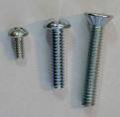
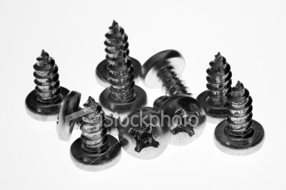
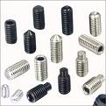
Screws
Machine Screws –
no nut required ( usually less then ¼”
Passes through one piece and threads into other.
Sheet Metal Screws(self tapping) –
makes its own hole/threads
Set Screw – (allen wrench/no head)
Used for aligning pullies on the shaft.

Slide 12
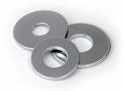
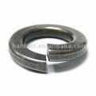
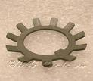
Washers
Flat Washer –
Distributes pressure over a wider surface area.
Lock Washer - Prevents the fastener from loosening.
Used at high vibration places.
Bites into the material and the fastener.

Slide 13
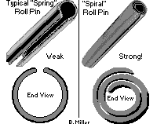
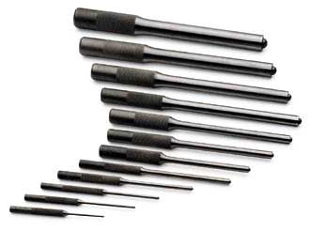
Fasteners
Roll-pins/Spring-pins aligns + locking devices driven into a hole to
Lock a pulley or a spline.

Slide 14
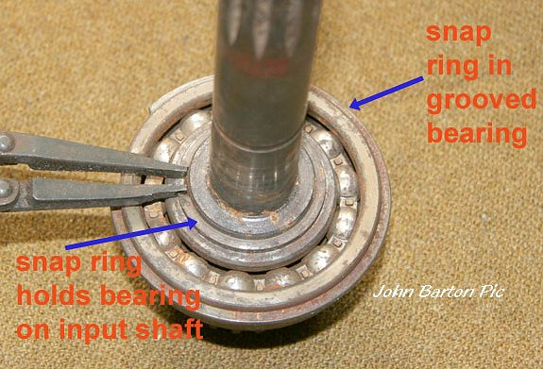
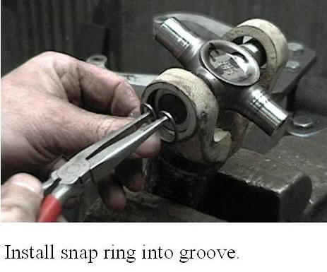
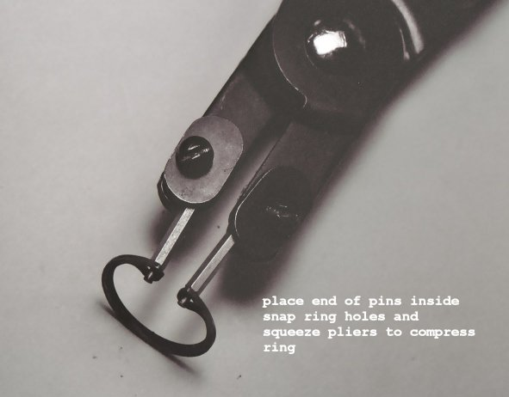
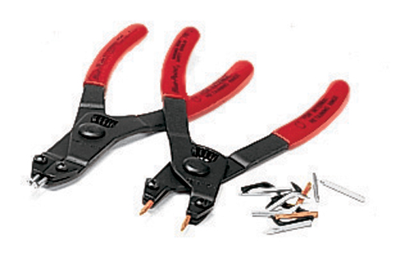
Fasteners
C - Clips
External C-Clip
Internal C-Clip
Snap Ring Pliers

Slide 15
Fasteners
Basic Rules
Use correct length and thread.
Start threads by hand (no tool).
Install all bolts before final tightening any one on a single part.
Tighten all installed fasteners before leaving or leave a note
NOT TIGHT
Tighten evenly to a correct torque specification
and in proper sequence.

Slide 16
Fasteners
Tightening Wheels
Tightening multiple bolts

