Slide 1
Unit 2- Digital Multimeter (DMM) Overview
When you complete this unit, you will be able to:
  Identify the 4 basic sections of the DMM
  Identify the common icons and information found on the display screen
  Identify the basic function buttons used on the multimeter
  Identify the basic functions found on the rotary dial
  Explain the differences in the test lead terminals

Slide 2
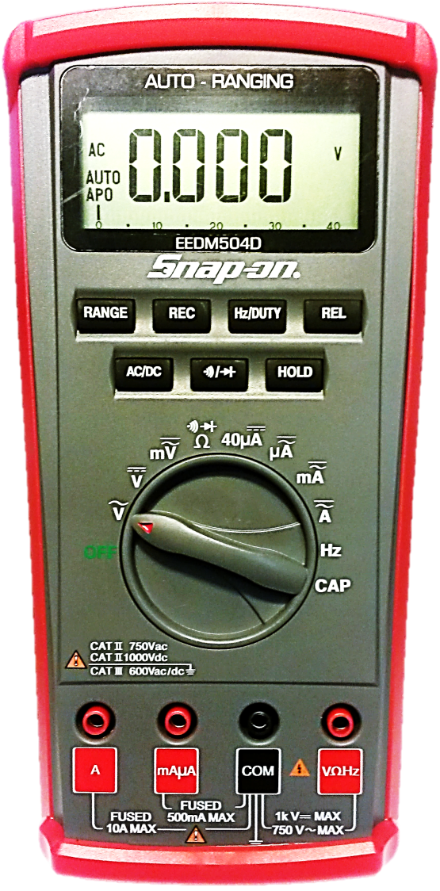
Digital Multimeter Overview
Four Basic Sections of the Multimeter
Digital Display
Push Button Functions
Rotary Dial Selector
Test Lead Terminals
2

Slide 3
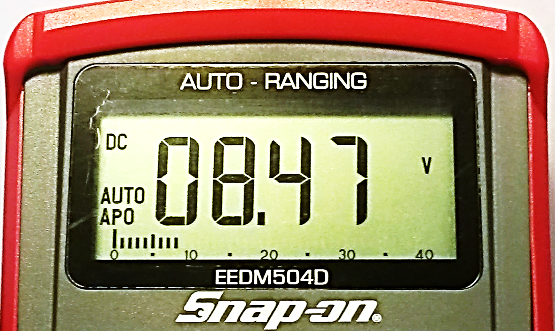
Digital Multimeter Overview
Digital Display Readings and Locations on Start-up
Low Battery symbol will appear only when power is low
Auto Ranging on Start-up
Dial Setting Icon Reference Area
Voltage Type AC or DC
Auto Power Off
Display of the Measured Value
Analog Bar Graph

Slide 4
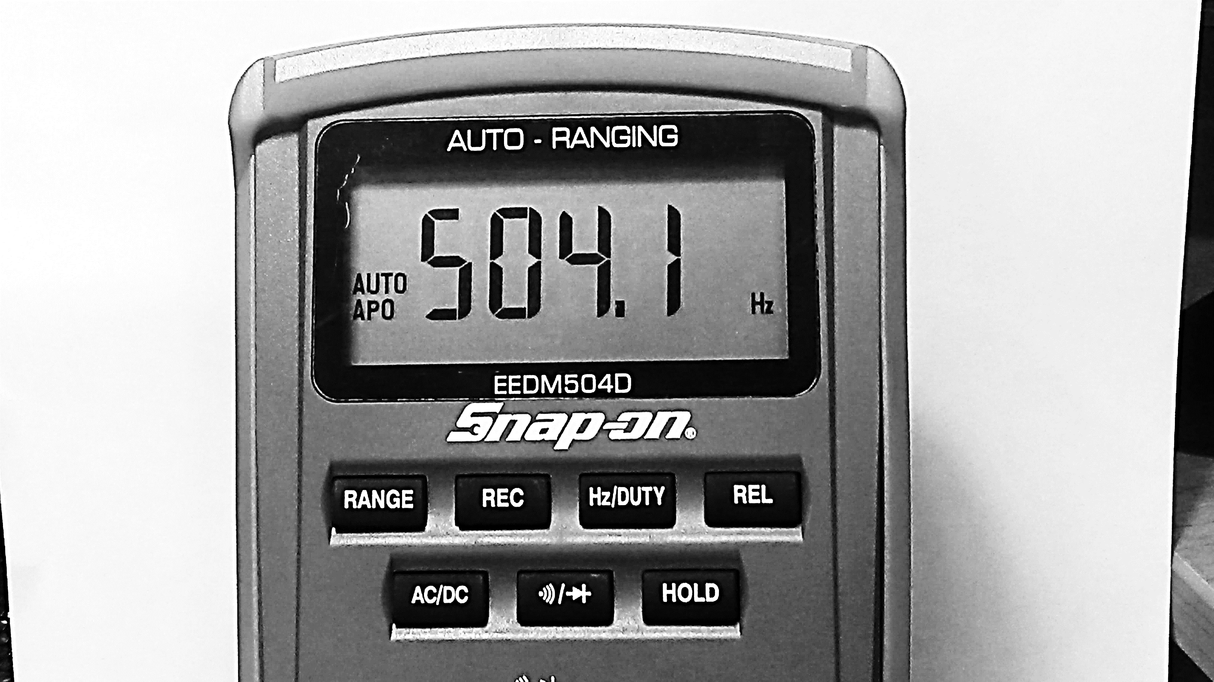
Digital Multimeter Overview
DMM Push-Buttons Enhance Dial Functions
REL activates Relative Mode - sets display to zero - factors out undesired readings
REC activates recording of MIN (minimum) and MAX (maximum) values
Hz/DUTY toggles between Frequency (Hertz - Hz) or Duty Cycle (%) on AC-Volts, AC-Amps, or Hz
RANGE toggles between Auto Ranging or Manual Ranging

Slide 5
Digital Multimeter Overview
DMM Push-Buttons Enhance Dial Functions
AC/DC toggles between AC (Alternating Current) or DC (Direct Current)
HOLD freezes a value on the display - a second press removes the hold going back to a live value
Continuity Buzzer - checks circuits for opens, shorts, broken wires loose fuses, etc. Diode - tests diodes, LED’s etc.
5

Slide 6
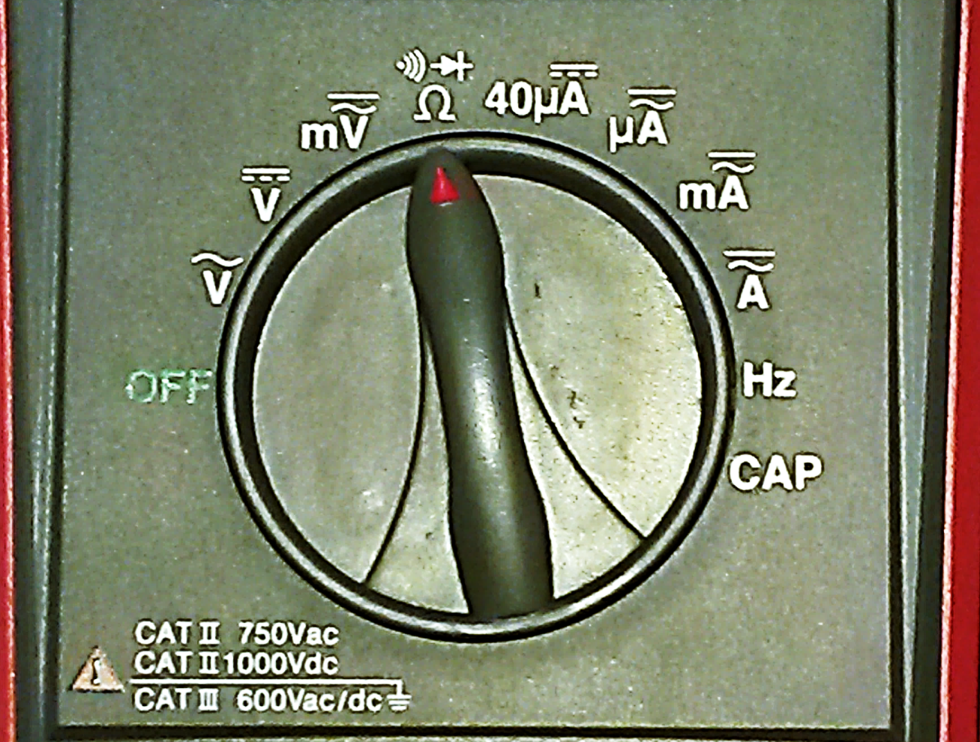
Digital Multimeter Overview
DMM Rotary Dial Symbol Definitions
AC or DC selectable millivolts
Ohms (or resistance) toggle to Continuity or Diode Test
40 micro amps max. current setting-measures tiny current draw in DC
DC Volts
4000 micro amps max. current setting selectable AC or DC for very low current draw
AC Volts
OFF meter is not active
6

Slide 7

Digital Multimeter Overview
DMM Rotary Dial Symbol Definitions
400 milli Amp max. current setting selectable AC or DC for low current draw
10 Amp max. current setting selectable AC or DC
HERTZ frequency measurements
7
CAPACITANCE measures capacitors

Slide 8
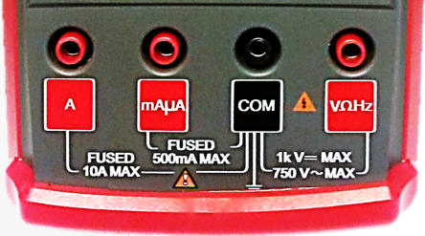
Digital Multimeter Overview
DMM - Test Lead Terminal Symbols
Micro & milliamps red lead connection 500 milliamp (½ amp) fused terminal
COMMON black lead connection used for most measurements (Typically Ground)
Volts/OHMS/Hertz red lead connection used for Voltage, Ohms(resistance) Diode Test, Continuity, Hertz (frequency) and Capacitance
Amps red lead connection 10 Amp fused terminal

Slide 9
Review for Understanding
What are the 4 main sections of the DMM?
Give three examples of how the button functions expand the meter’s capabilities
What is the function of the rotary dial?
How many test lead terminal ports are there? Name them.
Notes:
Answers
Display, buttons, rotary dial and test lead terminals
Converts to manual ranging, records min and max values, provide frequency and duty cycle, provide relative readings, converts from AC to DC signals, enables continuity and diode testing and holds a value
To select the desired test measurement
4 – amps, milliamps& micro amps, Com or ground and Volts, ohms and hertz

