Slide 1
Unit 3 - Digital Multimeter Safety and Set-up
When you complete this unit, you will be able to:
  Perform an inspection of the test leads and verify their proper operation
  Test and verify the fuses found in the meter before operation
  Explain the importance of using the proper replacement fuses.
  Compare and contrast auto and manual ranging options

Slide 2
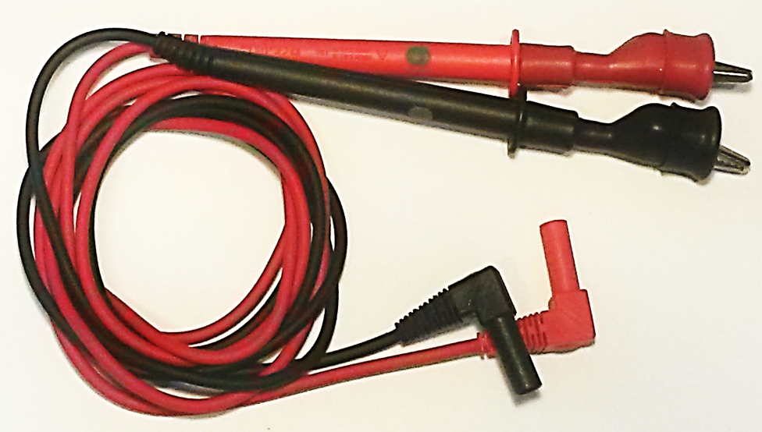
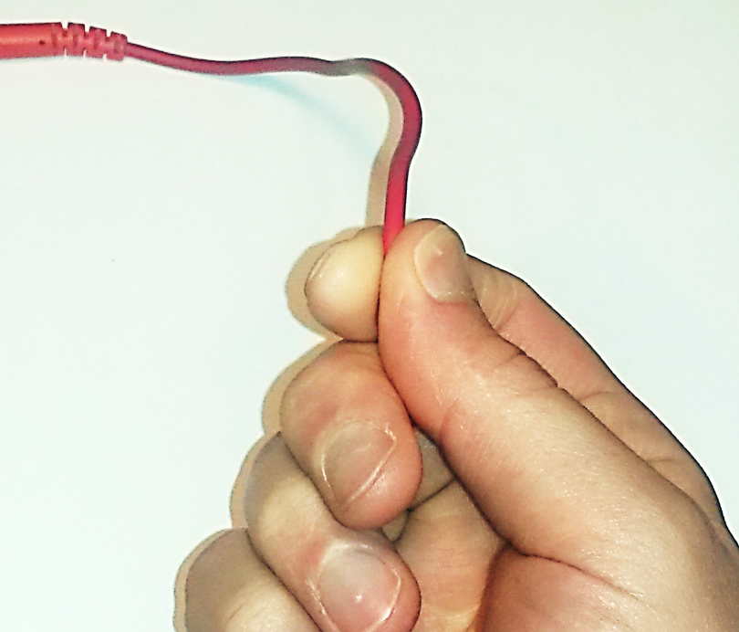
Digital Multimeter Safety and Set-up
Always Check for Good Test Leads Before Using a Meter
  Remove the test leads from the meter and visually inspect from terminal end to test probe tip for any signs of worn or broken insulation
  Run each test lead through your fingers and feel for any cuts, cracks, or damage to the insulation
Notes:
Test leads are double insulated – two coatings of red or black material separated with a white in-between material
- when white color shows up leads should be replaced

Slide 3
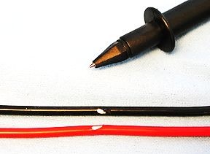
Digital Multimeter Safety and Set-up
Always Check for Good Test Leads Before Using a Meter
Quality test leads will be double insulated (both an inner and outer insulation barrier) to better protect the user
The inner insulation layer is white, so it is easy to spot any cuts or other damage against the red and black outer layer. These should NOT be used
Notes:
Test leads are double insulated – two coatings of red or black material separated with a white in-between material
- when white color shows up leads should be replaced

Slide 4
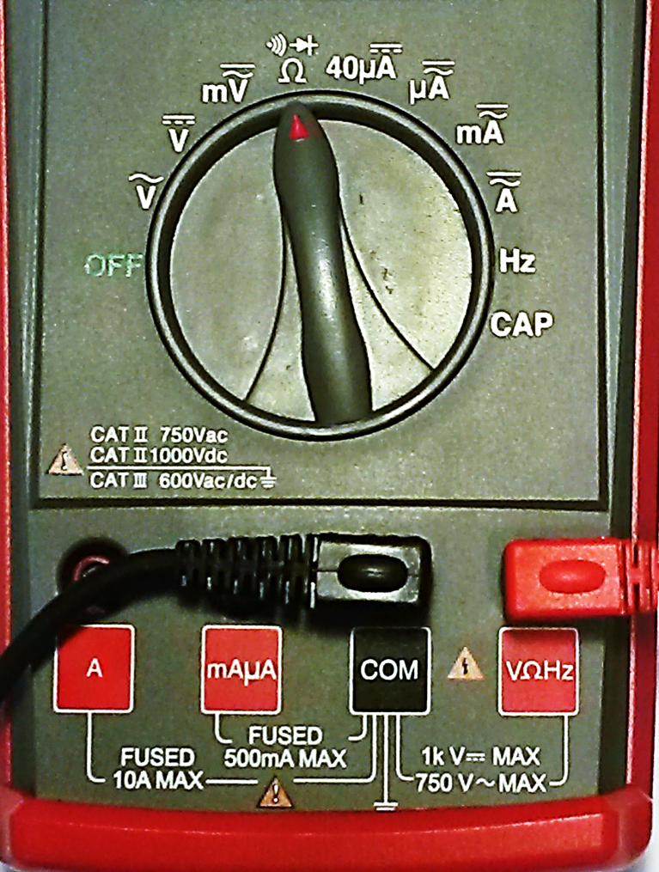
Digital Multimeter Safety and Set-up
Always Check for Good Test Leads Before Using a Meter
  Insert red lead into VΩHz terminal
  Insert black lead into COM terminal
  Rotate the Dial setting to Ω (Ohms)
4

Slide 5
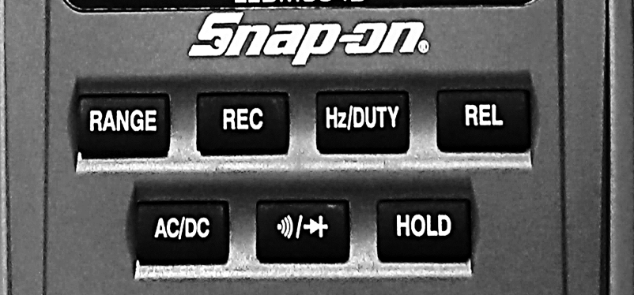

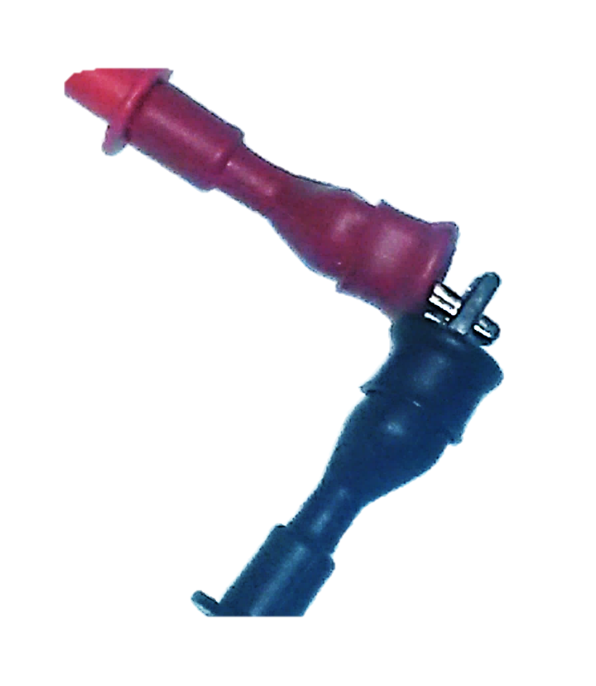
Digital Multimeter Safety and Set-up
Always Check for Good Test Leads Before Using a Meter
  Press the Continuity/Diode button once until the: is visible on the display
  Use the alligator clips. Clip red & black leads together
  Audible signal means leads should be good
  Move wires around – intermittent sound could mean internally broken wires

Slide 6
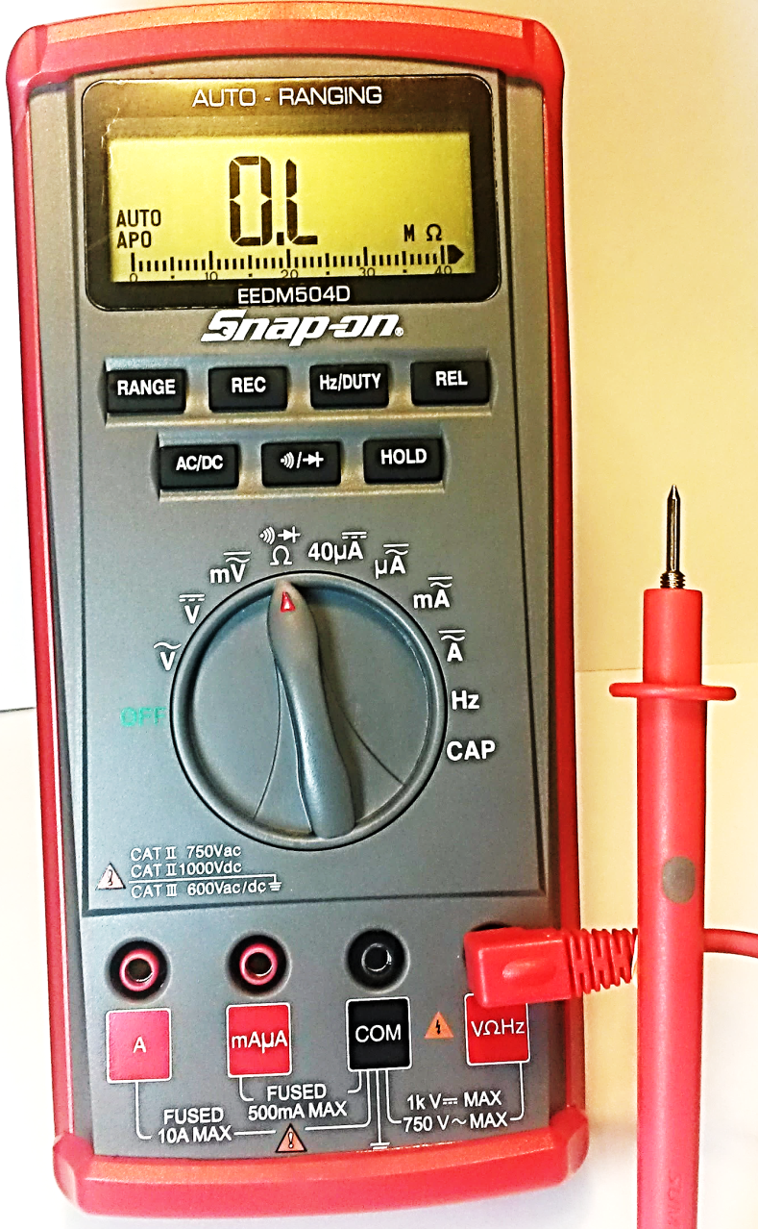
Digital Multimeter Safety and Set-up
Always Test for Good Fuses Before Using a Meter
  Put the red lead terminal into the VΩHz terminal – no black lead needed.
  Remove the red lead alligator clip
  Move the Rotary Dial to Ω (Ohms).
  Press the Continuity/Diode button until the meter will measure Ohms only
Notes:
Plastic tips are on the test lead tips. If not removed already do so here for step #4 by simply unscrewing the tip at the prod end

Slide 7
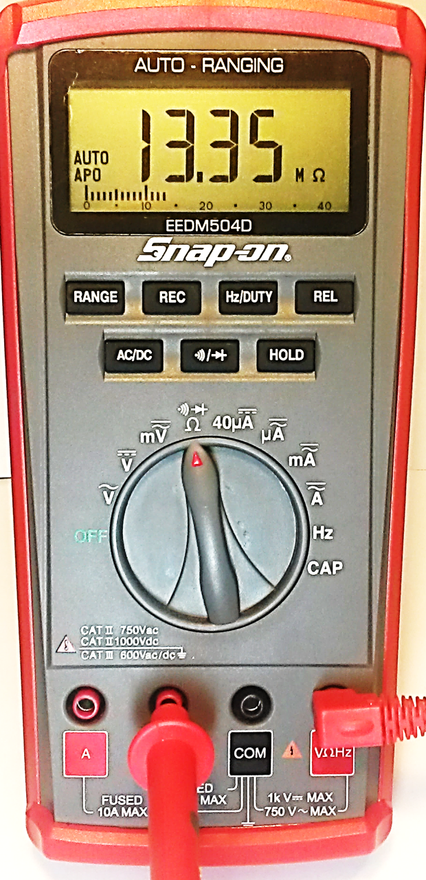
Digital Multimeter Safety and Set-up
Always Test for Good Fuses Before Using a Meter
  Touch the red probe to metal inside the terminal
    Any numeric value including 0.000 indicates a good fuse
    Any non-numeric value including OL indicates a bad fuse
mAµA
7
Notes:
Plastic tips are on the test lead tips. If not removed already do so here for step #4 by simply unscrewing the tip at the prod end

Slide 8
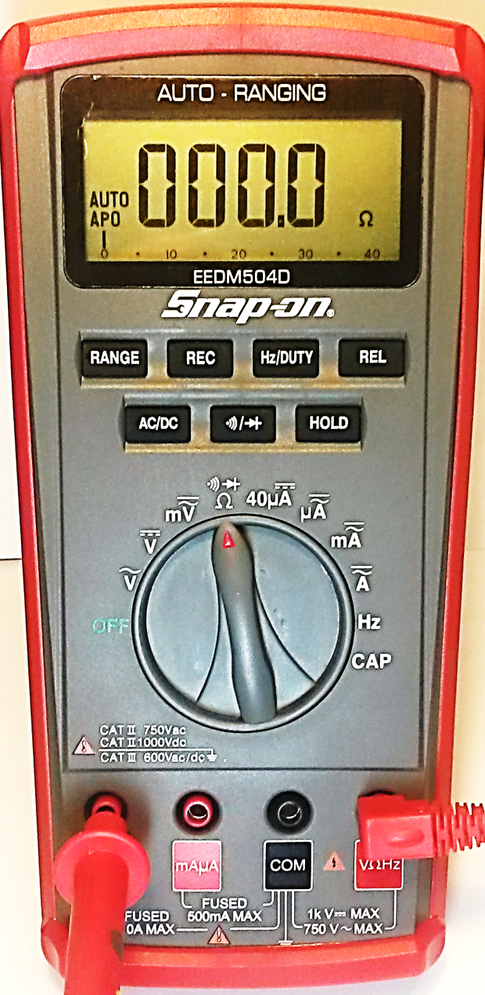
Digital Multimeter Safety and Set-up
Always Test for Good Fuses Before Using a Meter
  Touch the red probe to metal inside the terminal
    Any numeric value including 0.000 indicates a good fuse
    Any non-numeric value including OL indicates a bad fuse
A
8
Notes:
Plastic tips are on the test lead tips. If not removed already do so here for step #4 by simply unscrewing the tip at the prod end

Slide 9
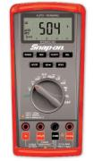
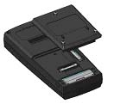
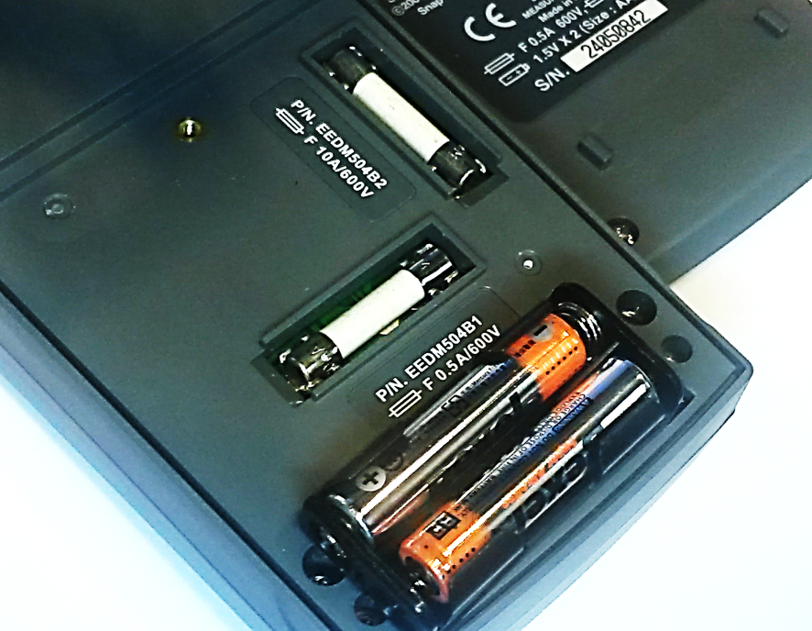
Digital Multimeter Safety and Set-up
If a Bad Fuse is Detected
  Remove the Protective Boot
  Turn the Meter with Back Facing Up
  Unscrew 3 Lower Screws
  Remove the Protective Cover
  Locate Bad Fuse
    10A
    0.5A
  Replace with original style fuses
  Reassemble in reverse order
  NOTE: Meter is powered by 2 –AAA batteries.
Notes:
Sulfur coated paper fuses should be used to reduce the chance of fire or damage to the meter.
Fuses are for the users protection. Bad fuses puts the user at risk.
Never substitute fuses with other materials as this could cause serious injury

Slide 10
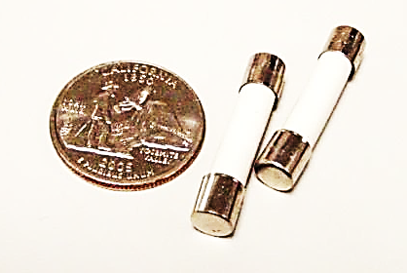
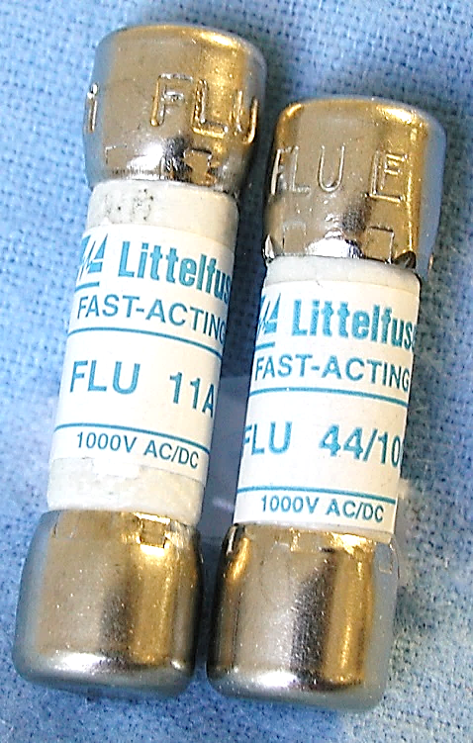
Digital Multimeter Safety and Set-up
Fuse Protection – There IS a Difference
  Fuses are designed specifically for multimeters
Prevent arcing at fuse holder
Exact replacements are critical to maintain the safety (category) rating
  Improper fuse replacement can be deadly
Lower CAT rating fuses
Higher CAT rating fuses

Slide 11

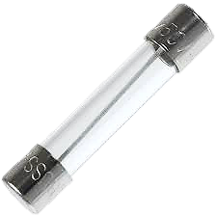
Digital Multimeter Safety and Set-up
Fuses: There IS a difference!!
Ceramic fast blow fuses have a much higher "breaking capacity” or the fuse’s ability to interrupt current flow without being destroyed or arced over
A glass fuse, subjected to a large energy spike, can be physically damaged and arc over can occur. If this happens the circuit remains connected by the electric arc over at the fuse holder, even though the fuse is open (blown). SERIOUS INJURY CAN RESULT
Notes:
Sulfur coated paper fuses should be used to reduce the chance of fire or damage to the meter.
Fuses are for the users protection. Bad fuses puts the user at risk.
Never substitute fuses with other materials as this could cause serious injury

Slide 12
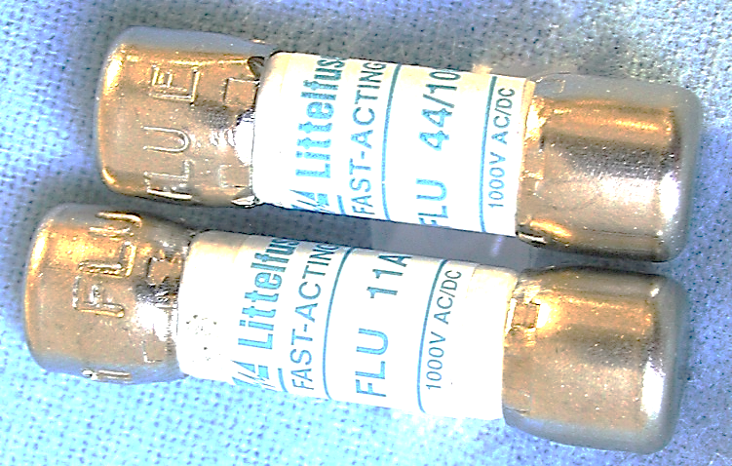
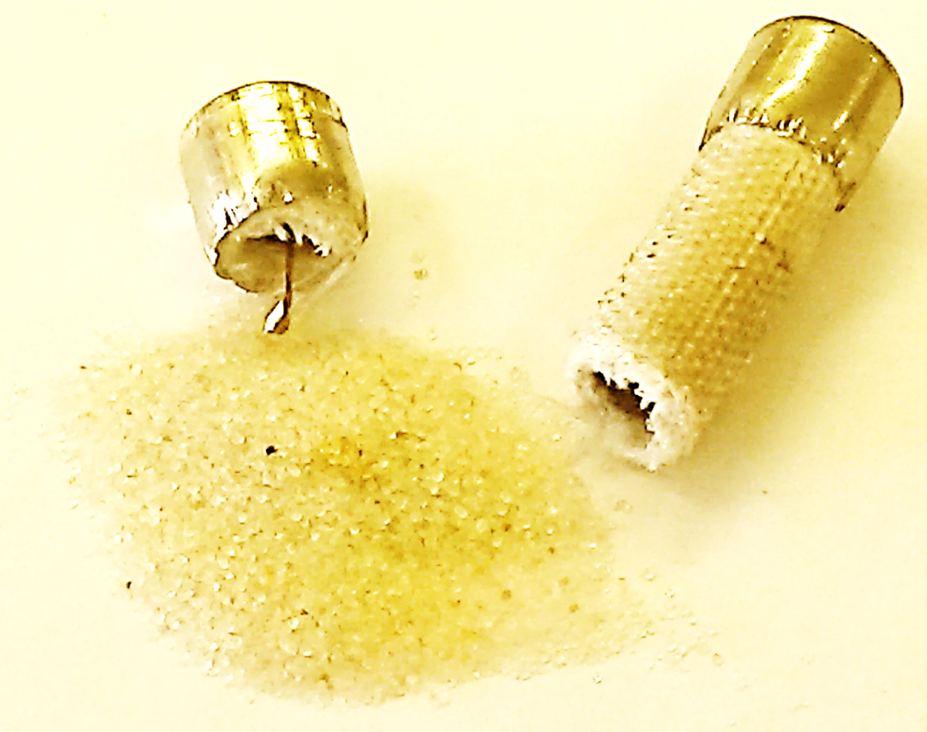
Digital Multimeter Safety and Set-up
Fuses: There IS a difference!!
Fuses used in higher Category meters are sometimes filled with a sand type material that will change to glass when exposed to high temperatures (overload situation) and this provides even more insulating protection
Notes:
Sulfur coated paper fuses should be used to reduce the chance of fire or damage to the meter.
Fuses are for the users protection. Bad fuses puts the user at risk.
Never substitute fuses with other materials as this could cause serious injury

Slide 13
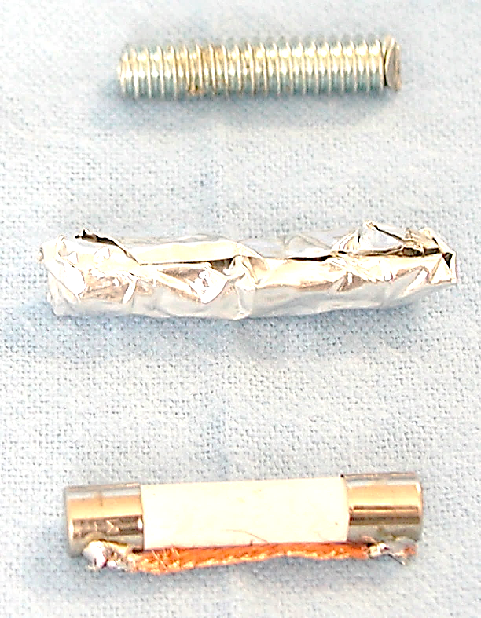
Digital Multimeter Safety and Set-up
Fuses: There IS a difference!!
    NOT TO BE USED AS FUSES
    Bolt
    Foil wrapped blown fuse
    Wire soldered across fuse
    Piece of copper tubing
    Larger amperage fuse
Notes:
Sulfur coated paper fuses should be used to reduce the chance of fire or damage to the meter.
Fuses are for the users protection. Bad fuses puts the user at risk.
Never substitute fuses with other materials as this could cause serious injury

Slide 14
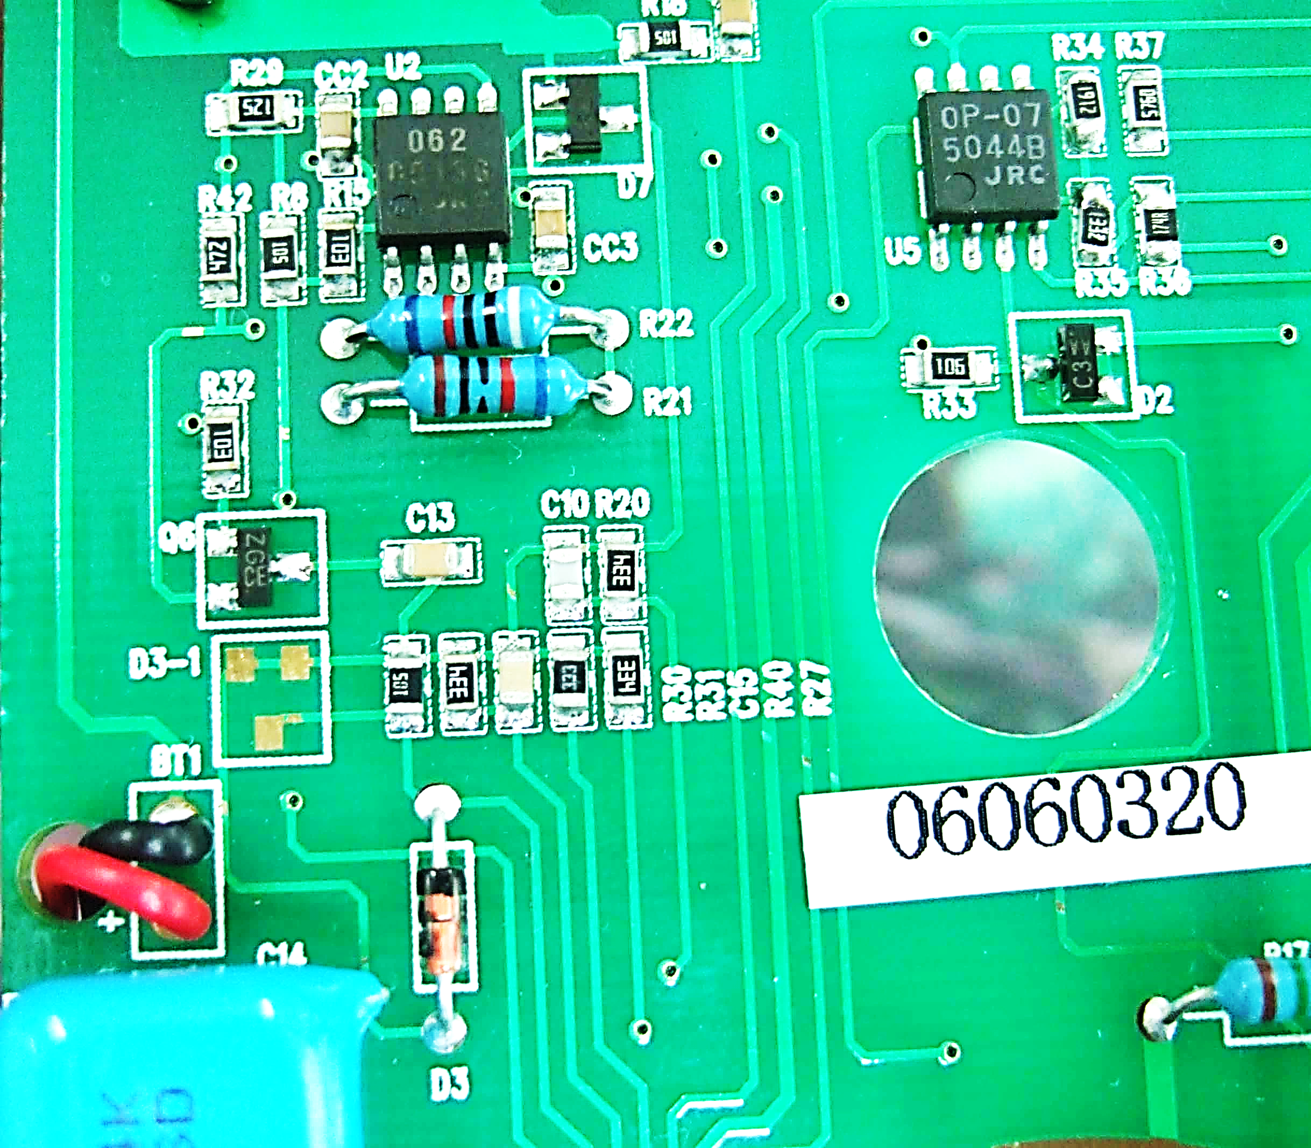
Digital Multimeter Safety and Set-up
Fuses: There IS a difference!!
The bypassing of a fuse is not only dangerous to the user, but can also damage the meter beyond repair (without a significant overload)
WITHOUT OVERLOADING: the circuit traces inside the meter can be a lot smaller than an improper fuse so the circuit trace pops first making the meter inoperable and non-repairable.
The Fuse should be the
weakest link / point
Circuit Traces on a printed
circuit board
Notes:
Sulfur coated paper fuses should be used to reduce the chance of fire or damage to the meter.
Fuses are for the users protection. Bad fuses puts the user at risk.
Never substitute fuses with other materials as this could cause serious injury

Slide 15

Digital Multimeter Safety and Set-up
Regardless of what electrical unit is being measured it is important to understand the 2 Range Options available and the advantages and disadvantages of each
  Auto Range
  Manual Range
Auto Ranging
Manual Ranging
15

Slide 16
Digital Multimeter Safety and Set-up
Auto Ranging
Auto Ranging Defaulted to “ON” at Start-up
Auto Ranging Advantages
Activated on start-up and if the Range button is pressed and held for 2-3 seconds
Moves decimal point automatically
Good for slow changing signals
AUTO Ranging
Auto Ranging Disadvantages
Could set the improper range
Over-ranging signals require adjustment
Fast changing signals could appear erratic as auto ranging keeps shifting the decimal point
display location - AUTO symbol

Slide 17

Digital Multimeter Safety and Set-up
Manual Range
Manual Ranging
Manual Range Advantages
RANGE activated on demand
moves decimal point on the display
stabilizes rapidly changing signals
can convert OL readings to readable values
Manual Range Disadvantages
operator must understand and determine proper range
Manual Range Activated via RANGE Button
Manual Ranging Button
Press until desired decimal value is reached
Notes:
Buttons toggle through the functions of the dial setting
* press the buttons as often as required to get back to the original setting
* cannot hurt the buttons or functions by pressing numerous times
* try pressing the RANGE button when the dial is on the milliVolts mV setting, watch the decimal point move
Use the RANGE function for rapidly changing signals or when you see and OL on the display to change to a range that captures the proper values. More on this later

Slide 18
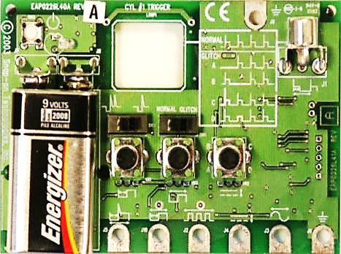
Digital Multimeter Safety and Set-up
Signal Generator (EESX306A) will be used extensively for tests done in the multimeter training
The next slides provide an introduction to the signal board we will be using
18

Slide 19
Signal Generator Introduction
Digital Multimeter Safety and Set-up
#7
5 Main Areas
  ON/OFF Button
    ON indicator light
  Battery Terminals
  Center Switches (2)
  Both to the LEFT
  Center Dials (3)
  Test Lead Terminal Posts (7)
Switches set to the left
A
B
C
#1
#2
#3
#4
#5
#6
19

Slide 20
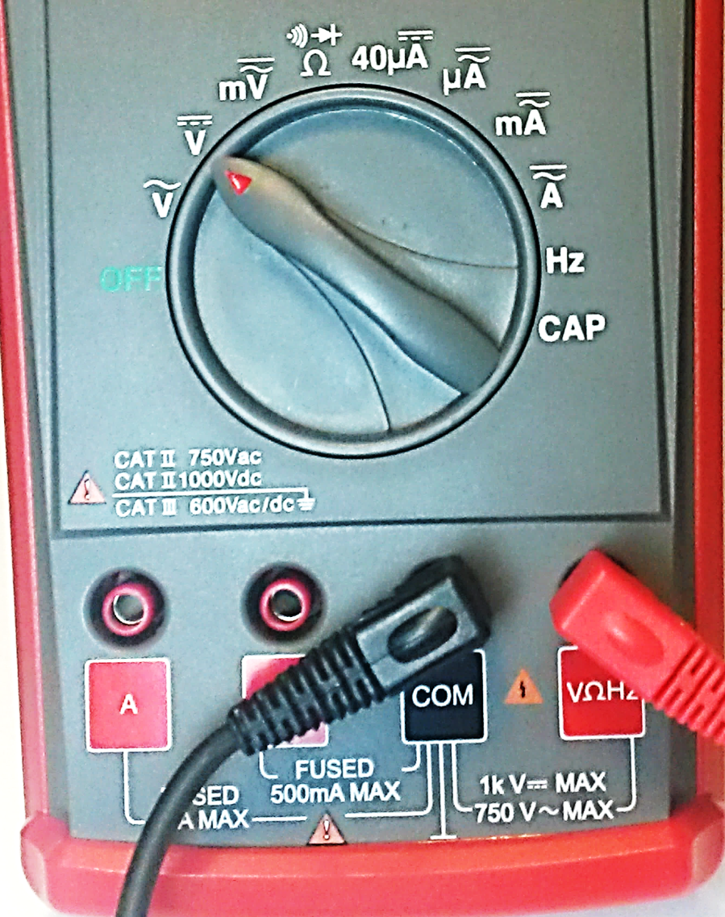
Digital Multimeter Safety and Set-up
Auto vs Manual Range
  Connect the red test lead to the VΩHz terminal
  Connect the black test lead to test lead to the COM terminal
  Move the Rotary Dial to DC Volts
© 2009 Snap-on Incorporated; All Rights Reserved
20
Notes:
The next slide illustrates the proper signal generator connections and test

Slide 21
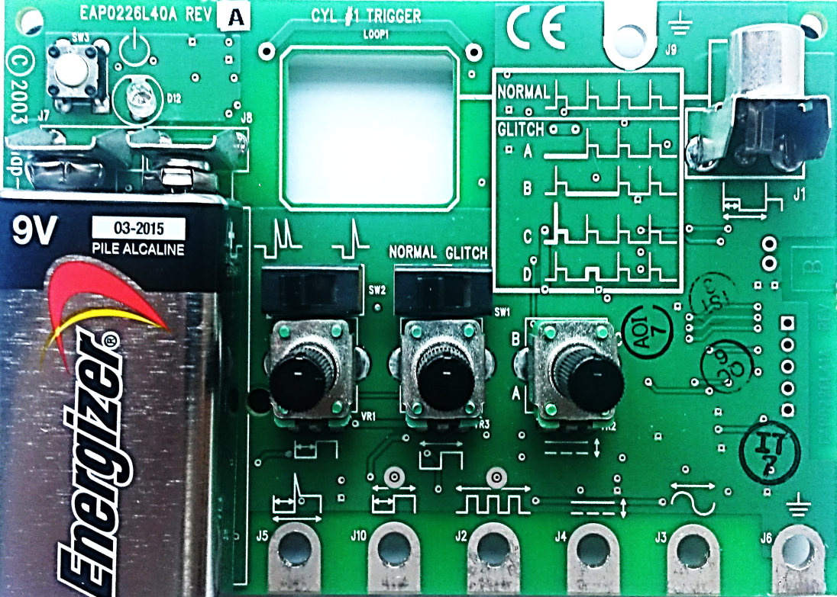
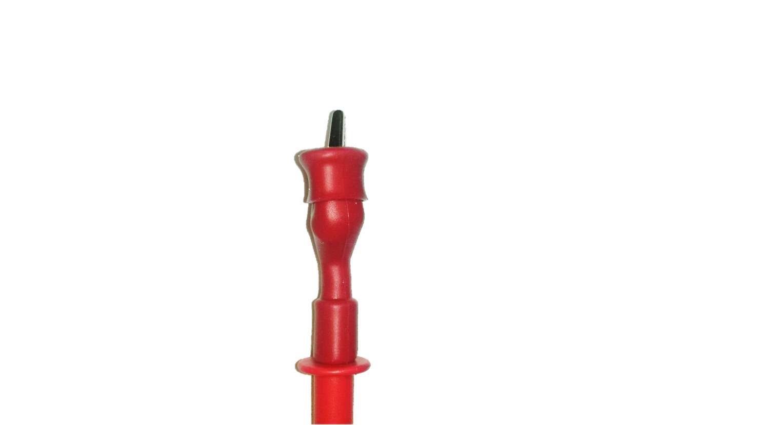
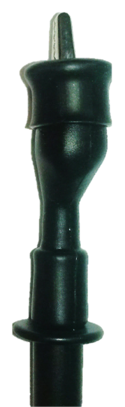
Digital Multimeter Safety and Set-up
Auto vs Manual Range
Connect the red test lead to test terminal #3 (DC voltage)
Connect the black test lead to test terminal #6 (ground)
Set ALL dials (A, B, & C) to the full left or counter clockwise position
Turn the simulator ON (press on/off button)
A
B
C
#6
#3

Slide 22



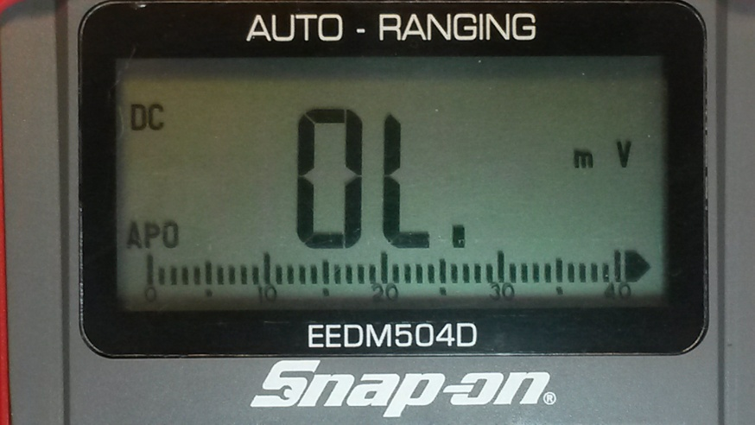
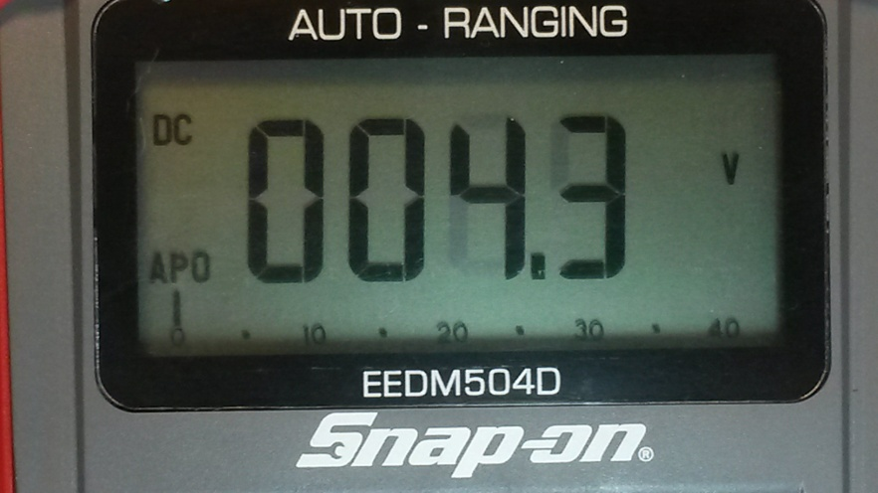
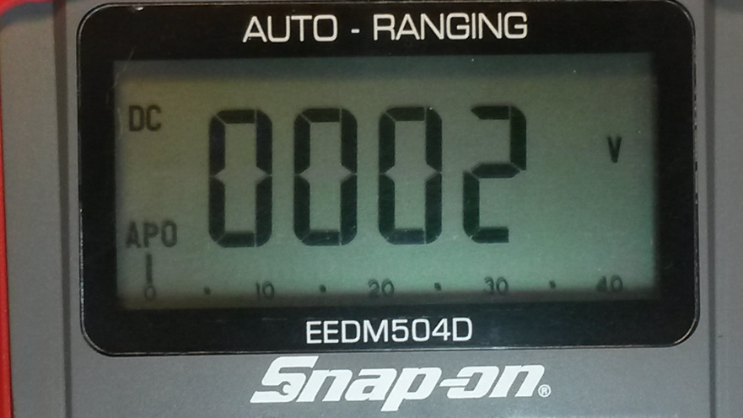
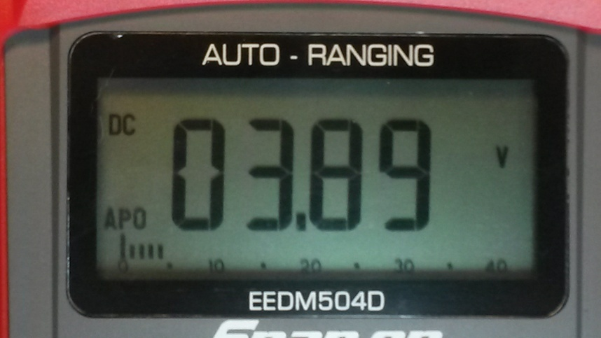
Digital Multimeter Safety and Set-up
Auto vs Manual Range
The signal will be erratic
Keep pressing the RANGE button
Note how the decimal point moves and the displayed units change
The decimal point keeps moving to a bigger unit of measure and helps to stabilize the reading
You will cycle
back to mV and
OL will appear
Press and hold
RANGE to return
to auto
A
B
C
#4
#6

Slide 23
Review for Understanding
What are two inspections that should be done to the test leads before using them?
What feature of the meter is used to verify the test leads have no intermittent faults?
For testing the fuses insert the red lead terminal into which meter terminal?
For testing the fuses which two terminals should be probed by the red test lead?
What values indicate a good fuse? What values indicate a bad fuse?
Notes:
Answers:
Visually inspect (look for nicks or the inner white insulation showing) AND use your fingers to feel for cracks or other worn parts of the test leads.
Continuity
VΩHz terminal or far right terminal
A and mAμA terminals or the two most left terminals
GOOD: Any numeric value including 0 BAD: OL or any non-numeric value

