Slide 1
Unit 4 - Digital Multimeter Voltage Testing
When you complete this unit, you will be able to:
  Identify the voltage testing settings on the rotary dial
  Explain the advantage of using the millivolt setting when possible
  Demonstrate how to switch between AC and DC voltage testing

Slide 2
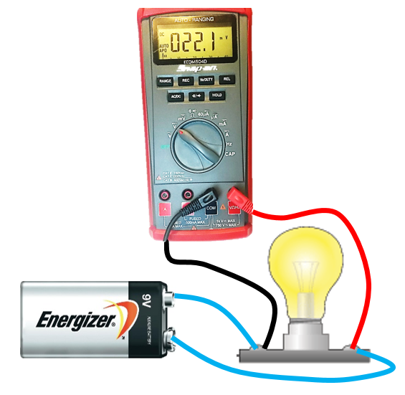
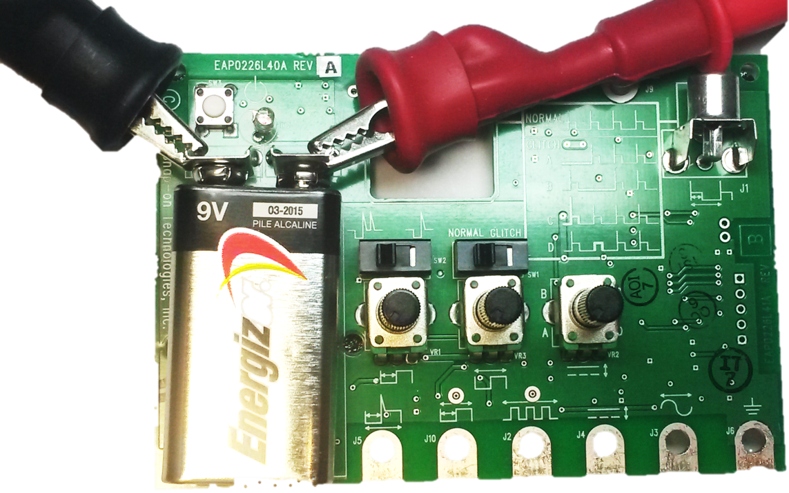
Digital Multimeter Voltage Testing
The meter MUST be connected in Parallel when preforming voltage tests
This requires a completed circuit which the meter can then be connected to as an additional branch circuit
This is why high impedance is important, so the circuit is minimally impacted

Slide 3
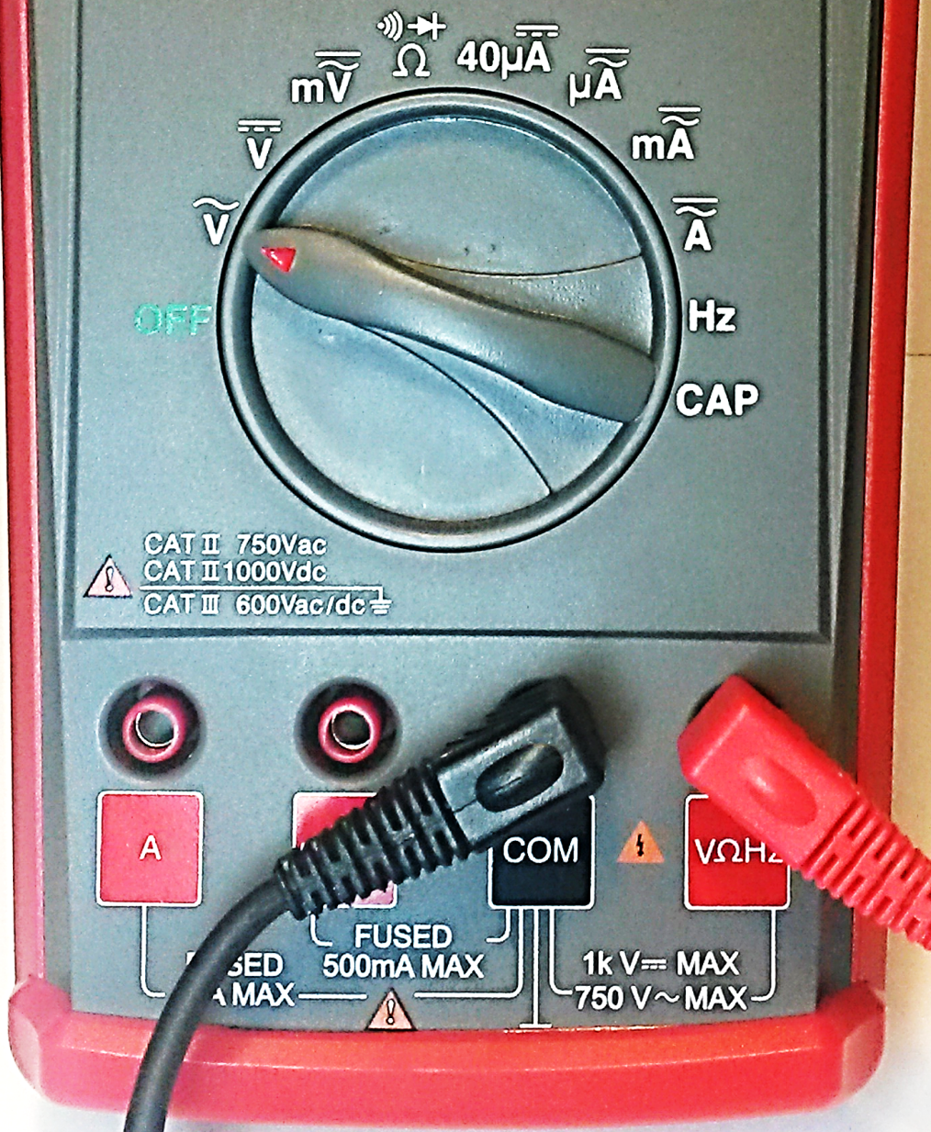
Digital Multimeter Voltage Testing
AC Voltage Testing
  Connect the red test lead to the VΩHz terminal
  Connect the black test lead to test lead to the COM terminal
  Move the Rotary Dial to AC Volts
3
Notes:
The next slide illustrates the proper signal generator connections and test

Slide 4
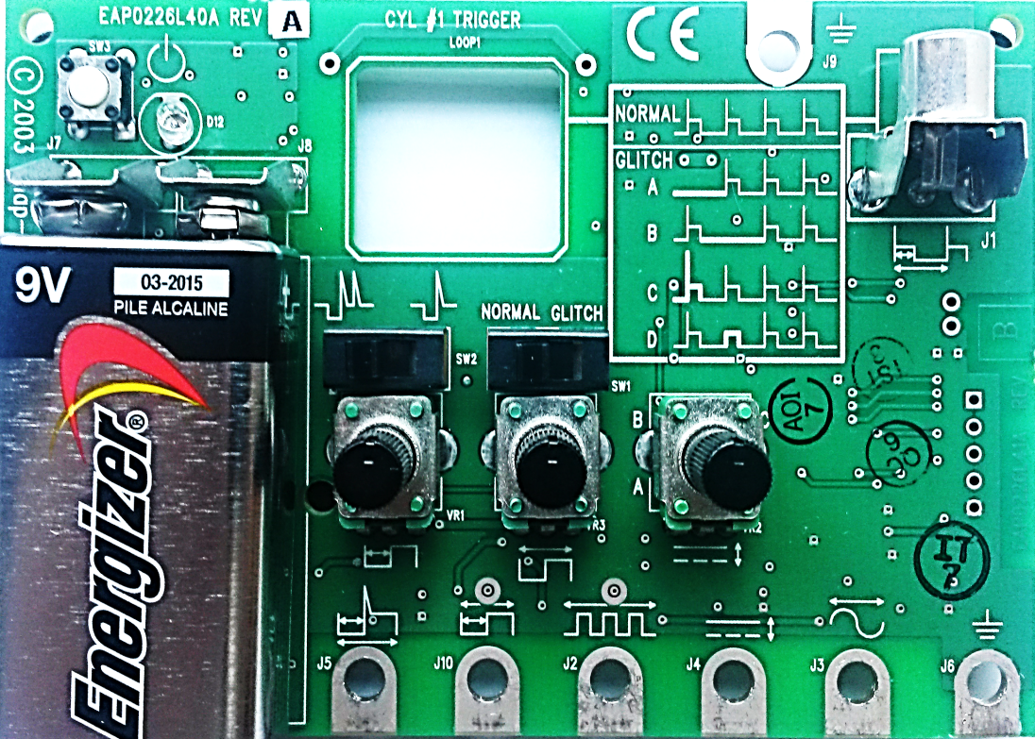
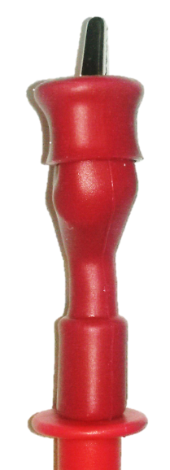

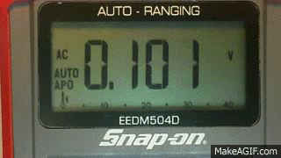
Digital Multimeter Voltage Testing
AC Voltage Testing
Connect the red test lead to test terminal #5 (AC sine wave)
Connect the black test lead to test terminal #6 (ground)
Turn the simulator ON (press on/off button)
Rotate the middle dial B
Watch the changing voltage values on both the digital display and analog bar
B
#5
#6
4
This completes the AC Volt Test

Slide 5
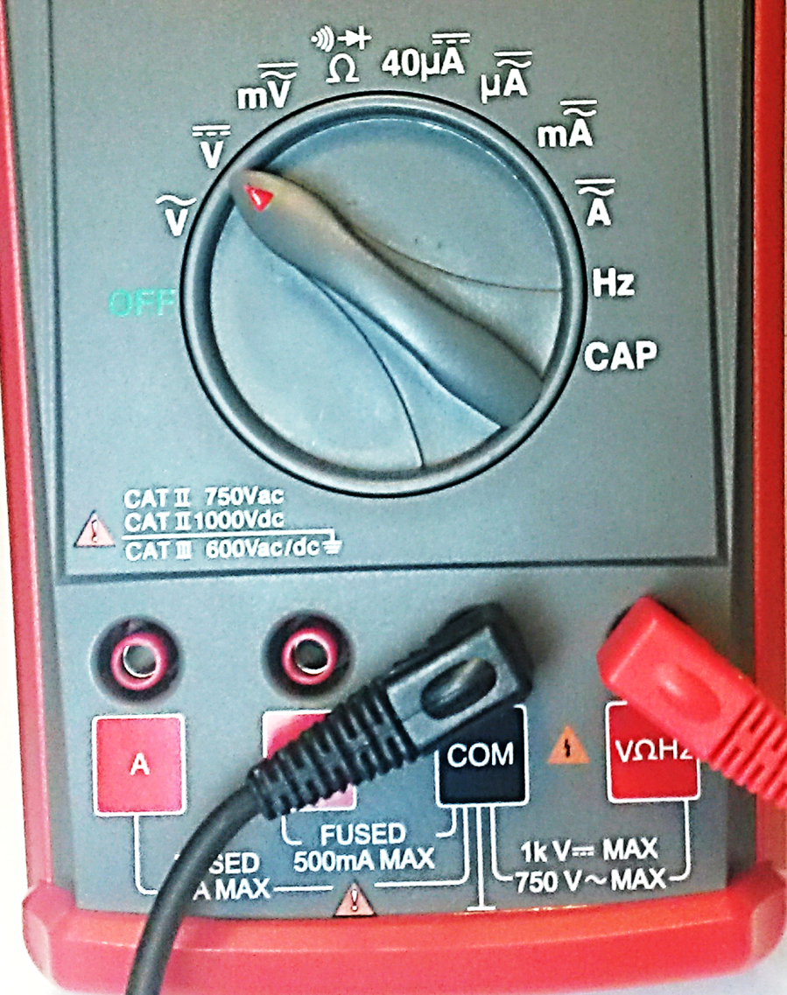
Digital Multimeter Voltage Testing
DC Voltage Testing
  Connect the red test lead to the VΩHz terminal
  Connect the black test lead to test lead to the COM terminal
  Move the Rotary Dial to DC Volts
5
Notes:
The next slide illustrates the proper signal generator connections and test

Slide 6
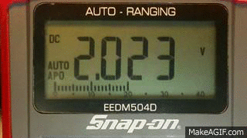
Digital Multimeter Voltage Testing
DC Voltage Testing
Connect the red test lead to test terminal #4 (DC voltage)
Connect the black test lead to test terminal #6 (ground)
Turn the simulator ON (press on/off button)
Rotate dial C
Watch the changing voltage values on both the digital display and analog bar
C
#4
#6
6
This completes the DC Volt Test

Slide 7
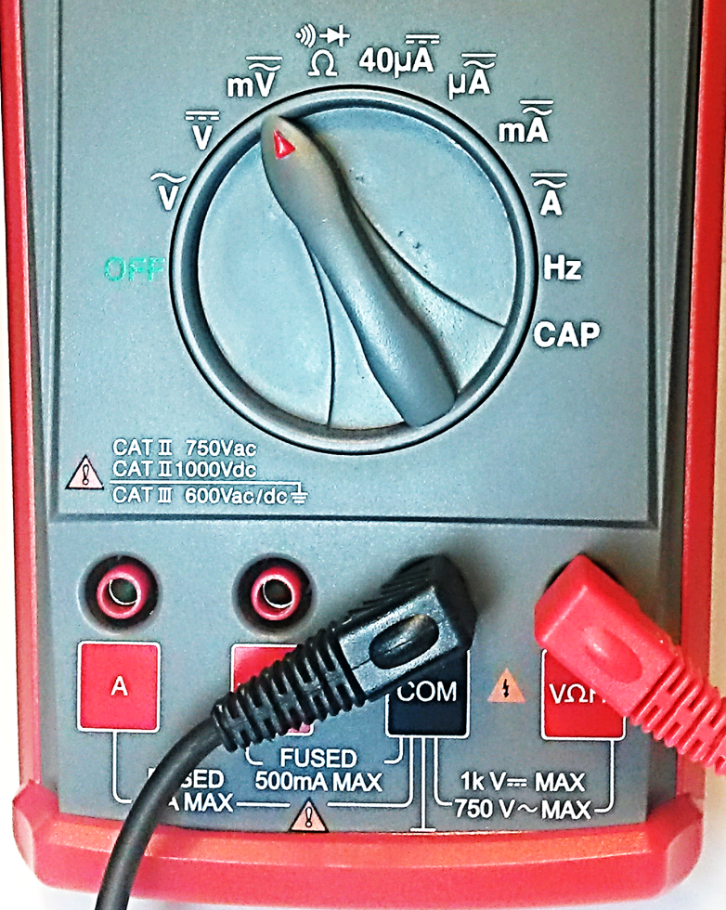

Digital Multimeter Voltage Testing
AC/DC millivolt Testing
  Connect the red test lead to the VΩHz terminal
  Connect the black test lead to test lead to the COM terminal
  Move the Rotary Dial to AC/DC millivolts
  Rotate dial C all the way to the left
C
7
Notes:
The next slide illustrates the proper signal generator connections and test

Slide 8
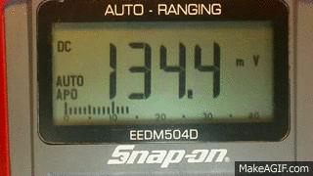
Digital Multimeter Voltage Testing
DC millivolt Testing
Connect the red test lead to test terminal #4 (DC voltage)
Connect the black test lead to test terminal #6 (ground)
Turn the simulator ON (press on/off button)
Slowly rotate dial C
Watch the changing voltage values on both the digital display and analog bar
C
#4
#6
This completes the DC millivolt Test
8

Slide 9
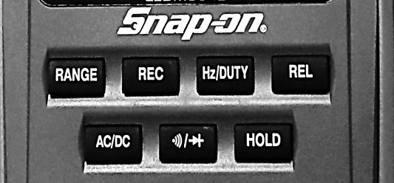
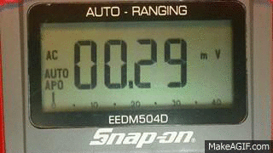
Digital Multimeter Voltage Testing
AC millivolt Testing
  Rotate dial B all the way to the left
  Connect the red test lead to test terminal #5 (AC voltage)
  Press the AC/DC button
  Slowly rotate dial B
  Watch the changing voltage values on both the digital display and analog bar
B
#5
#6
This completes the AC millivolt Test

Slide 10
Review for Understanding
When testing for DC Voltage which rotary dial setting is used?
When testing for AC Voltage which rotary dial setting is used?
Why would you use the millivolt (mV) setting?
How do you switch between testing AC millivolts and DC millivolts?
Notes:
Answers:
The second setting: Volts DC (V with a straight line and 3 dashed underneath)
The first setting: Volts CC (V~ with a wavy line ~)
If measuring a small voltage (millivolts) this setting will be more accurate than the standard voltage setting.
Press the AC/DC button

