Slide 1
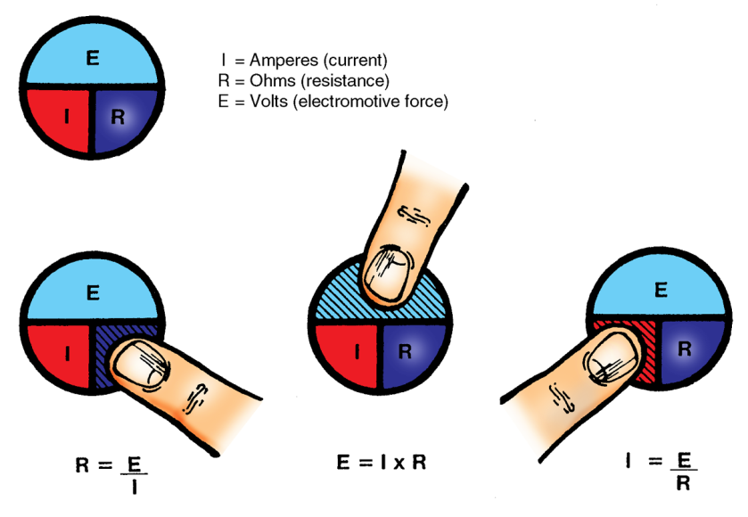
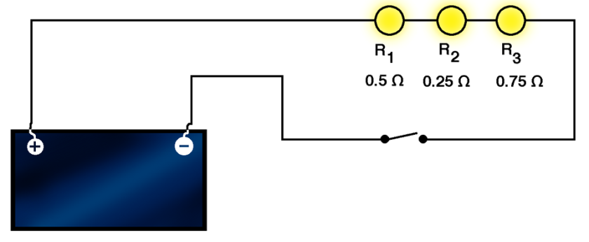
Electrical Measurements
and Ohm’s Law

Slide 2
The basics of electrical measurement
Voltage is electrical pressure, which is potential force or the difference in electrical charge between two points. Voltage pushes electrical currents though a wire but not through its insulation.
Voltage | Basic Unit | Units for Very Small Amounts |  | Units for Very Large Amounts
Symbol | V | µV | mV | kV | MV
Pronounced as | Volt | Microvolt | Millivolt | Kilovolt | Megavolt
Multiplier | 1 | 0.000001 | 0.001 | 1,000 | 1,000,000

Slide 3
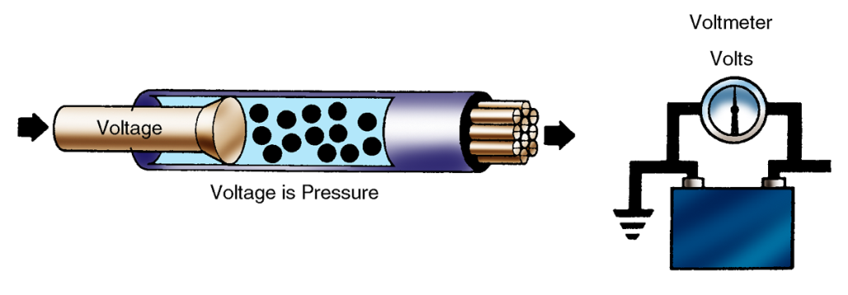
The basics of electrical measurement
Voltage is measured in volts. The volt is the unit of measurement for electron force. The volt is based upon the number of electrons that are pushed through a circuit’s resistance. A basic principle is that 1 volt equals the amount of electron force required to push 1 ampere through 1 ohm of resistance.
A voltmeter measures the difference in electrical pressure between two points. A voltmeter is used in parallel with the circuit.

Slide 4
The basics of electrical measurement
Current is the flow of electrons through a wire, which is pushed by voltage to overcome the resistance in a wire or conductor.
Current is measured in amperes, or amps.
Current | Basic Unit | Units for Very Small Amounts |  | Units for Very Large Amounts
Symbol | A | µA | mA | kA | MA
Pronounced as | Ampere, or Amp | Microampere | Milliampere | Kiloampere | Mega-ampere
Multiplier | 1 | 0.000001 | 0.001 | 1,000 | 1,000,000
An ammeter measures the amount of current flow in amps. The ammeter is inserted into the path of current flow. In the case of a series, it is inserted in a circuit.

Slide 5
The basics of electrical measurement
NOTE: Resistance is measured by the size of the wire or conductor.
The ampere is the unit of measurement for electrical current. Andre Ampere (1775-1836) discovered that 6.28 x 10¹⁸ electrons pass a given point in a circuit in 1 second. This unit is called 1 ampere-second of electrical flow.
As a measure of electron flow, the ampere involves both time and volume. If 12.56 x 10¹⁸ electrons, or twice the electrons of 1 ampere-second, move past a given point, then 2 ampere-seconds of current flow have occurred.

Slide 6
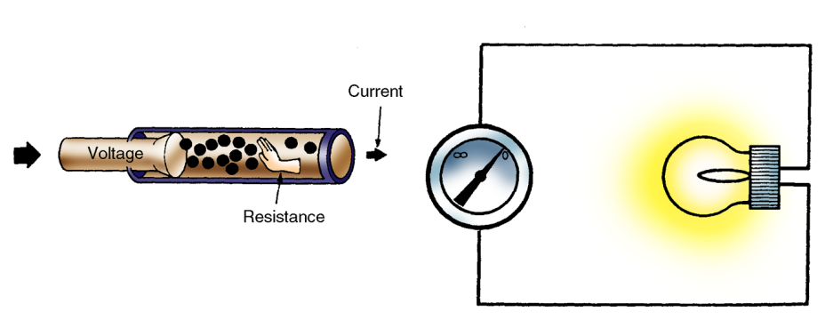
The basics of electrical measurement
The ohm is the unit of measurement for electron resistance in a circuit. Current flowing in a circuit must overcome resistance. A basic principle is 1 ohm equals the volume of 1 ampere forced by 1 volt of electron force. The greater a circuit’s resistance, the greater the force or voltage required to maintain electron flow.
Resistance | Basic Unit | Units for Very Small Amounts |  | Units for Very Large Amounts
Symbol | W | µW | mW | kW | MW
Pronounced as | Ohm | Micro-ohm | Milli-ohm | Kilo-ohm | Mega-ohm
Multiplier | 1 | 0.000001 | 0.001 | 1,000 | 1,000,000

Slide 7
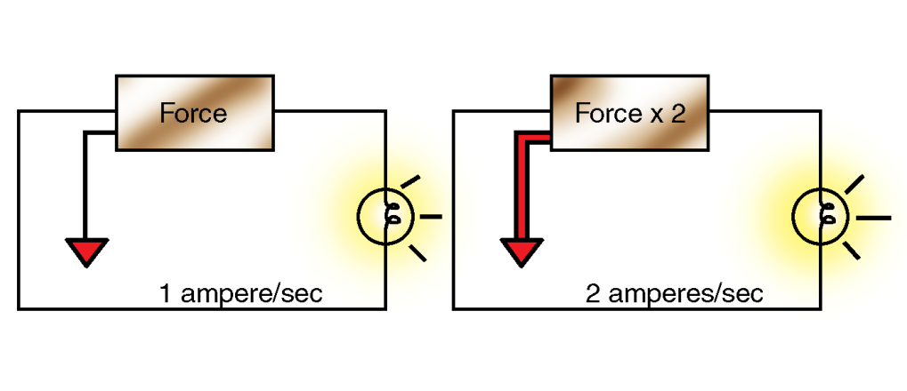
The basics of electrical measurement
The volume of electrons flowing in a circuit is determined by the amount of voltage applied against circuit resistance.
Assume that a circuit and load allow 1 ampere-second of electron flow at a given voltage. If the force in the circuit is doubled then 2 ampere-seconds are forced through the circuit.

Slide 8
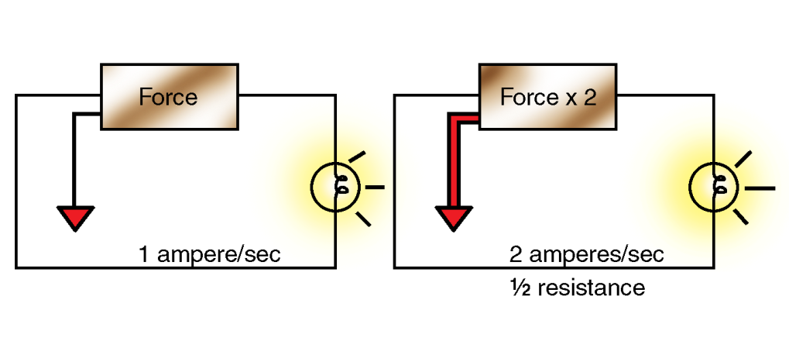
The basics of electrical measurement
Inversely, assume that a light bulb with half the resistance is placed in the same circuit. The results are the same with an equivalent voltage.
NOTE: The ampere indicates the number of electrons that flow through the circuit during a given length of time.

Slide 9
Ohm’s law
Ohm’s law refers to the relationship between volts, amperes, and ohms. Voltage equals the current in amperes multiplied by resistance in ohms. Technicians use Om’s law to predict how a circuit will behave during operation.

Slide 10
Ohm’s law
Amperes, volts, and ohms refer in some way to the volume of electron flow. These units of measurement are related mathematically by the following rules of electricity.
Volts are directly related to amperes. If volts are increased, amperes increase. If volts are decreased, amperes decrease.
NOTE: The number of amperes produced is dependent upon the amount of force pushing them. A change in the amount of force pushing the amperes produces a change in the rate of electron flow.
Ohms are inversely related to amperes. If ohms increase, amperes decrease. If ohms decrease, amperes increase.
NOTE: An increase in resistance means the number of electrons forced through the circuit is reduced. Conversely, if resistance is reduced, a greater number of electrons is allowed through the circuit.

Slide 11
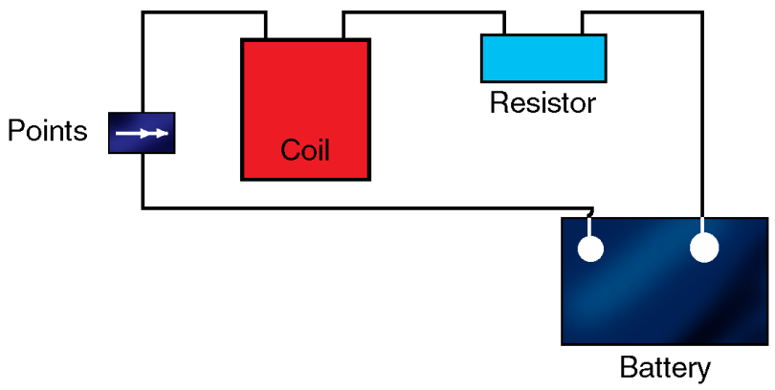
Circuit arrangements
Components in an electrical circuit can be placed in an almost limitless number of arrangements, both simple and complex. The electrical circuit is limited to three configurations: series, parallel, or series-parallel.
In a series circuit, electrical components are connected end to end, providing only one path for current.
Each component receives electrical current from the component before it.
Resistance is determined by totaling the resistance of each load.

Slide 12
Circuit arrangements
Ohm’s law is used to find the total current of a circuit in which the resistance of each load device is known.
Ohm’s law determines resistance.
R1 + R2 + R3 = Rt Ohms
Example:
.5 + .25 + .75 = 1.5 Ohms

Slide 13
Circuit arrangements
Ohm’s law determines current flow.
Example:
If any component in the series circuit fails and interrupts current flow, all components in the circuit are denied current.

Slide 14
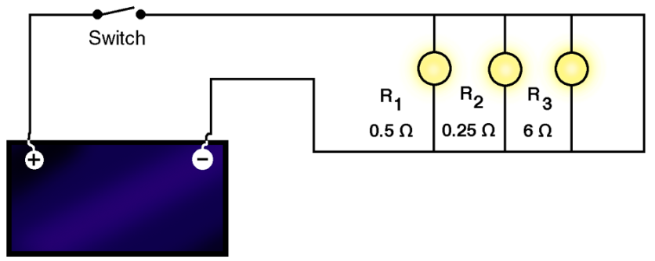
Circuit arrangements
In a parallel circuit, all positive and negative component connections are hooked to a common point.
Each component operates independently and each has equal access to current.
The failure of one component does not affect other components.

Slide 15
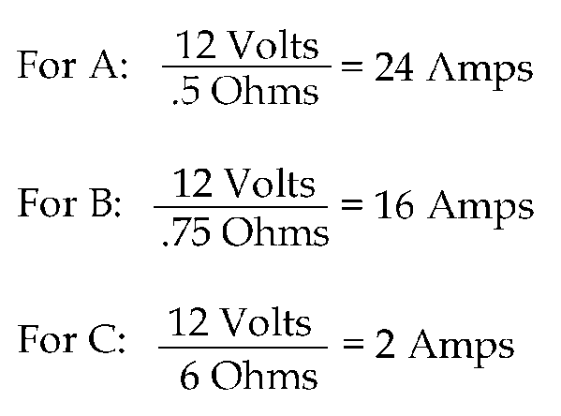
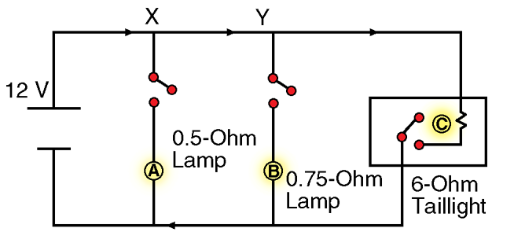
Circuit arrangements
Example: Assuming switches are closed, Ohm’s law (I=E/R) determines current in each component.
To find current in the line at X, remember that all electrons pass point X. So, current at X is
24 + 16 +2 = 42 Amps
Total current is the sum of individual currents.

Slide 16
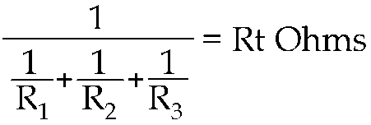
Circuit arrangements
Ohm’s law is used to find total current in a circuit where resistance of each load device is known.
Ohm’s law determines resistance.
Example:
Ohm’s law determines current flow.
Example:

Slide 17
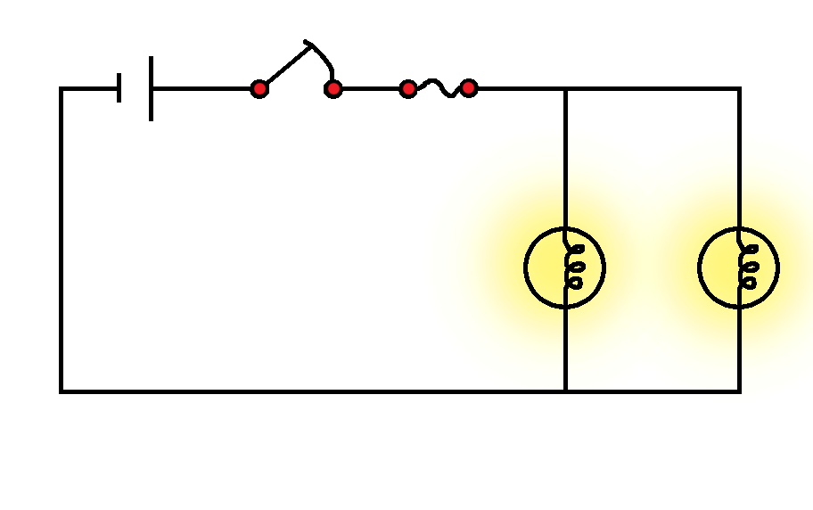
Circuit arrangements
In a series-parallel circuit, some components are arranged in series and others in parallel. Each component functions according to its position in the circuit.

Slide 18
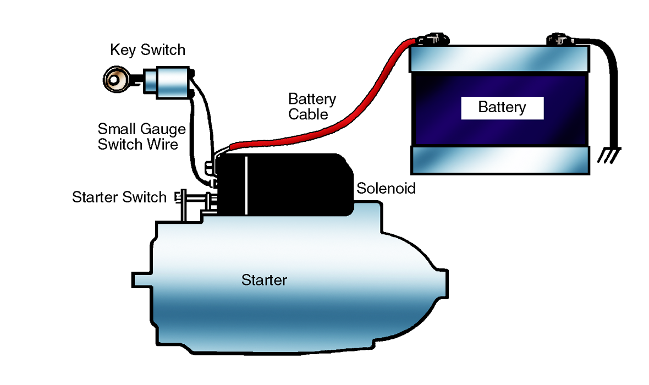
Circuit arrangements
A vehicle uses all three electrical circuit configurations.
The starter circuit is a series circuit. The major components are the mechanical relay and the starter motor.

Slide 19
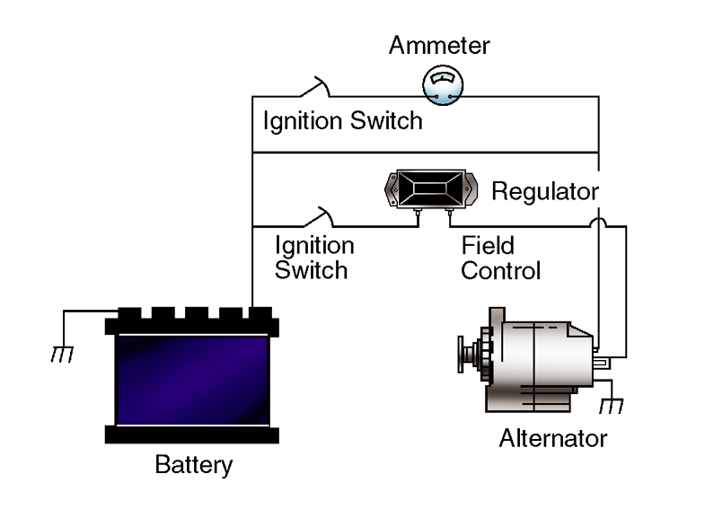
Circuit arrangements
The charging circuit is a parallel circuit. The voltage regulator is wired parallel with the alternator’s field circuit.

Slide 20
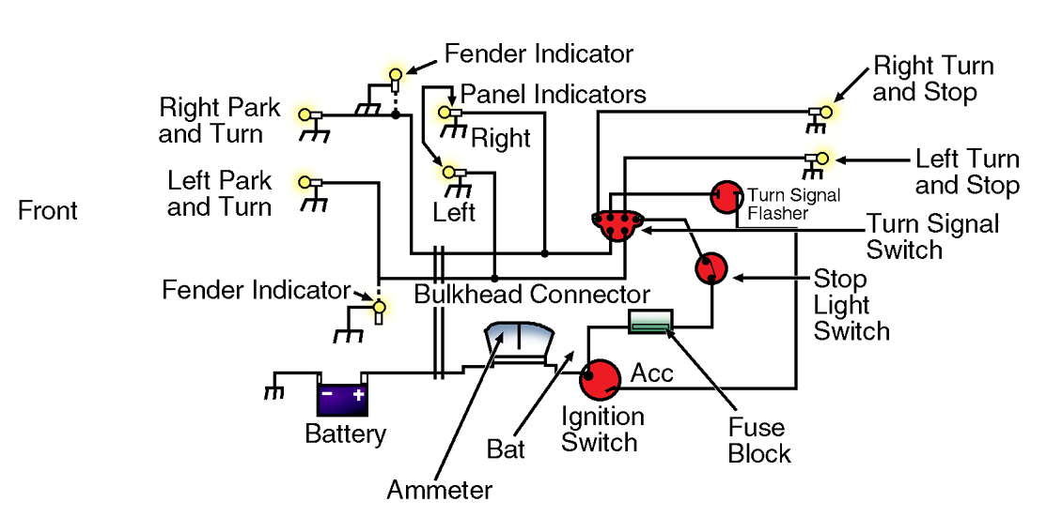
Circuit arrangements
The headlight circuit is a series-parallel circuit. The headlight switch is hooked in series to the headlights, which are hooked in parallel.

Slide 21
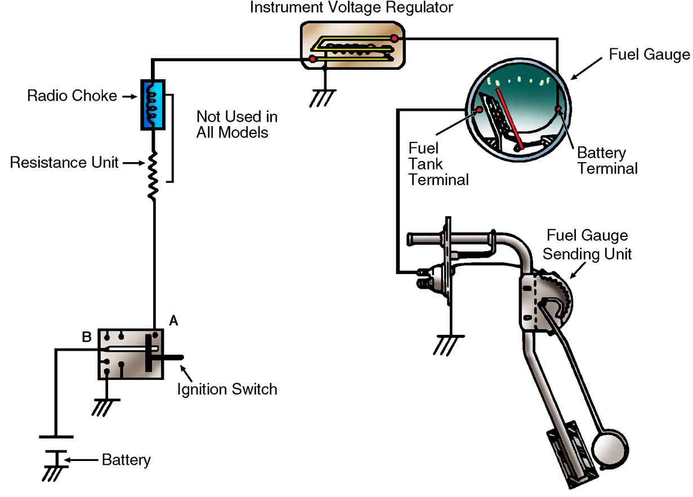
Circuit arrangements
Accessory circuits are stand-alone series circuits. An accessory circuit is usually parallel to other accessory circuits.

