Slide 1
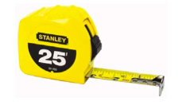
Reading a Tape Measure

Slide 2
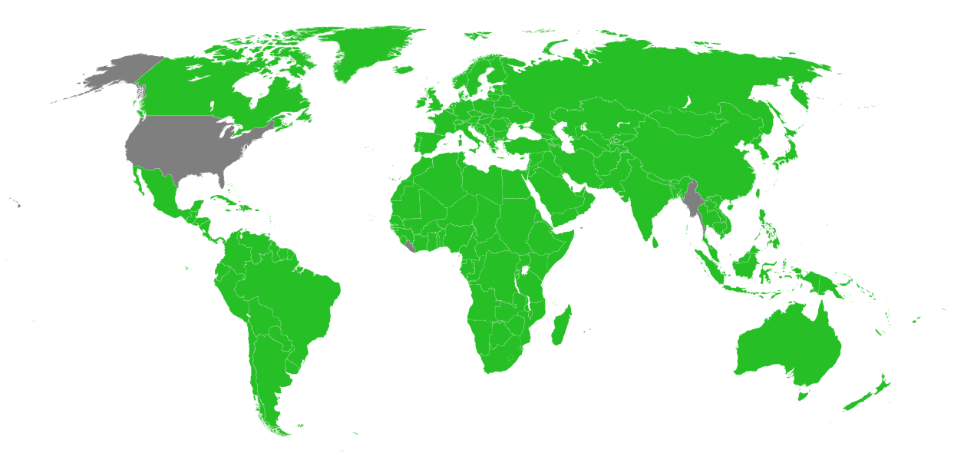
Countries that have not officially adopted the metric system Myanmar, Liberia and the United States

Slide 3
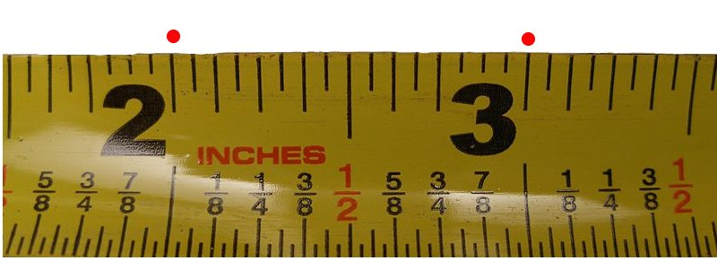
How to Read a Measuring Tape
__ (Symbol of Inches is: “)
Inches are the long lines that cross either half of, or all of the 1" width of the tape. They usually are preceded or followed by numbers.

Slide 4
The Arrows Below Represent 1”, 2”,3”, and 4” Marks

Slide 5
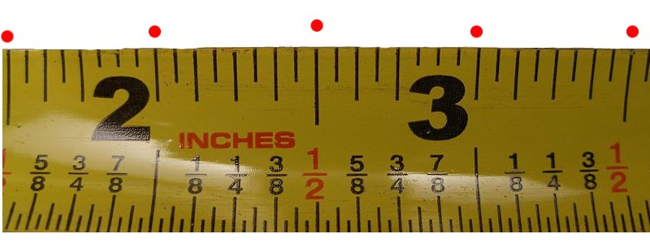
How to Read a Measuring Tape
A 1/2 (half) inch is exactly what it sounds like: Half of 1 inch.

Slide 6
The Arrows Below Represent 1/2”,11/2”, 21/2”, and 31/2” Marks

Slide 7
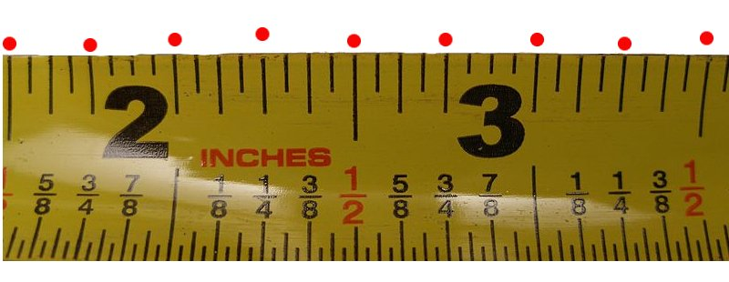
How to Read a Measuring Tape
1/4 of an inch is every four marks on your tape measure.

Slide 8
The Arrows Below Represent 1/4”,11/4”, 23/4”, and 33/4” Marks

Slide 9
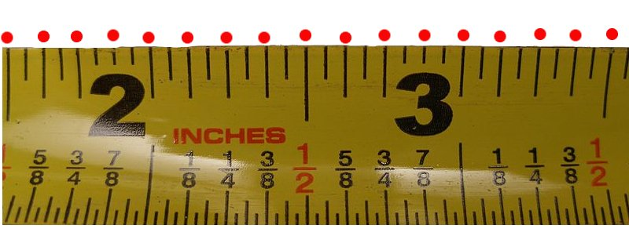
How to Read a Measuring Tape
An 1/8 of an inch is twice as big as the 1/16 of an inch. It is every other mark.

Slide 10
The Arrows Below Represent 7/8”, 11/8”, 23/8”, 35/8” Marks

Slide 11
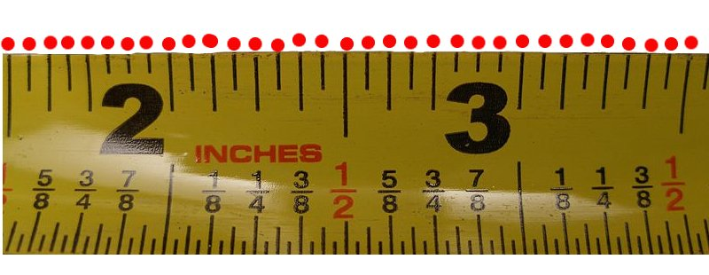
How to Read a Measuring Tape
16ths
Understand what a 1/16th is. A 1/16 of an inch, is usually the smallest measurement on a tape measure. The distance between every line on the tape measure is 1/16 of an inch.
The distance between each measurement that has a red dot above it.

Slide 12
Accuracy
The tip of the tape is riveted in place and slides slightly; the length of the slide is the same as the thickness of the tip, to allow the user to make accurate measurements. With a sliding tip you get the same measurement hooking the end of the tape over a piece of lumber or butting the tip into a corner.

Slide 13
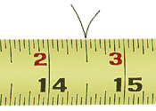
Marking Center
Making accurate marks is as important as taking accurate readings. To ensure that your markings are correct, make a "V" on the material being marked. Draw the "V" so its point is centered where you want the mark.

Slide 14
Marking for a Cut
When cutting a board mark exactly the length the board needs to be cut.
Then mark an X on the waste piece of the board
Then cut to the outside of the line on the waste side of the board
Keep
Cut
Waste
X
14

