Slide 1
Careers in the
Automotive Field

Slide 2
Opportunities in the automotive field
• According to statistics from the U.S. Department of Labor, over 800,000 people in the United States are employed as automotive service technicians and mechanics.
Most are employed in the following businesses:
Automotive repair and maintenance shops
Automotive dealers
• Retailers and wholesalers of automotive parts, accessories, and supplies
Others work in the following businesses or organizations:
Gas stations
Home and automotive supply stores
Automotive equipment rental and leasing companies
Federal, state, and local governments

Slide 3
Opportunities in the automotive field
Over 16% own their own their own business.
Many job opportunities are available that relate directly and indirectly to the automotive technology field.

Slide 4
Opportunities in the automotive field
Opportunities directly related to automotive technology
Automotive technician
Automotive technician’s apprentice
Repair shop supervisor
Exhaust and emissions technician
Tune-up technician
Service writer
Mechanical unit repairer
Technician in automotive manufacturing plants
Air conditioning technician
Engine technician
Teacher or trainer
NOTE: Many graduates of automotive technology programs qualify to pursue a career as a teacher or trainer with little or no extra training required for an entry-level position.

Slide 5
Opportunities in the automotive field
• Diesel technician
• Bus inspector
• Tractor technician
• Parts salvager
Opportunities indirectly related to automotive technology
• Farm equipment supervisor
• Aircraft technician
• Office equipment service technician/ service representative
• Machinist apprentice
• Air conditioning and heating service apprentice
• Industrial machine maintenance technician
• Small engine technician
• Marine equipment technician
• Motorcycle technician

Slide 6
Training and certification
• Repairing and maintaining today’s sophisticated vehicles requires knowledge in many diverse systems and technologically advanced areas.
The days of getting a job based on performing automotive repair as a hobby or tinkering in the garage are gone.
Most job opportunities require formal training in automotive technology in high school or a postsecondary school or college.
• Certifying organizations
As stated on their Web site, the National Institute for Automotive Service Excellence (ASE) is a nonprofit organization that aims to “improve the quality of vehicle repair and service through the testing and certification of repair and service professionals.”

Slide 7
Training and certification
• Automotive technicians can be certified in one or more of the eight areas below.
Brakes
Electrical/ electrical systems
Engine performance
Suspension and steering
Automatic transmission and transaxle
Engine repair
Heating and air conditioning
Manual drive train and axles

Slide 8
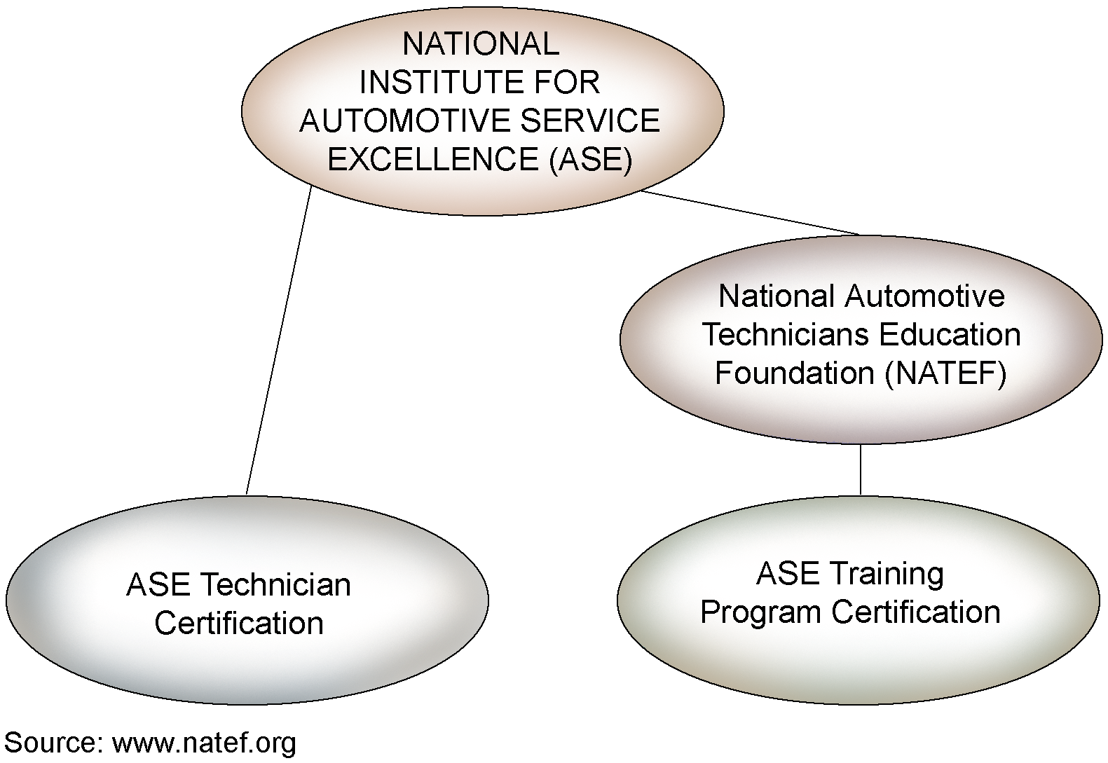
Training and certification
• To be certified, technicians must have at least 2 years of experience and pass an ASE written examination. They must retake the exam every 5 years to maintain their certification.

Slide 9
Training and certification
• Training programs request the review process on a voluntary basis. If a program passes the review, NATEF recommends it to ASE for certification. Programs must be reviewed again every 5 years to be recertified.
• In ASE’s automobile specialty, training programs can be certified in the eight areas previously listed.
• To stay current with changes and advancements in the field, automotive technicians will need to attend training classes throughout their careers. Technicians may receive training at their workplace or may need to attend classes at a technical school or college.

Slide 10
Job prospects in the automotive technology field
Prospects are very good for individuals with training and skills in diagnosis, problem solving, electronics, and mathematics. Knowledge in electronics has become crucial because most vehicle concerns involve working with or analyzing the electrical system. According to the Alliance of Automobile Manufacturers, “electronics now control more than 86% of all systems in a typical vehicle.”
• Many employers in the industry have reported that there is a shortage of automotive technicians and they have difficulty hiring individuals with education and experience in the areas desired.
• According to the Occupational Outlook Handbook, published by the U.S. Department of Labor, job opportunities for automotive technicians are expected to increase 9% to 17% through the year 2014. The growth will be due to the increased number of vehicles on the road and the loss of technicians because of retirement or advancement to specialized positions.

Slide 11
Job prospects in the automotive technology field
• Work for automotive technicians is generally steady throughout the year and not very sensitive to changes in economic conditions. Therefore, layoffs are not a big concern.

Slide 12
Common methods used to pay automotive technicians
• Hourly–The technician is paid for the time he or she puts in.
• Salary–A salary is a set amount of money, usually 40 hours per week, regardless of the volume of work performed.
• Flat rate–The technician is paid his or her hourly wage multiplied by the time listed for a specific job in a factory flat-rate manual or an aftermarket labor time guide. These guides are sometimes called parts and labor estimating guides. Technicians refer to these as “book hours.” The technician is paid this flat rate regardless of the time spent on a job.
Hourly plus a percentage of labor and parts

Slide 13
Other facts about working as an automotive technician
• Automotive technician’s use many different tools and equipment, including those in the following list. Technicians usually purchase their own hand tools, whereas the shop provides the more expensive power tools and equipment.
Common hand tools
Power tools
Machine tools
Welding and oxyfuel cutting equipment
Lifts and Jacks
Computers to perform administrative tasks and access service information
Computerized diagnostic equipment
Measuring tools
Test instruments
Other specialty tools, depending on the automotive technology area

Slide 14
Other facts about working as an automotive technician
Some shops are unionized, which means that technicians employed there are subject to union rules regarding pay and other issues. For example, the technician may be required to work for 2 years as an apprentice before advancing to the journey level. The union also functions to help employees negotiate with their employers regarding salaries and working conditions.

