Slide 1
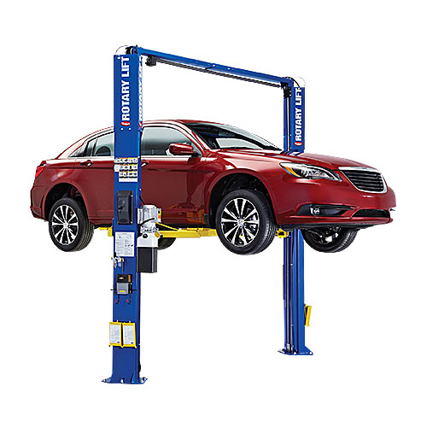
Raising and Supporting Vehicles Safely

Slide 2
Common lifting devices
In order to inspect or repair a vehicle, it is frequently necessary to get the vehicle off the ground to provide access to the underside.
A wide variety of equipment is available for lifting vehicles, such as lifts and hydraulic floor jacks. Most equipment is hydraulic, but there are also pneumatic lifts.

Slide 3
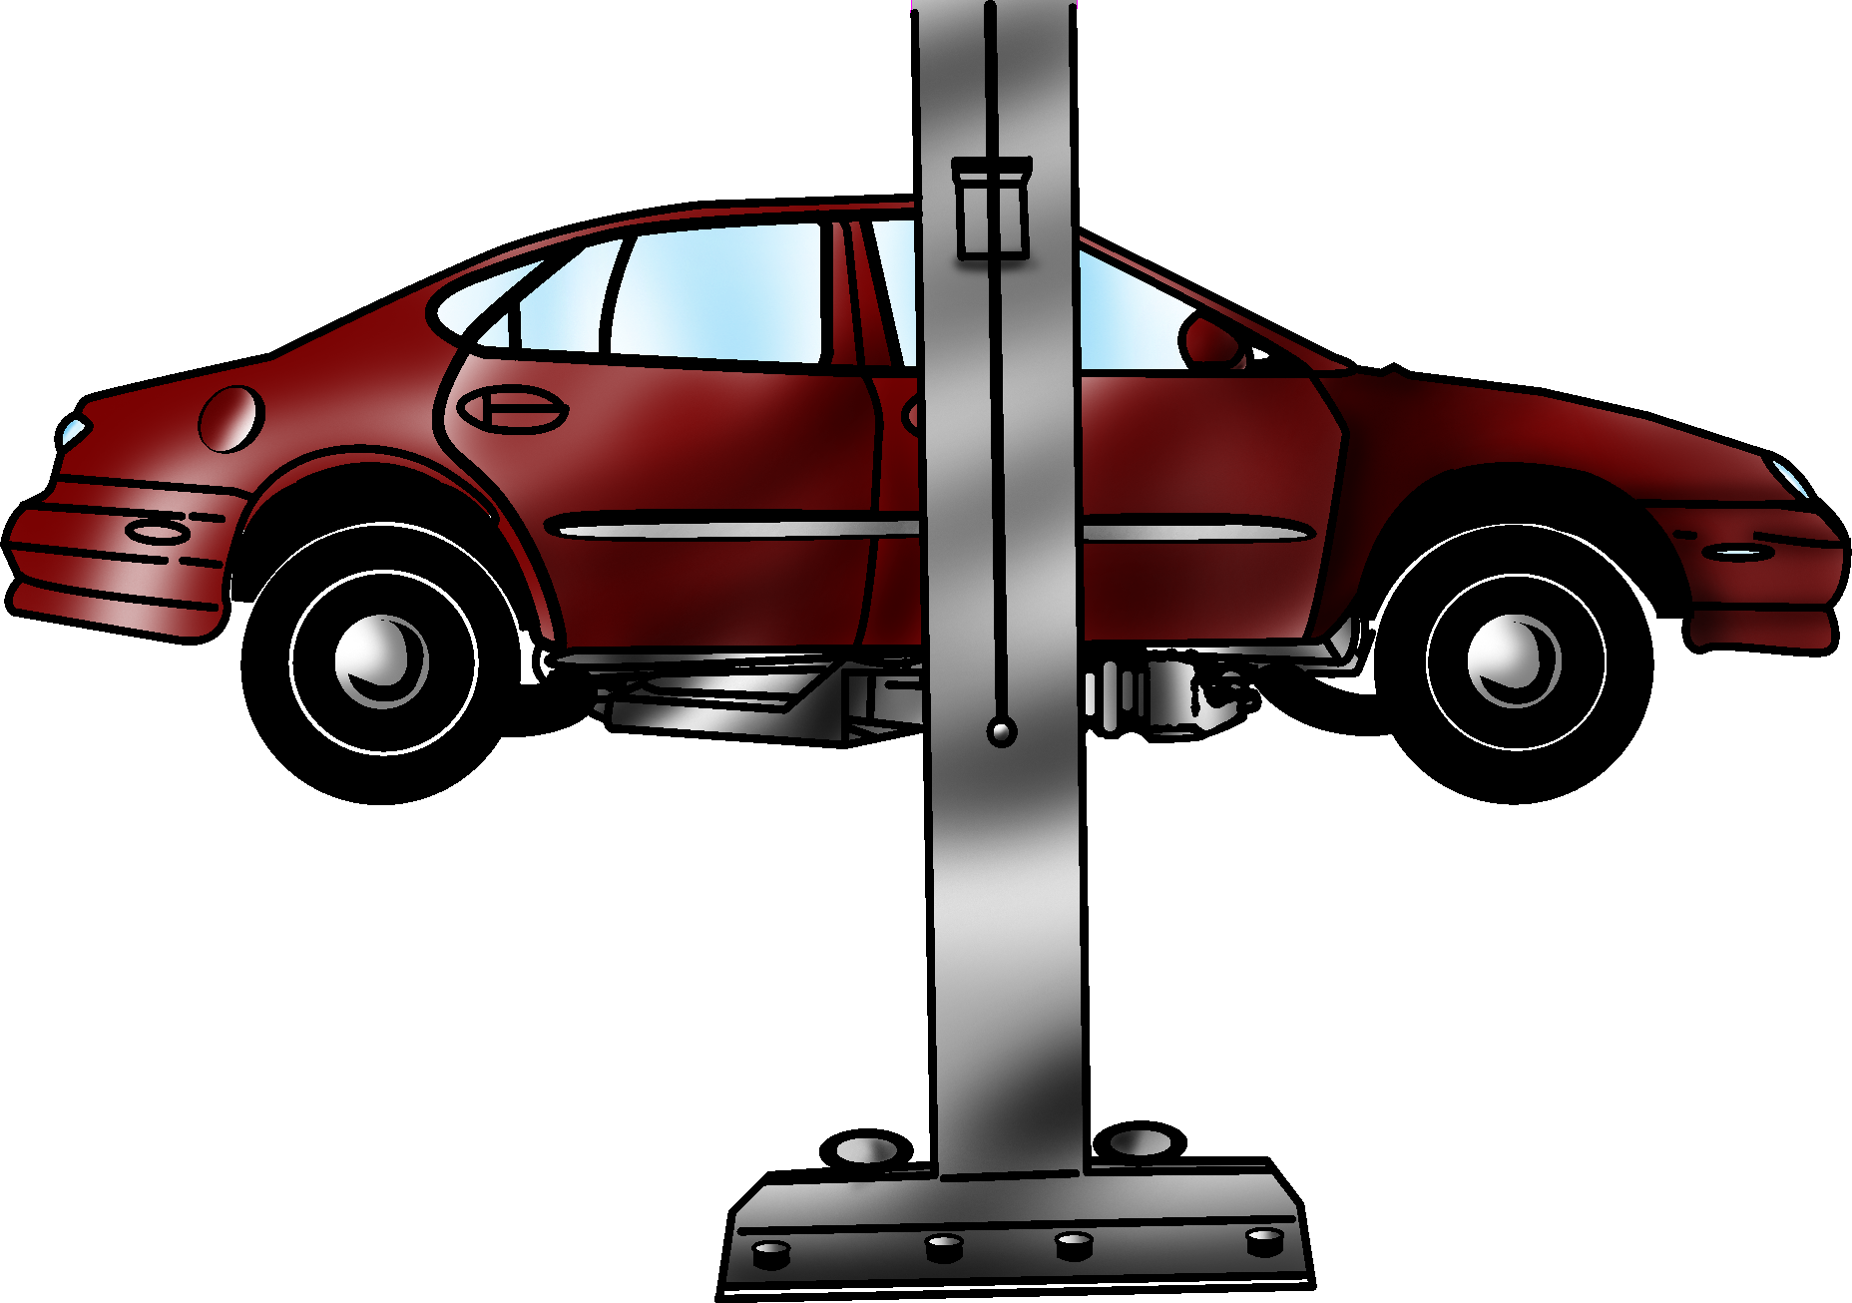
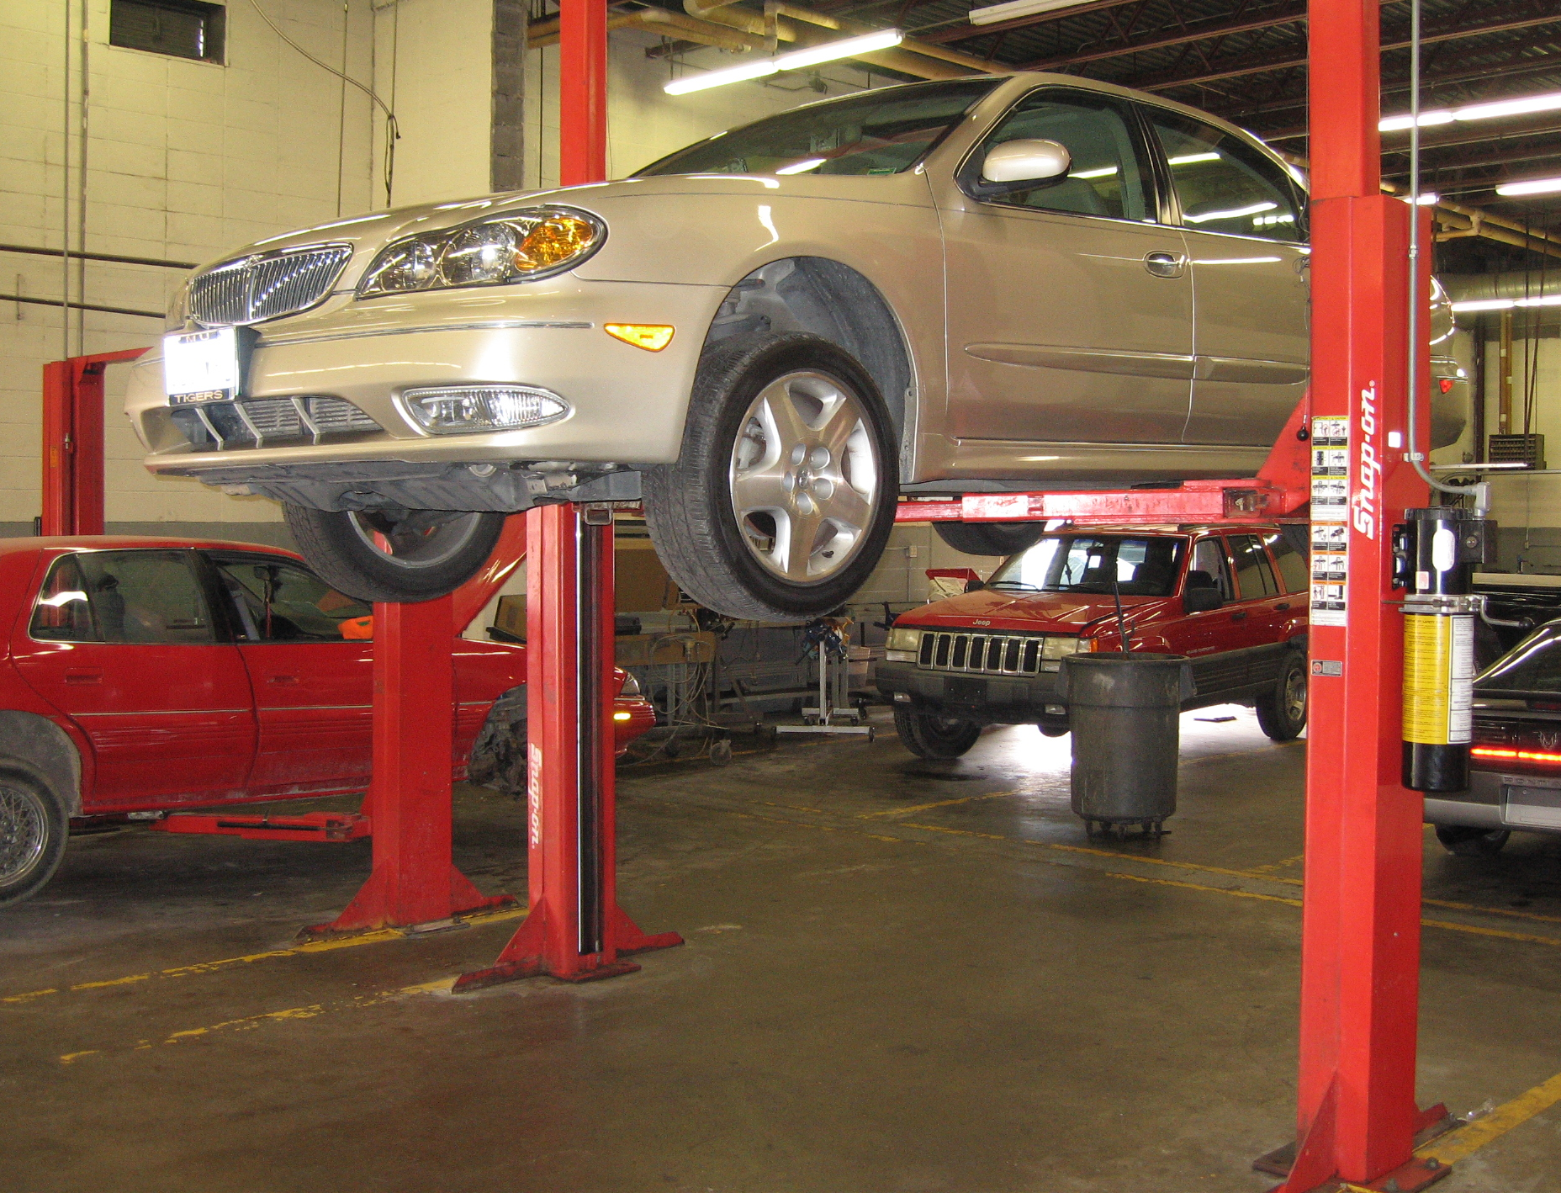
Common lifting devices
Hydraulic lift
Functions hydraulically to raise the whole vehicle off the floor
Allows for inspection under the vehicle
Allows repairs to be done at a more comfortable height for the technician

Slide 4
Common lifting devices
Safety
Refer to service information for positioning the vehicle on the lift and follow all safety precautions for operating the lift.
Before lifting the vehicle, check for proper clearance on all sides of the vehicle in the lift area so that the vehicle does not hit other objects.
Do not lift vehicles with passengers inside or with the doors, hood, or luggage lid open.
Be sure that the lift’s locking mechanism is in the locked position before walking under the lift.
Be familiar with safety lock release mechanisms for safe lowering of vehicles.

Slide 5
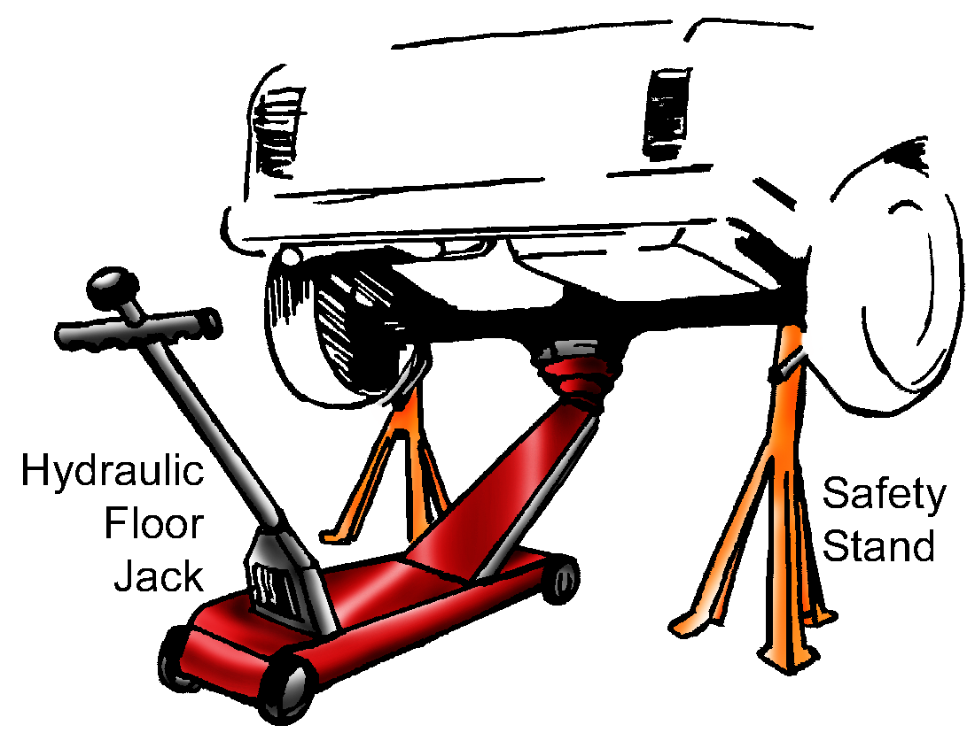
Common lifting devices
Hydraulic floor jack
Uses mechanical force, with the operator using a lever to pump up the jack
Is mounted on four wheels for portability
Used often in raising the front, rear, or side of a vehicle for placement on safety stands

Slide 6
Common lifting devices
Safety
Ensure the vehicle being lifted is on a level, solid surface.
Always be sure the release valve is completely closed before attempting to lift a vehicle.
Refer to service information to find the correct lift point on the vehicle to position the saddle of the jack.
Never crawl under a vehicle held up only by a jack, either hydraulic or pneumatic. Always use safety stands to support the vehicle.
Be sure that the load-capacity rating for the safety stands is sufficient to safely support the vehicle.
After positioning the safety stands under the vehicle, shake the body of the vehicle to make sure it is stable.

Slide 7
Common lifting devices
After raising a vehicle with a floor jack, be sure the handle of the jack is pointed straight up.
Do not operate hydraulic jacks if they are leaking because they may fail.
Do not lift vehicles with passengers inside or with the doors, hood, or luggage lid open.
Make sure everyone in the vicinity is standing well away from a raised vehicle before opening the release valve to lower it. When lowering a vehicle, the release mechanism should be opened a little at a time, and then closed, to lower the vehicle a little at a time.
CAUTION: If the release mechanism is opened all the way, it will drop the vehicle to the floor instantly. This may cause injury to the operator and others in the area as well as damage to vehicle.

Slide 8
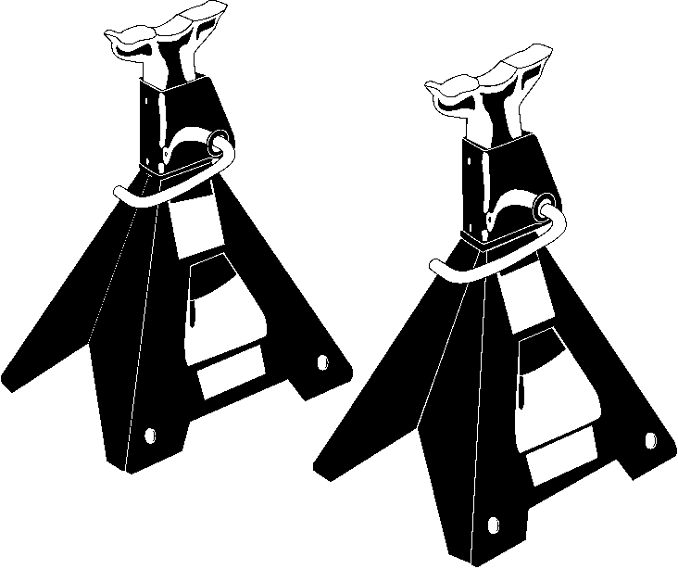
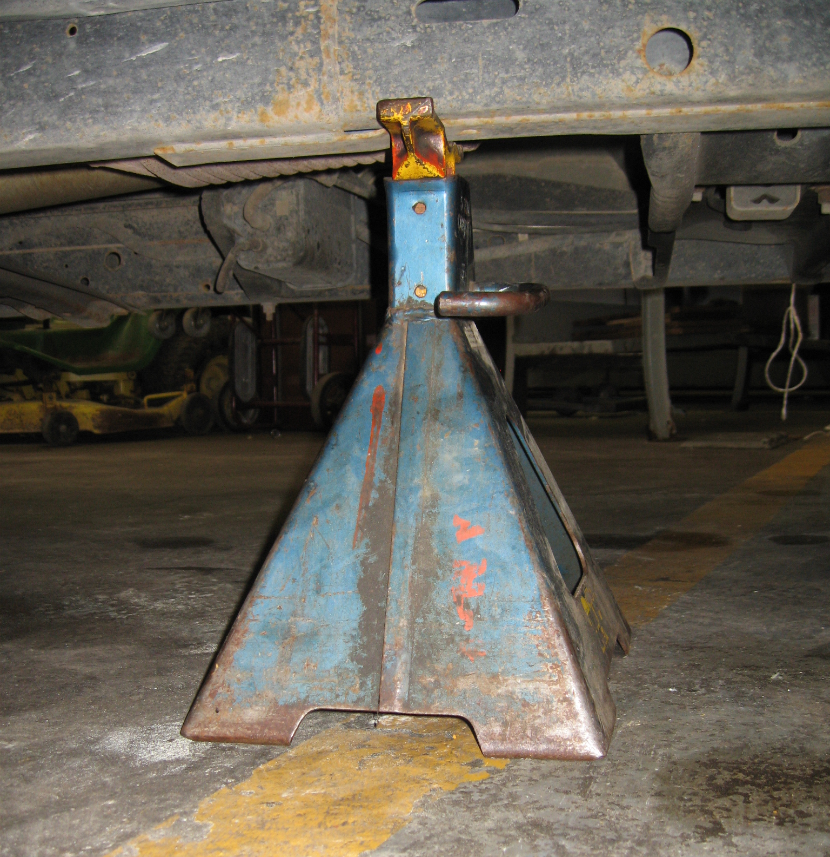
Common support devices
Safety stands
Sturdy metal devices that support the vehicle after being lifted by a jack
Available in different heights and load capacities
Placed under secure points on the vehicle such as the frame and axle housing
NOTE: Refer to service information and the manufacturer’s instructions for the correct points to place safety stands.

Slide 9
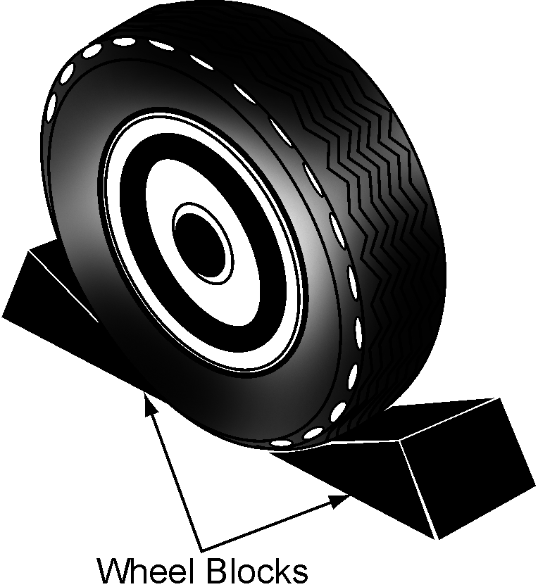
Common support devices
Wheel blocks, also known as wheel chocks
Wedge-shaped blocks used as a safety measure, in addition to safety stands, to keep the vehicle from rolling after being lifted
Used before lifting the vehicle with a jack
Placed in the front and rear of a wheel that will remain on the ground after lifting

Slide 10
Principles of lifting and supporting vehicles
Each vehicle has specific lifting points. Consult current service information or the owner’s manual for each model to determine proper lifting points.
CAUTION: Identification of proper lifting points is extremely important. Damage caused by improper lifting can be severe. Common sense, along with an understanding of vehicle construction and vehicle supporting techniques, must be used in each repair instance.
The purpose of raising the vehicle is to get the vehicle high enough in the air to safely inspect, service, or repair the underside.
Before lifting a vehicle, check both the vehicle and equipment manufacturer’s recommendations.

Slide 11
Principles of lifting and supporting vehicles
In getting the vehicle off the ground, there are two separate points to be considered as follows:
Proper lifting methods
Proper supporting methods
Lift and support points
NOTE: The correct lift and support points depend on the model of the vehicle and the type of lift equipment being used. Refer to service information and the manufacturer’s instructions.

Slide 12
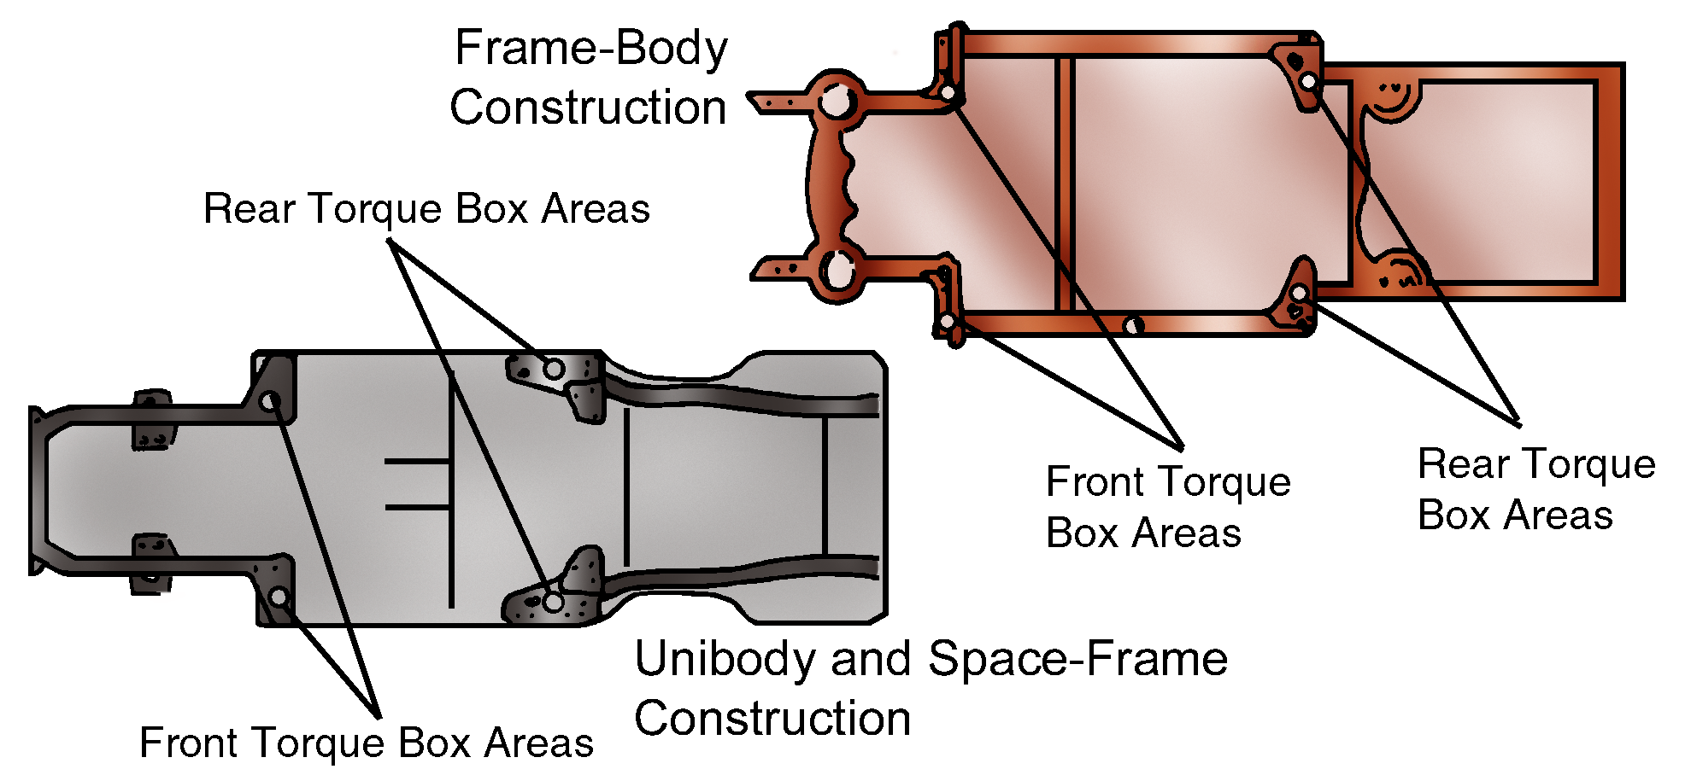
Principles of lifting and supporting vehicles
Torque box areas are generally acceptable lift points.
These areas are designed to absorb twisting (torque) force caused by a collision and route damage away from the passenger compartment.
The four torque box areas are located at the corners of the passenger section.

Slide 13
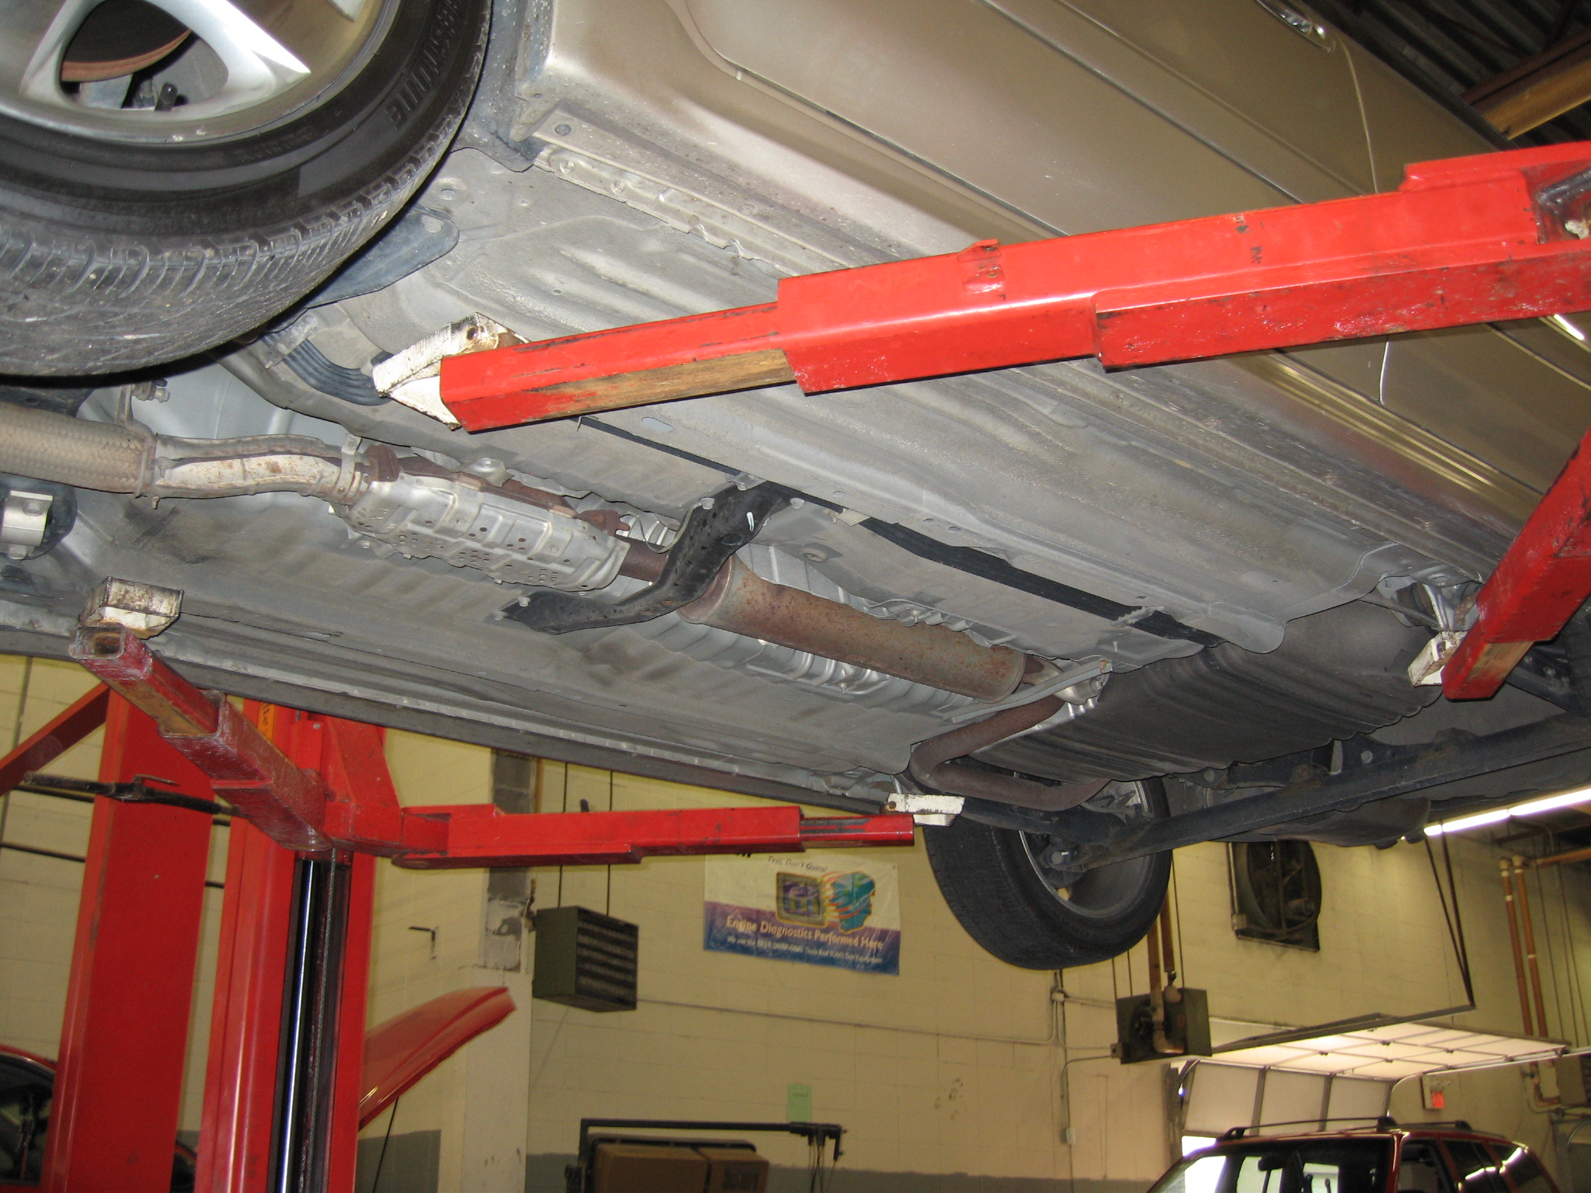
Principles of lifting and supporting vehicles
Even if the vehicle does not have actual torque boxes, the four corners of the passenger compartment are referred to as torque box areas.
• Torque box areas are generally the strongest areas of the vehicle for lifting and supporting.

Slide 14
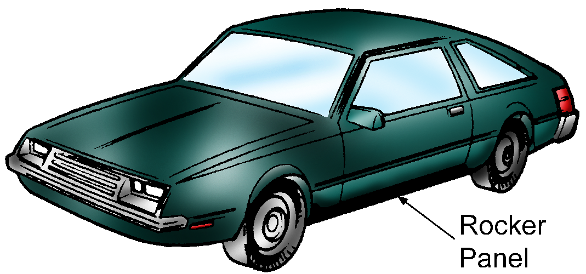
Principles of lifting and supporting vehicles
The pinch-weld area of the rocker panel, which is the factory weld that fuses the bottom flange of the outer rocker panel to the inner rocker panel, is a strong support area on unibody vehicles.

