Slide 1
Unit 5 - Digital Multimeter Amperage Testing
When you complete this unit, you will be able to:
  Explain how to connect a DMM when performing an amperage measurement
  Describe the most common cause of blown fuses and how to prevent it from happening
  Compare and Contrast the various amperage settings on the rotary dial
  Demonstrate how to switch between AC amperage and DC amperage measurements

Slide 2
Digital Multimeter Amperage Testing
NEVER exceed the maximum amperage of the meter terminal (either 500mA or 10 amps)
Always start with the Amps setting first to verify if the milliamps or microamps can be used safely
***REMOVE THE RED TEST LEAD IMMEDIATELY from the meter when done performing any amperage test***
This lowers the chance of accidently checking voltage (parallel connection) when the meter is connected in series for amperage
Blown fuses are most commonly caused by having the test leads in the wrong meter terminals, NOT by the wrong dial setting

Slide 3
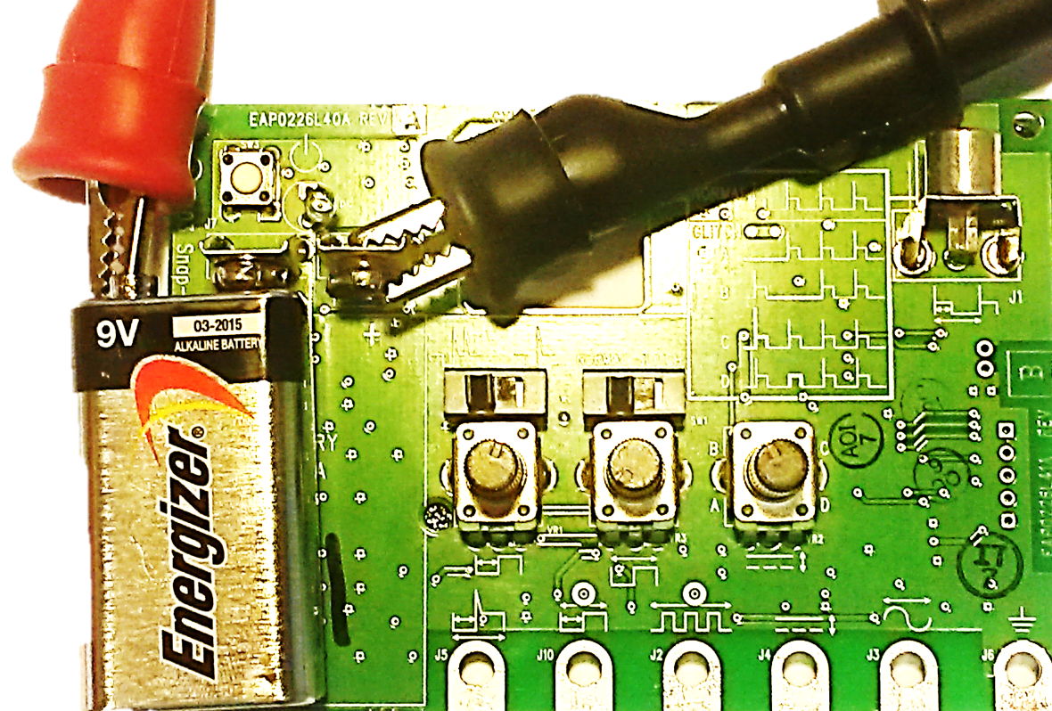
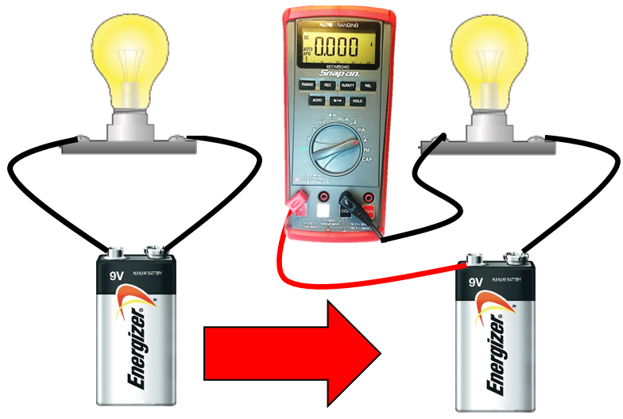
Digital Multimeter Amperage Testing
The meter MUST be connected in SERIES when preforming amperage tests
This requires a break in the circuit which the meter can then be connected into, which recompletes the circuit through the meter

Slide 4

Digital Multimeter Amperage Testing
The meter MUST be connected in SERIES when preforming amperage tests
Do NOT connect it in parallel as you would for a voltage test. THE FUSE WILL BLOW
Series = Amperage Test
Parallel = Voltage Test

Slide 5
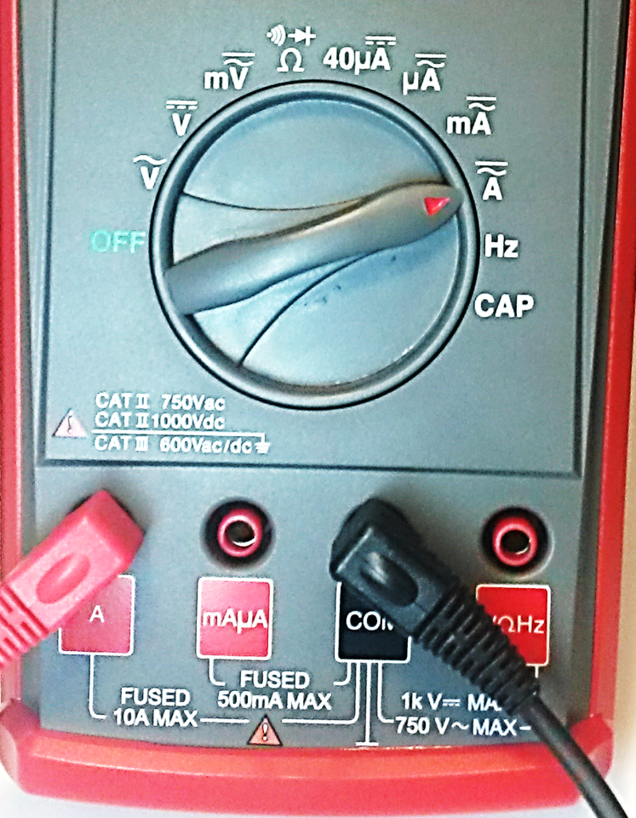
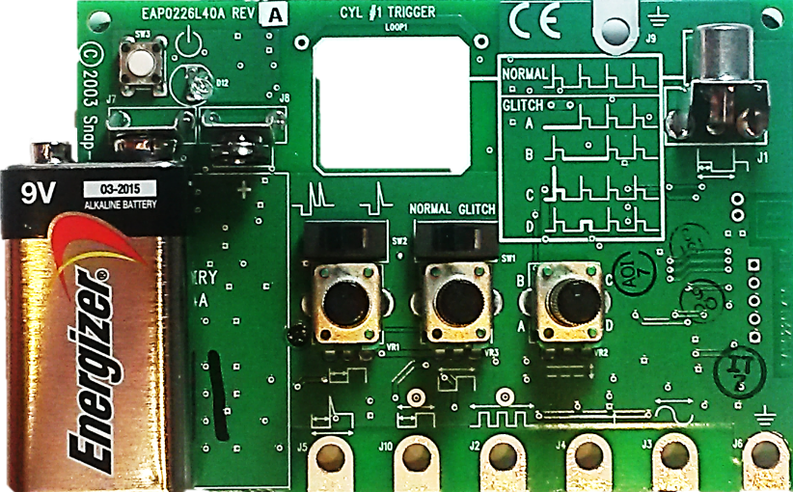
Digital Multimeter Amperage Testing
DC Amperage Testing
  Connect the red test lead to the A terminal
  Connect the black test lead to test lead to the COM terminal
  Move the Rotary Dial to AC/DC Amperage
  Connect ONLY the negative(-) terminal of the battery to the signal board
    - This creates a break in the circuit that the meter can then be connected into
© 2009 Snap-on Incorporated; All Rights Reserved
Notes:
The next slide illustrates the proper signal generator connections and test

Slide 6

Digital Multimeter Amperage Testing
DC Amperage Testing
Connect the red test lead to the positive (+) battery post
Connect the black test lead to the positive (+) battery terminal
The circuit is now complete as the meter is connected in SERIES
Turn the simulator ON (press on/off button)

Slide 7
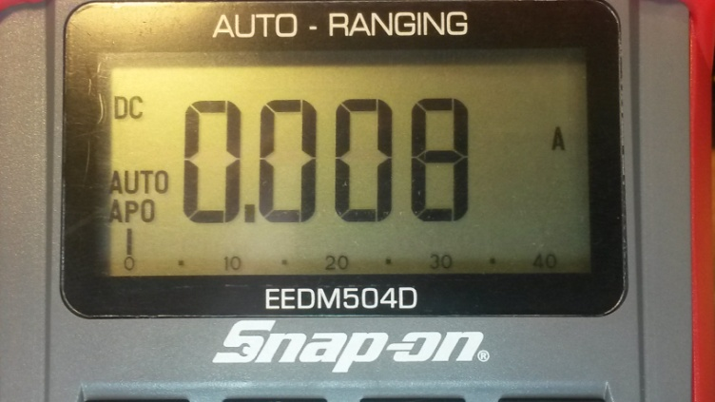
Digital Multimeter Amperage Testing
DC Amperage Testing
Read the value on the display
Would it be safe to use the milliamp setting to get a more accurate measurement without blowing the mA fuse?
How many milliamps is 0.008 Amps (you calculate your displayed value)
= 8mA: Yes, being its less than 500mA it is safe to test

Slide 8

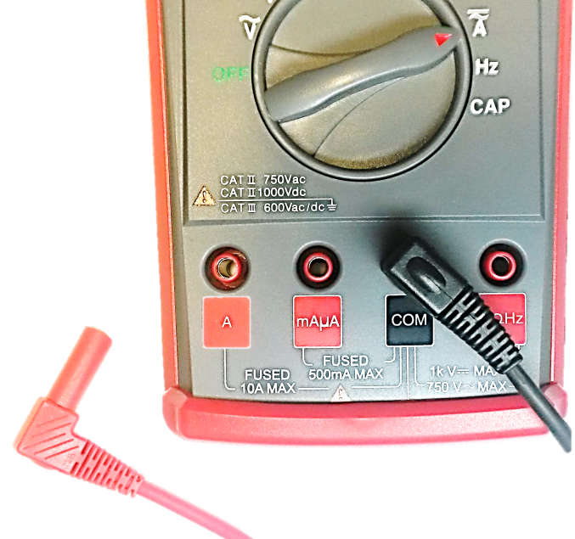
Digital Multimeter Amperage Testing
This completes the DC Amp Test
What is the next step?
REMOVE THE RED TEST LEAD FROM THE METER
Why?
Notes:
Why = ***REMOVE THE RED TEST LEAD IMMEDIATELY from the meter when done performing any amperage test***
This lowers the chance of accidently checking voltage (parallel connection) when the meter is connected in series for amperage
Blown fuses are most commonly caused by having the test leads in the wrong meter terminals, NOT by the wrong dial setting

Slide 9
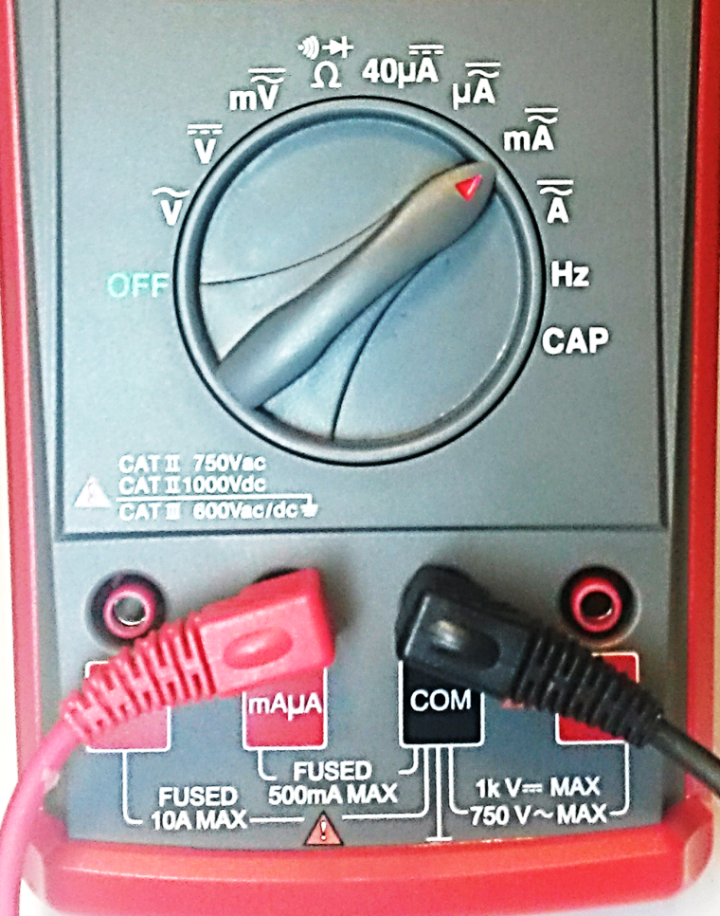
Digital Multimeter Amperage Testing
DC milliamp Testing
  Connect the red test lead to the mAµA terminal
  Connect the black test lead to test lead to the COM terminal
  Move the Rotary Dial to AC/DC milliamps
  Connect ONLY the negative(-) terminal of the battery to the signal board
  - This creates a break in the circuit that the meter can then be connected into
9
Notes:
The next slide illustrates the proper signal generator connections and test

Slide 10
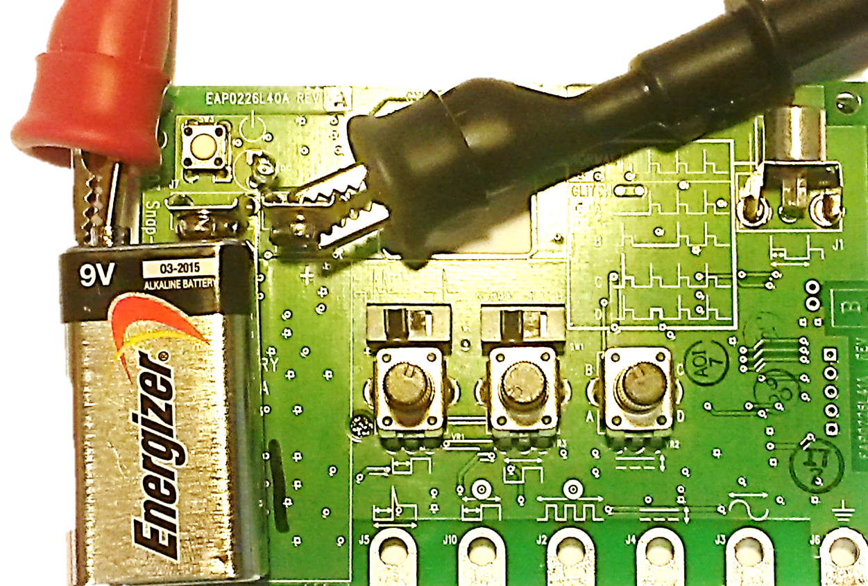
Digital Multimeter Amperage Testing
DC milliamp Testing
Connect the red test lead to the positive (+) battery post
Connect the black test lead to the positive (+) battery terminal
The circuit is now complete as the meter is connected in SERIES
Turn the simulator ON (press on/off button)
Notes:
Only Terminal 7 has Continunity

Slide 11

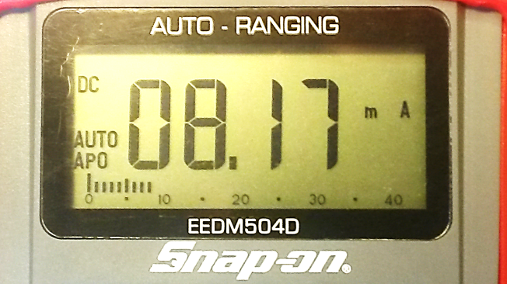

Digital Multimeter Amperage Testing
DC milliamp Testing
Read the value on the display
Note how it is more accurate (more decimal places) than the previous Amps test
What is the next step?
REMOVE THE RED TEST LEAD FROM THE METER
Why?
Notes:
Why = ***REMOVE THE RED TEST LEAD IMMEDIATELY from the meter when done performing any amperage test***
This lowers the chance of accidently checking voltage (parallel connection) when the meter is connected in series for amperage
Blown fuses are most commonly caused by having the test leads in the wrong meter terminals, NOT by the wrong dial setting

Slide 12

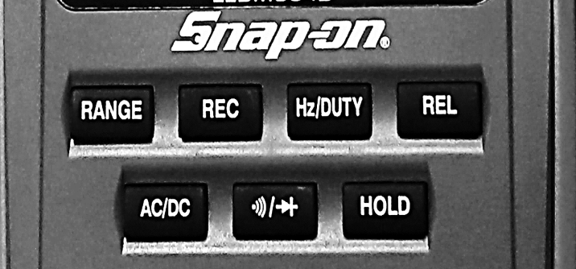
Digital Multimeter Amperage Testing
The signal board has too high of amperage for testing using the DC 40µA and the AC/DC µA settings. The amperage is low enough where the meter fuse will NOT blow, but an OL reading will be displayed
  These microamp (µA) settings are to improve accuracy when measuring very small amounts of amperage
Remember the µA, mA, and A settings have both AC and DC measuring capabilities. The same procedures we have demonstrated apply
  Press the AC/DC button to switch between AC and DC amperage

Slide 13
Review for Understanding
What is the most common cause of a blown meter fuse?
How can you avoid blowing the meter fuse?
Why would you use the milliamp (mA) or microamp (µA) settings?
How do you switch between testing AC amperage and DC amperage?
Notes:
Answers:
MOST COMMON: Forgetting to remove the test leads from the amperage terminals and then performing a VOLTAGE reading. Even with the rotary dial set properly (to voltage) the physical test lead terminal connection will cause the fuse to blow.
REMOVE THE RED TEST LEAD IMMEDIATELY when done performing any amperage test. Also be sure to not test a circuit that is higher than the meter’s maximum amperage.
If measuring a very small amperage these settings will be more accurate than the standard amperage setting.
Press the AC/DC button

