Slide 1
Unit 7 - Digital Multimeter Additional Functions
When you complete this unit, you will be able to:
  Explain the Record (REC) feature and how it is used
  Explain the Relative (REL) feature and how it is used
  Explain the Hold (HOLD) feature and how it is used
  Match the additional functions to the rotary dial settings where they can be utilized

Slide 2
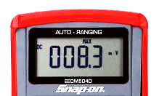
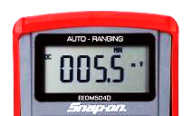
Digital Multimeter – Record Button
Record captures two extreme readings
  MAX - high or maximum reading
  MIN - low or minimum reading
Used for Rapidly Changing signals
  Voltage drop, Intermittent issues, etc
Notes:
Starter draw will exceed the amperage capabilities of the meter however with the proper inductive pickup this test can be performed.

Slide 3
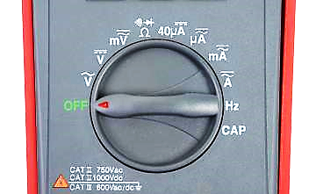
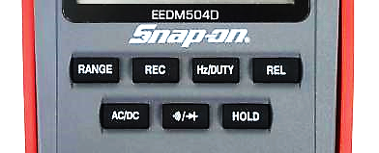
Digital Multimeter – Record Button
Use with the follow Rotary Dial settings
REC
Next we’ll Record AC Voltage as an example, but remember it can be used with any of the electrical measurements circled above
3

Slide 4
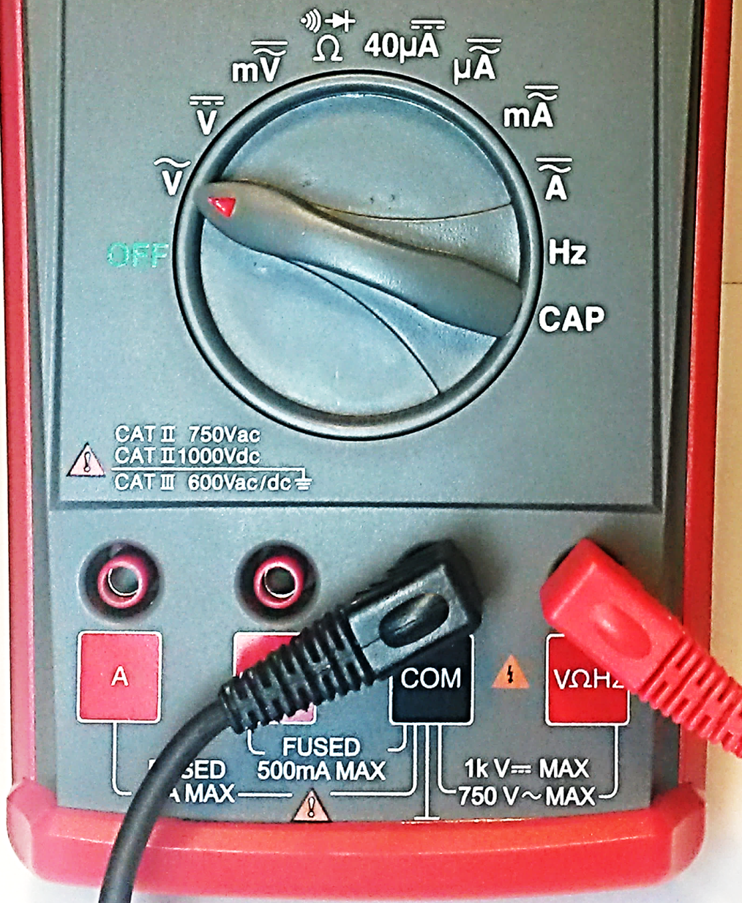
Digital Multimeter – Record Button
Recording AC Voltage
  Connect the red test lead to the VΩHz terminal
  Connect the black test lead to test lead to the COM terminal
  Move the Rotary Dial to AC Volts
4
Notes:
The next slide illustrates the proper signal generator connections and test

Slide 5
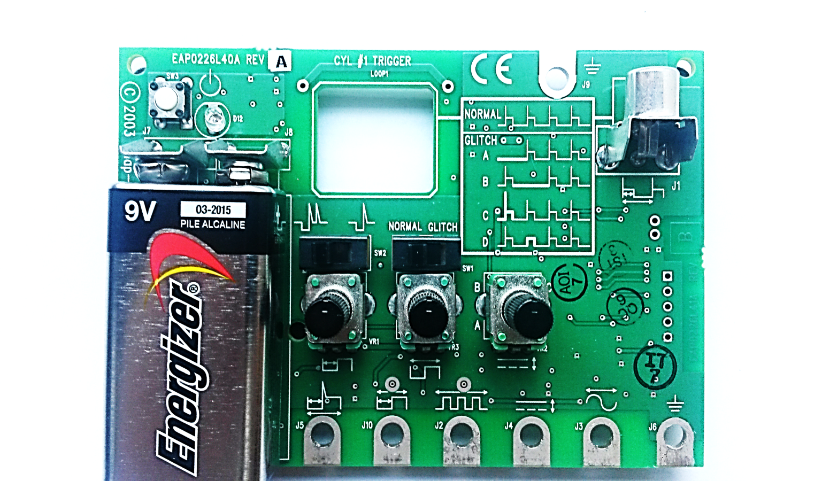
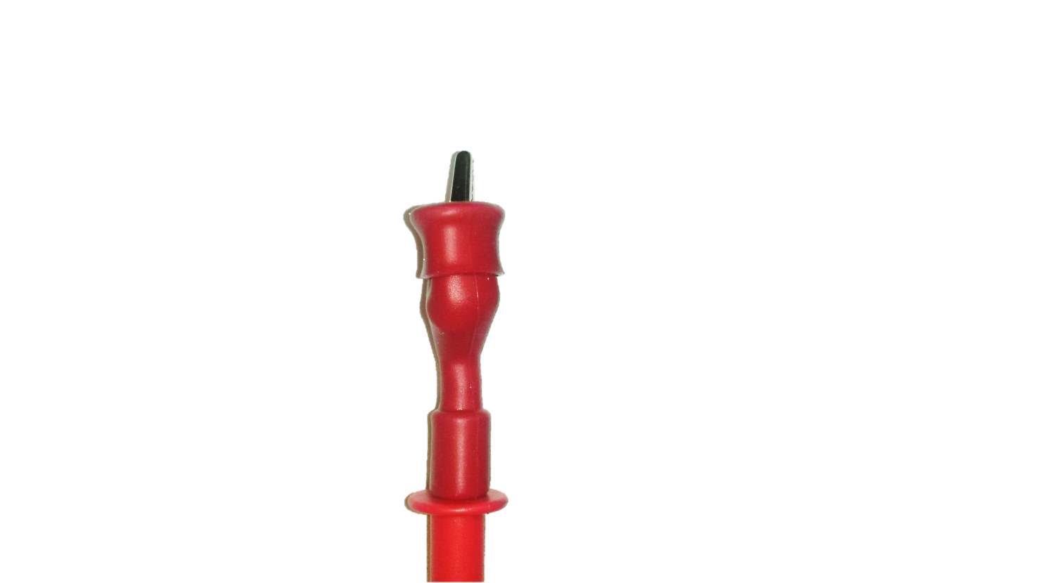

Digital Multimeter – Record Button
Recording AC Voltage
Connect the red test lead to test terminal #5 (AC sine wave)
Connect the black test lead to test terminal #6 (ground)
Turn dial B to the 12 o’clock or straight up position
Turn the simulator ON (press on/off button)
B
#5
#6
5

Slide 6
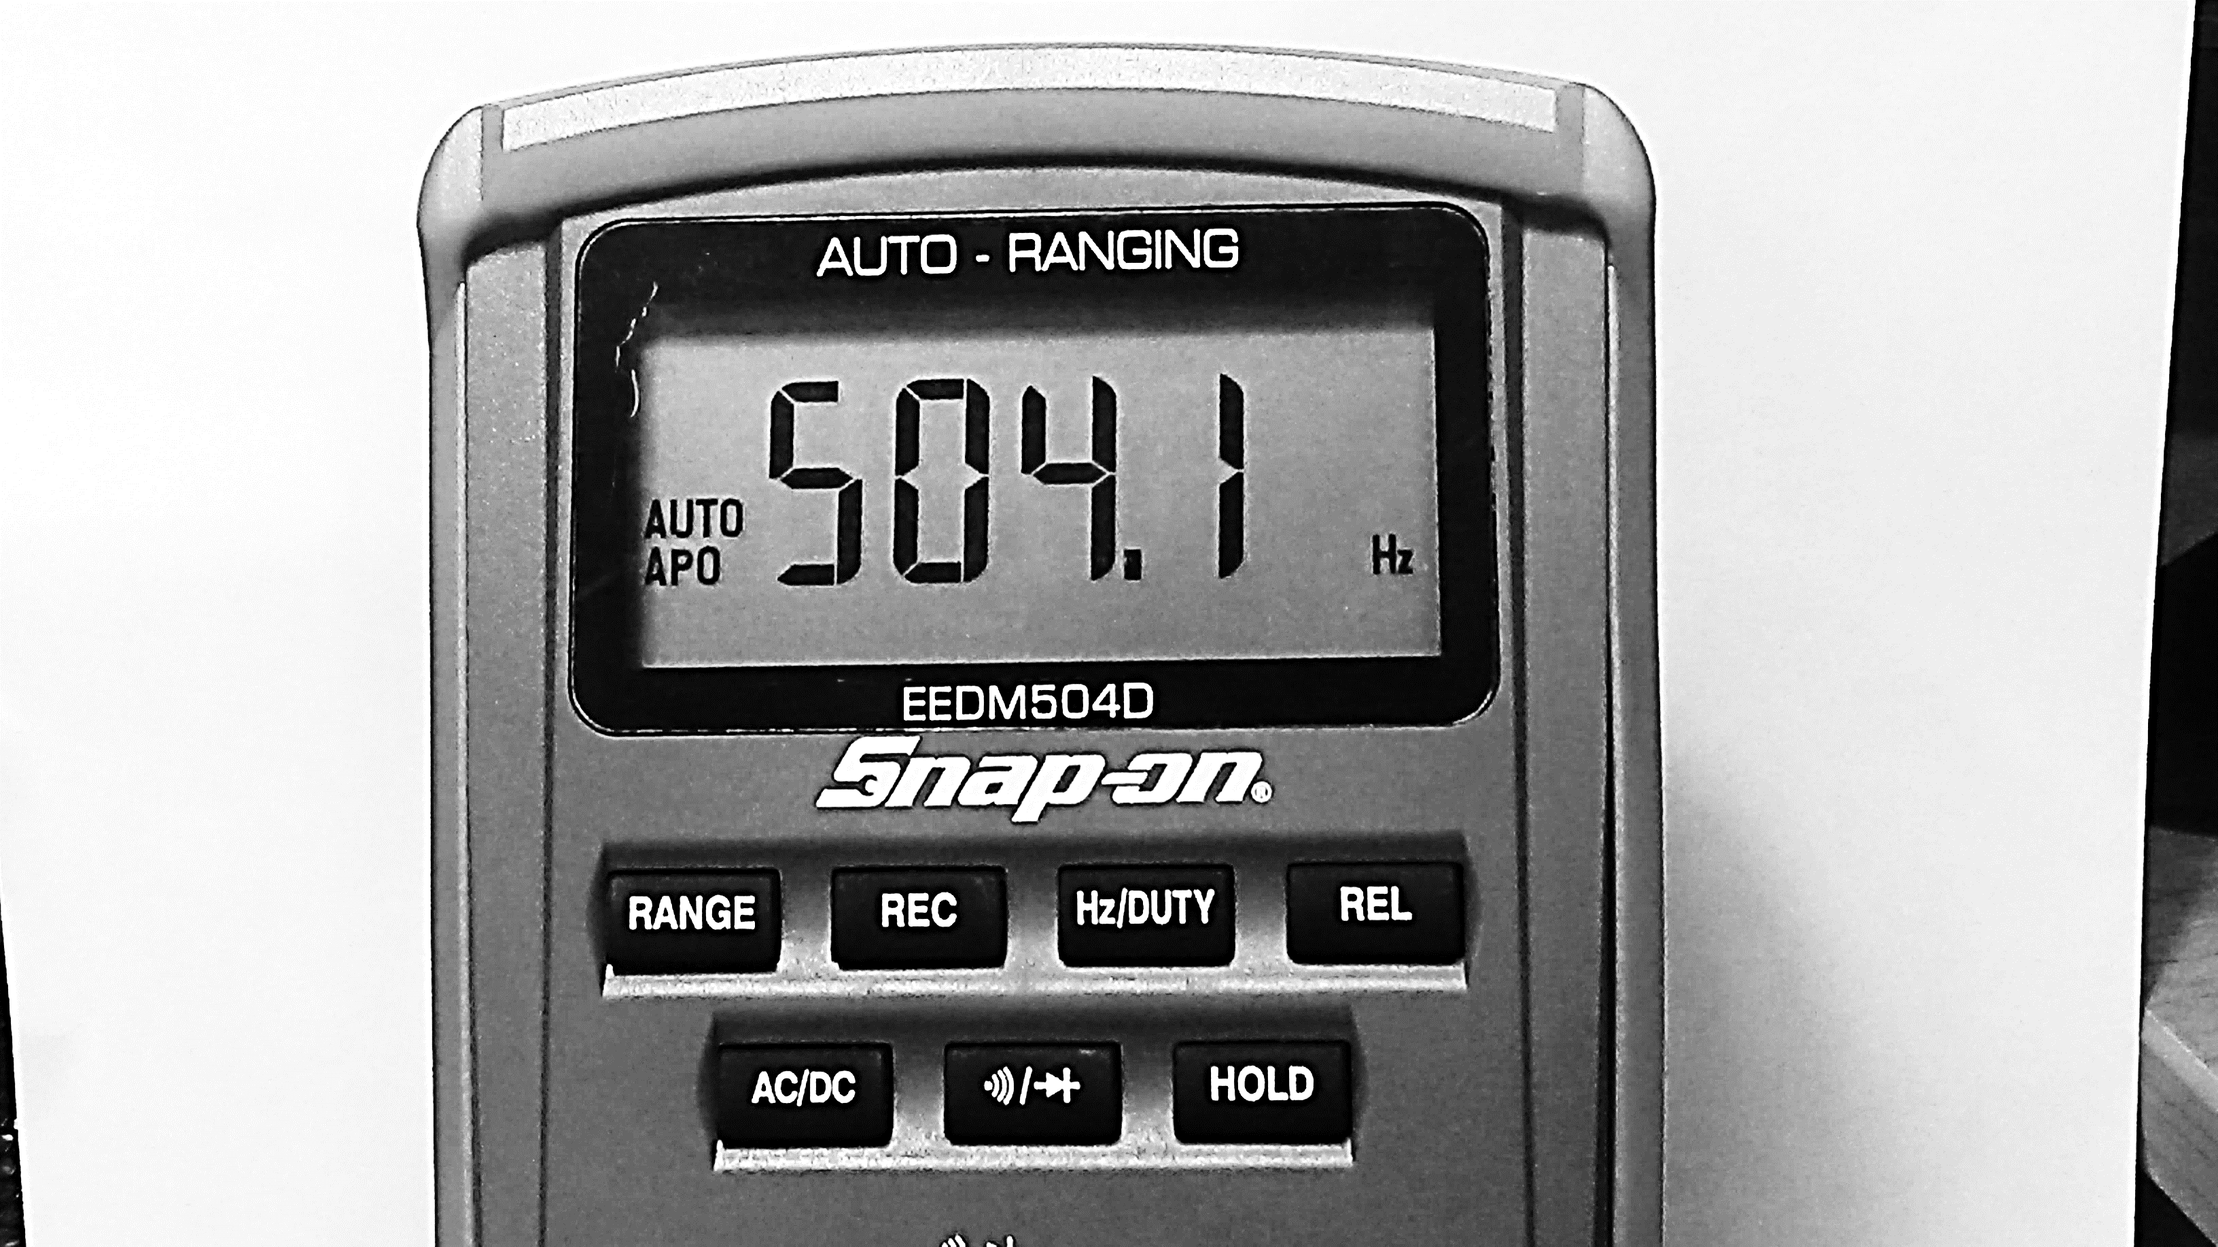
Digital Multimeter – Record Button
Recording AC Voltage
Press the REC button
Quickly rotate dial B to the left and then the right
This will simulate a fast changing signal that might be hard to see and interpret with the human eye
B
#5
#6
6

Slide 7
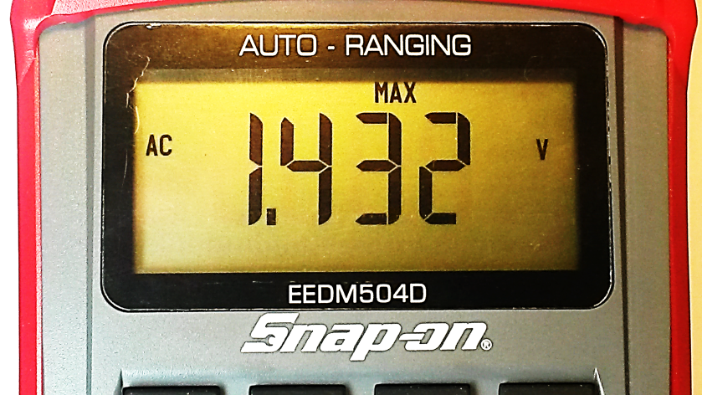
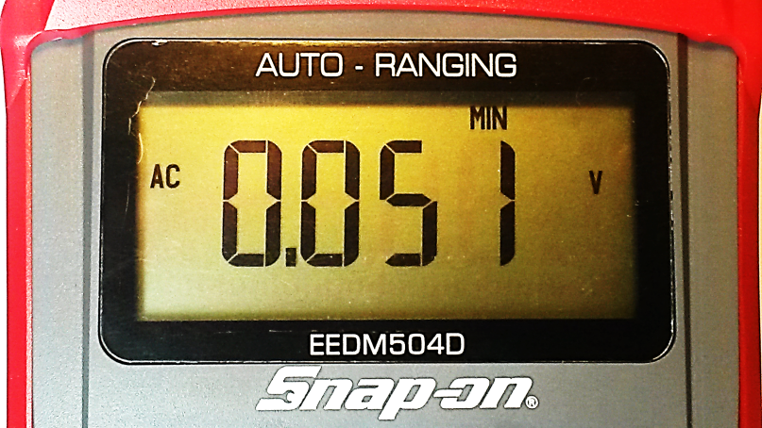
Digital Multimeter – Record Button
Recording AC Voltage
The MAX value is displayed by default and will update when a new MAX value is captured
Press the REC button
The MIN value will now be displayed
Continue to press the REC button to switch between the MIN and MAX values
7

Slide 8
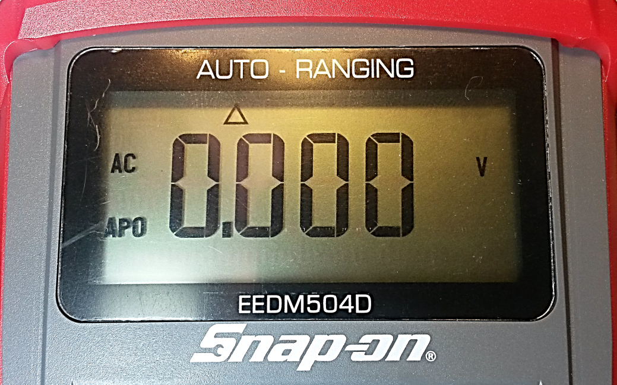
Digital Multimeter – Relative Button
Relative (REL) Function: Factors Out Lead Resistance on Sensitive Readings
Zero’s the display if desired
Can be used to see the change (delta triangle) in an electrical signal as compared to a relative base point
8

Slide 9
Digital Multimeter – Relative Button
Use with the follow Rotary Dial settings
Next we’ll perform a Relative DC voltage test as an example, but remember it can be used with any of the electrical measurements circled above.
9

Slide 10
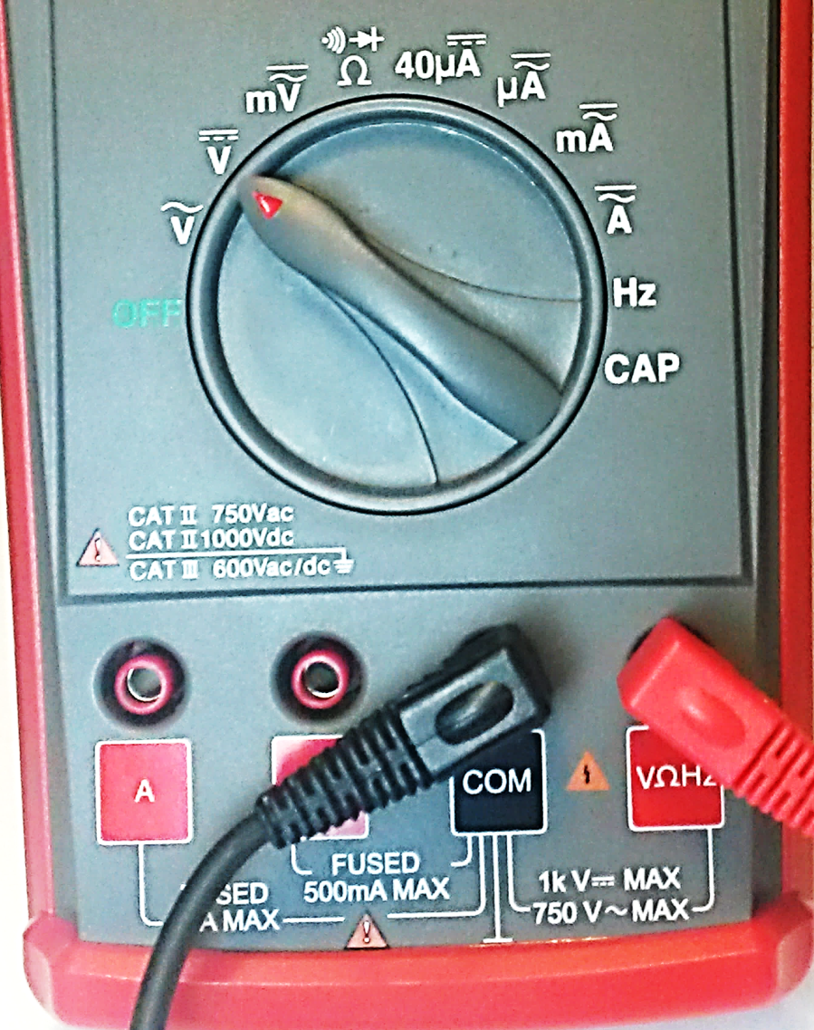
Digital Multimeter – Relative Button
Relative DC Voltage
  Connect the red test lead to the VΩHz terminal
  Connect the black test lead to test lead to the COM terminal
  Move the Rotary Dial to DC Volts
10
Notes:
The next slide illustrates the proper signal generator connections and test

Slide 11
Digital Multimeter – Relative Button
Relative DC Voltage
Connect the red test lead to test terminal #4 (DC voltage)
Connect the black test lead to test terminal #6 (ground)
Set dial C to the 12 o’clock or straight up position
Turn the simulator ON (press on/off button)
C
#4
#6

Slide 12

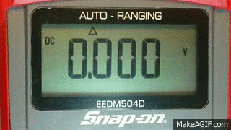
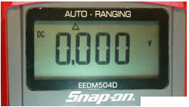
Digital Multimeter – Relative Button
Relative DC Voltage Test
Press the REL button
NOTE: The Display will be zeroed out
Rotate dial C to the left and then the right
The change in voltage will be displayed based on the value that was set to zero using the relative button
C
#4
#6

Slide 13
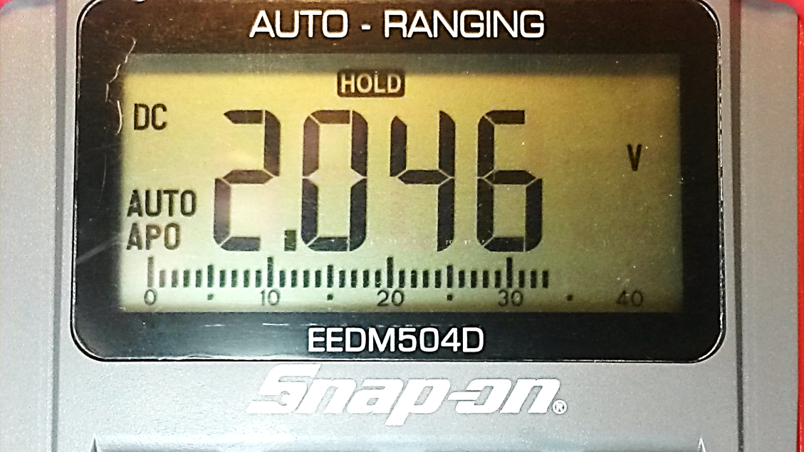
Digital Multimeter – Hold Button
Hold Function: Pressing the Hold button will pause or freeze the screen display to hold the value for easy reference
Pressing the Hold button a second time will return the display to the live reading.
13

Slide 14
Digital Multimeter – Hold Button
Use with the all follow Rotary Dial settings
Next we’ll perform a Hold on a DC voltage test as an example, but remember it can be used with any of the electrical measurements circled above
14

Slide 15
Digital Multimeter – Hold Button
Hold DC Voltage Test
  Connect the red test lead to the VΩHz terminal
  Connect the black test lead to test lead to the COM terminal
  Move the Rotary Dial to DC Volts
15
Notes:
The next slide illustrates the proper signal generator connections and test

Slide 16
Digital Multimeter – Hold Button
Hold DC Voltage Test
Connect the red test lead to test terminal #3
Connect the black test lead to test terminal #6 (ground)
Set ALL dials (A, B, & C) to the full left or counter clockwise position
Turn the simulator ON (press on/off button)
A
B
C
#6
#3

Slide 17
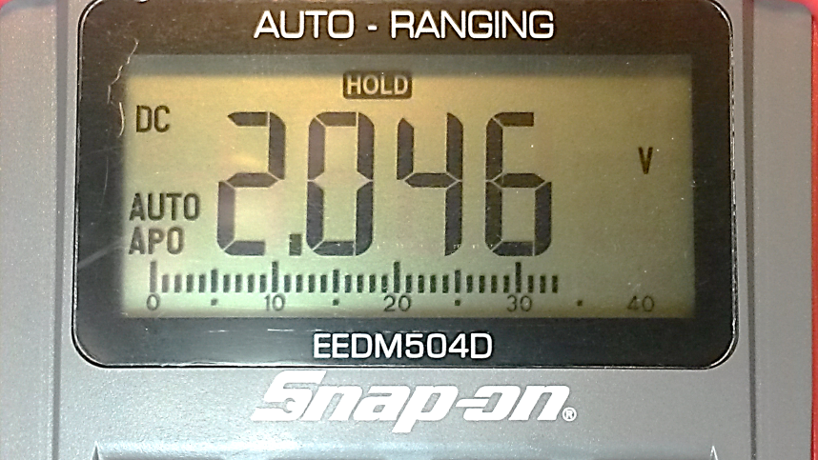
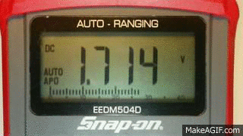
Digital Multimeter – Hold Button
Hold DC Voltage Test
The signal will be erratic.
Press the HOLD button
Note how the display is paused or frozen for easy reference.
Press the HOLD button again to return to the live reading
A
B
C
#4
#6

Slide 18
Review for Understanding
What two values does the Record feature capture?
What purpose does the Relative feature perform?
What happens to the value being displayed when the Hold button is pressed?
List 4 rotary dial functions that can utilize the REC, REL, and Hold features
Notes:
Answers:
Minimum and Maximum values
It will zero out the initial measurement value and can be used to see the change in an electrical signal as compared to a relative base point.
The displayed value will be frozen or paused for easy reference.
AC Volts, DC Volts, AC/DC millivolts, Ohms, DC 40 micoramps, AC/DC micoamps, AC/DC milliamps, and AC/DC Amps
NOTE: REL is NOT used with HZ and REC is NOT used with Hz or CAP.

